Slide 1
Smart Cities and Data-Driven
Energy Policy
Jennifer Clark, Director, Center for Urban Innovation; Associate Professor, School of Public Policy
Emma French, Research Scientist, Center for Urban Innovation
January 26, 2018

Slide 2
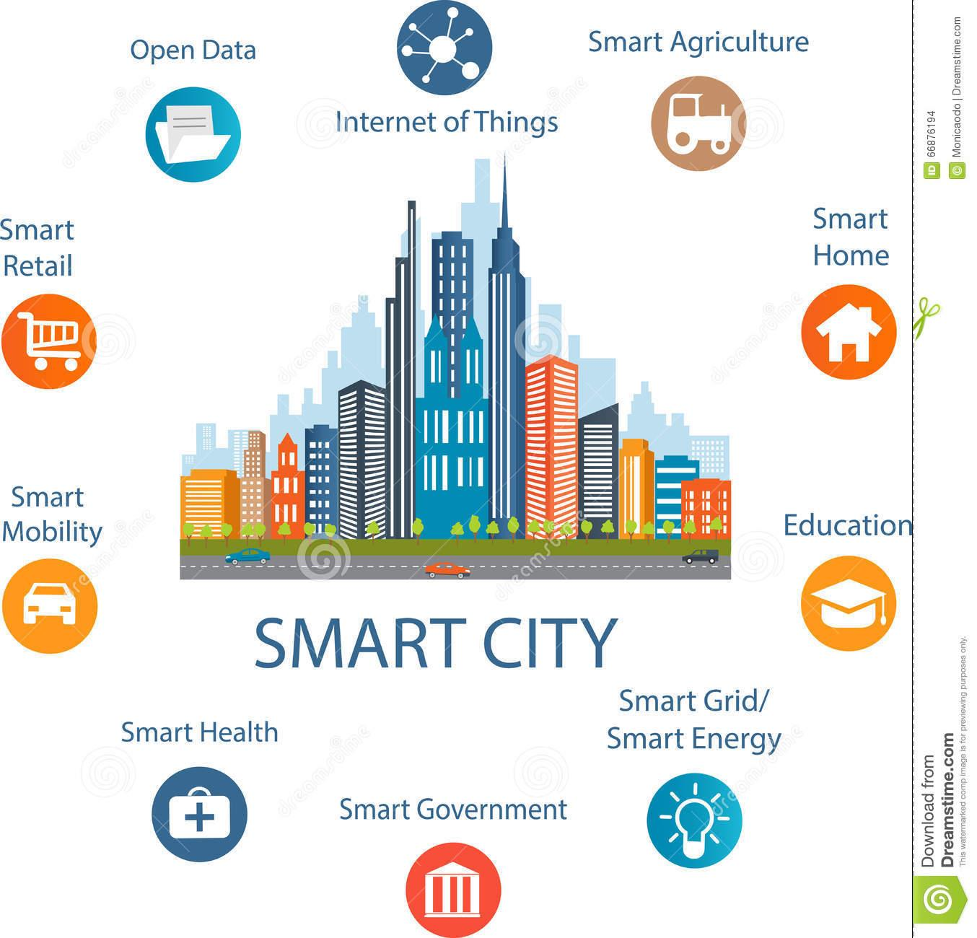
What is a smart city?

Slide 3
The role of data in smart cities and energy policy
Open Data
Increased accountability and transparency through open data
Smart Energy
Smart Governance
Increased efficiency through smarter policies
Smart city governance with data-driven, participatory policy making

Slide 4
Benchmarking
Measuring and comparing performance of similar objects in order to encourage better performance.

Slide 5
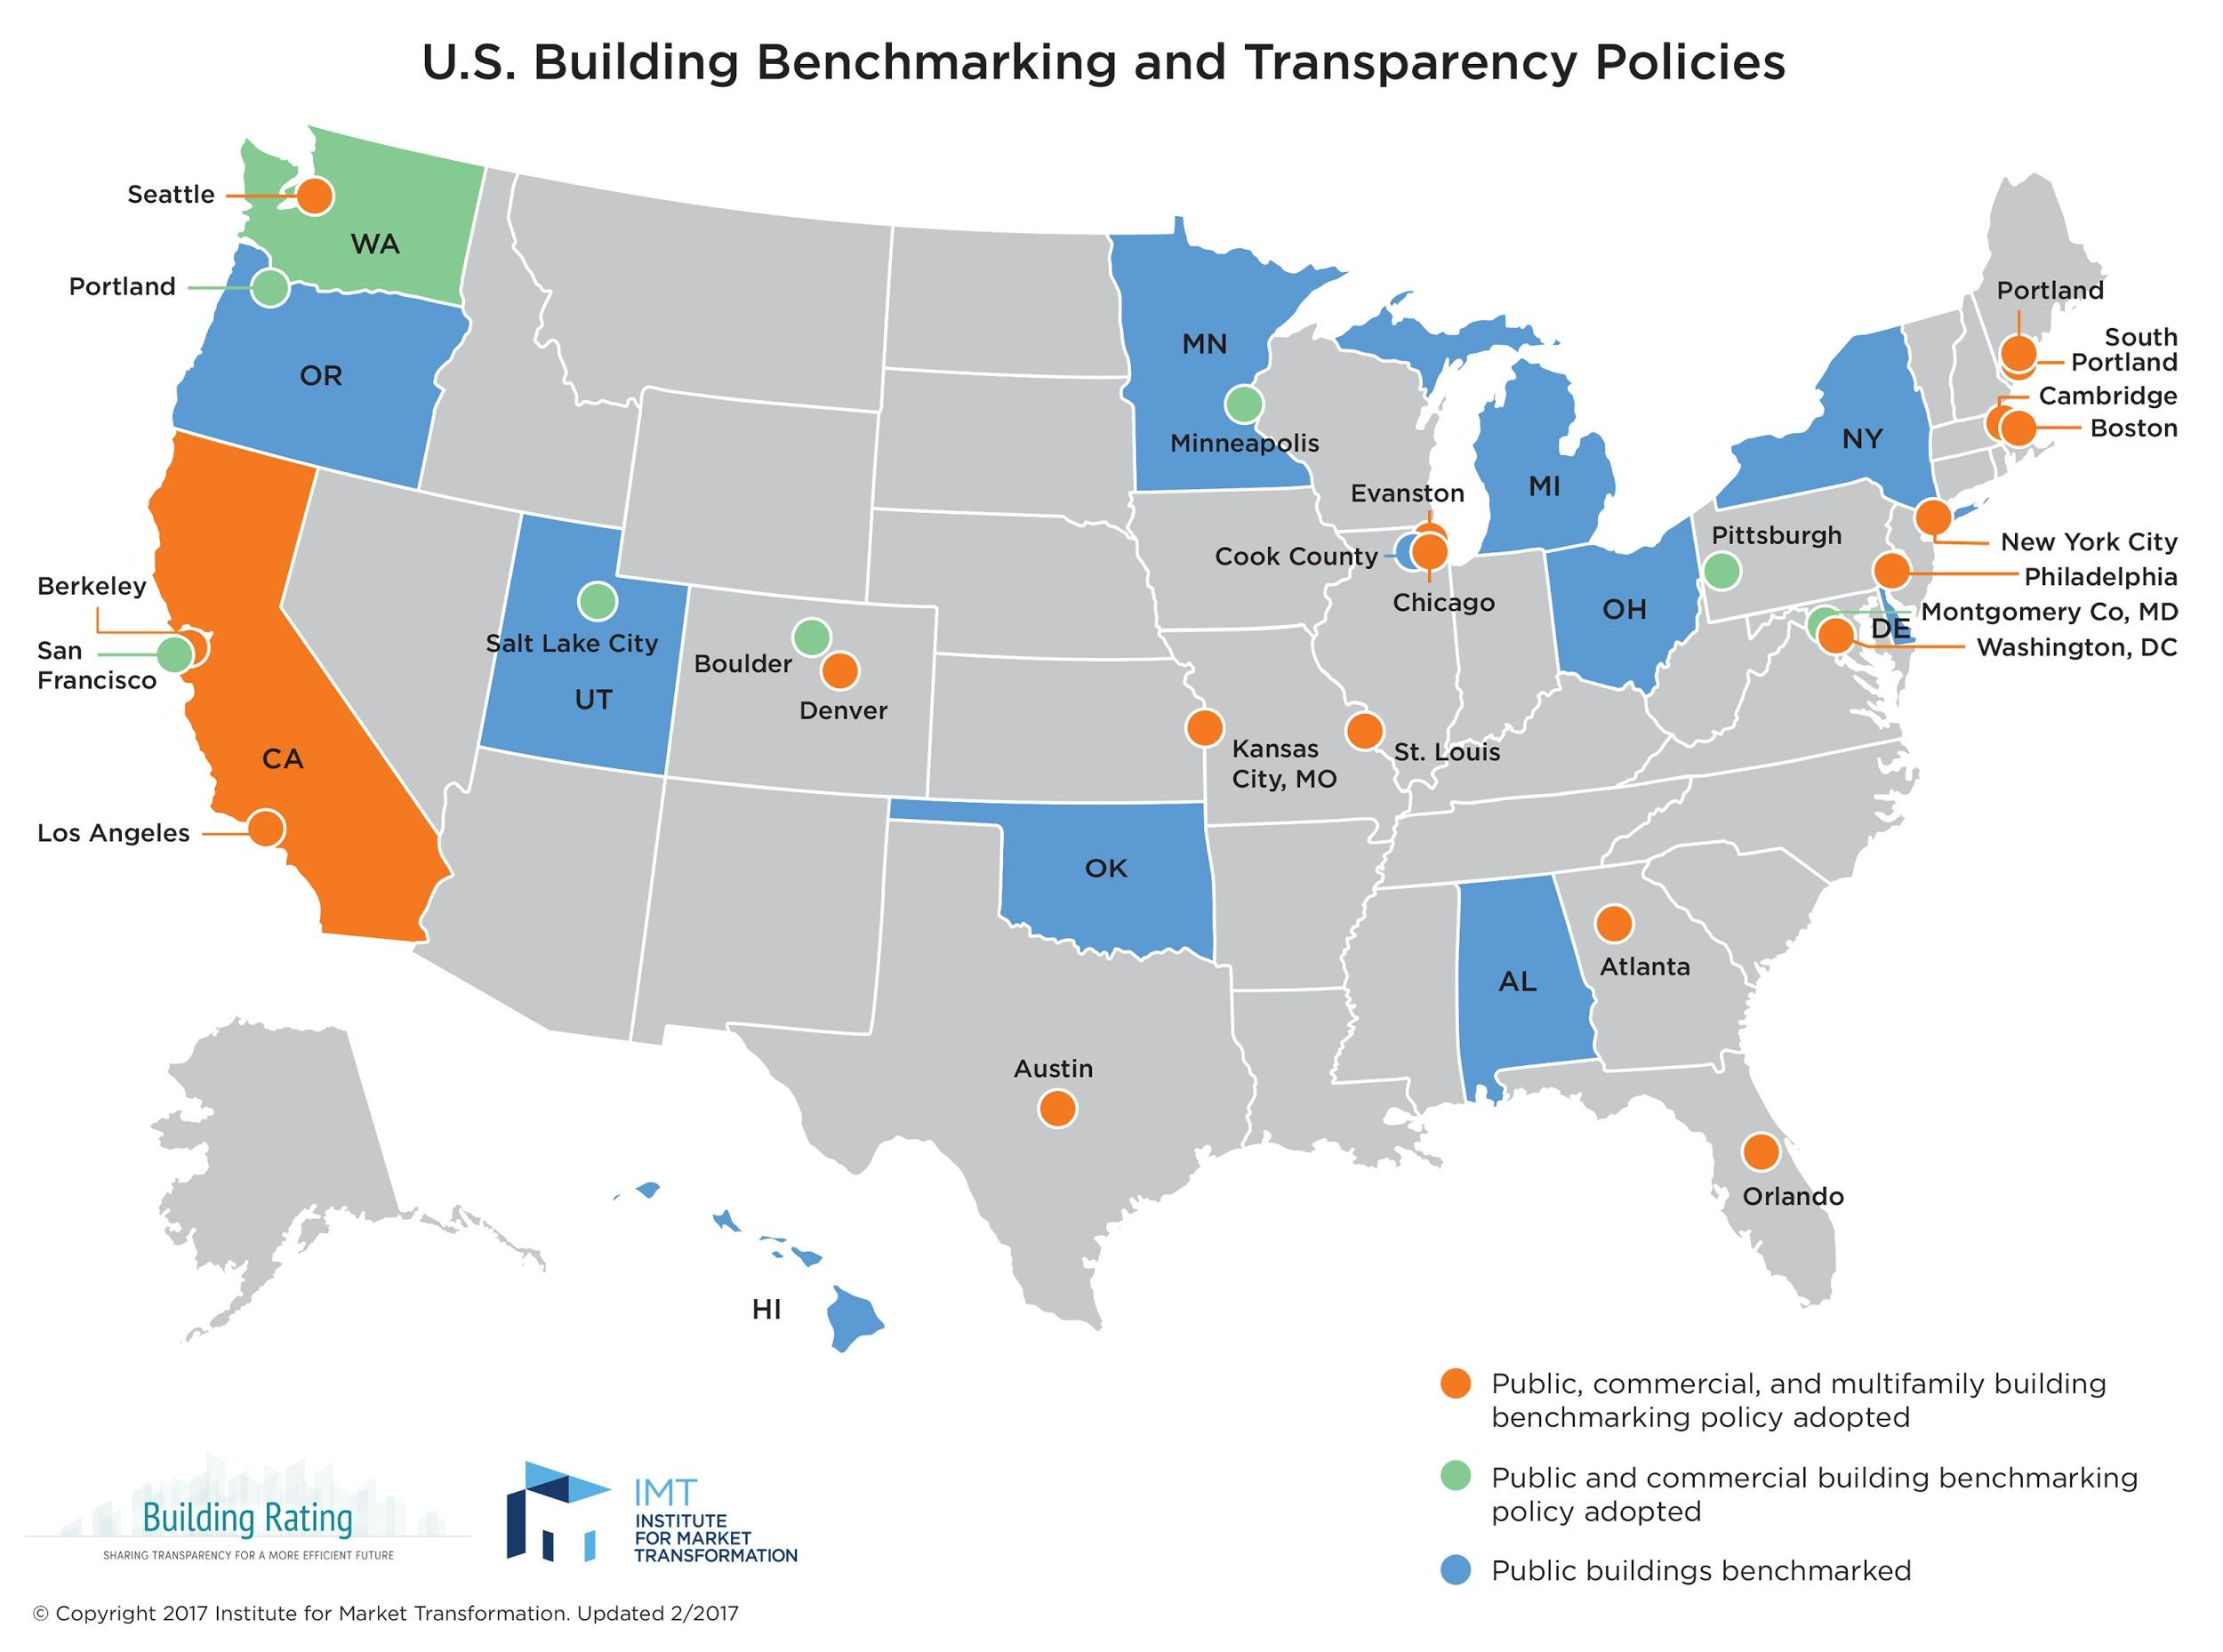
Open Data
Increased accountability and transparency through open data
Smart Energy
Smart Governance
Increased efficiency through smarter policies
Smart city governance with data-driven, participatory policy making

Slide 6
On average, buildings that benchmark their energy usage reduce their energy consumption by 2.4% each year.
U.S. Dept of Energy

Slide 7
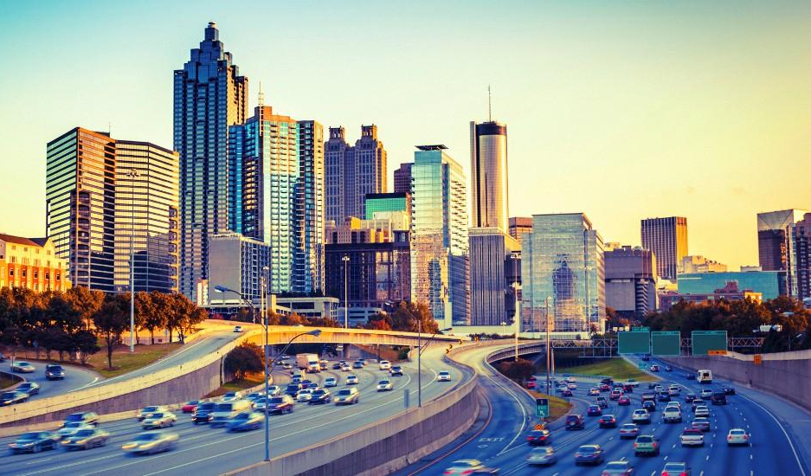
Smart Cities and Data-Driven Energy Policy

Slide 8
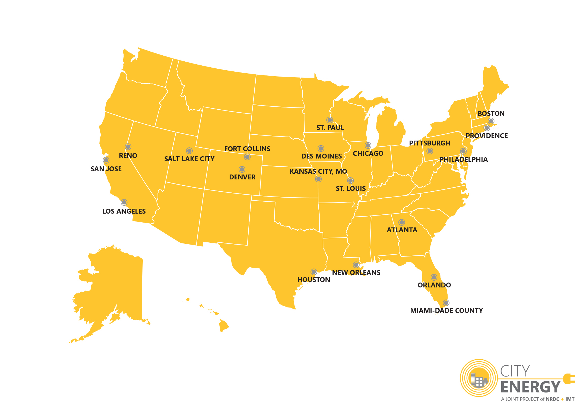
City Energy Project
Positioning Georgia Tech as a leader in research design, implementation and evaluation in the smart cities ecosystem
20 U.S. cities
Phase 1 - 2014
Phase 2 - 2016
NRDC + IMT
Bloomberg Philanthropies
Doris Duke Charitable Foundation
The Kresge Foundation

Slide 9
Evolution of energy efficiency initiatives in Atlanta
Atlanta Commercial Building Energy Efficiency Ordinance
Climate Action Plan
Atlanta joins the U.S. Mayors Climate Protection Agreement
Office of Sustainability (now Resiliency)
Atlanta Better Building Challenge
Selected for City Energy Project
Selected for Rockefeller Resilient Cities
Atlanta Resilience Strategy
2006
2008
2011
2014
2015
2016
2017

Slide 10
Methodology
Mapping evolution of relevant policies and programs over time
Content analysis of policy and planning documents
Audit of available energy data
Structured interviews with stakeholders (policymakers, energy experts, city planners, network staff, etc.)
Workshop with key stakeholders for knowledge sharing and data gathering

Slide 11
Questions?

