Slide 1
Smart Grid Subcommittee Report
Marilyn Brown
Subcommittee Vice-Chair
U.S. Department of Electricity
Electricity Advisory Committee
February 20, 2018

Slide 2
Subcommittee Overview
Statutory basis: The Energy Independence & Security Act of 2007 §1303 advised DOE to establish a smart grid advisory committee covering:
“the development of smart grid technologies, the progress of a national transition to the use of smart-grid technologies and services, the evolution of widely-accepted technical and practical standards and protocols to allow interoperability and inter-communication among smart-grid capable devices, and the optimum means of using Federal incentive authority to encourage such progress.”
Notes:
Past activities: The Value of DER
Smart Grid Technology needs

Slide 3
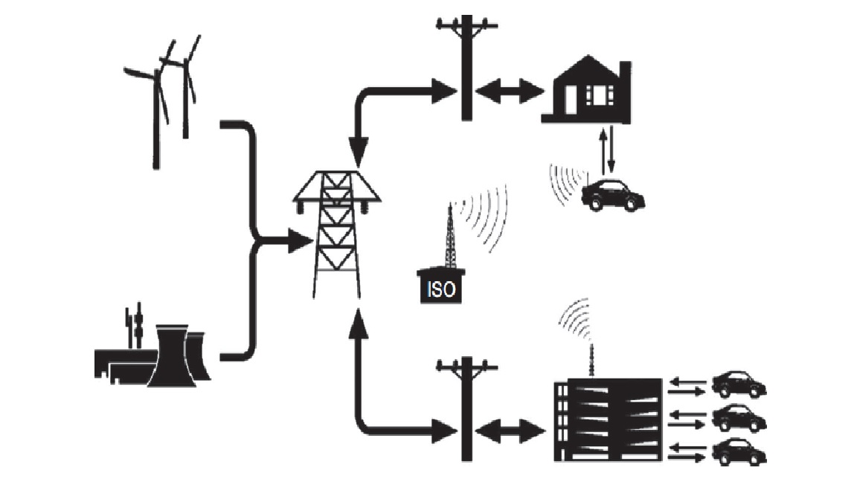
Four Work Product Proposals in Oct. 2017 were Consolidated into Two
Integration of Electric Vehicles into the Smart Grid + Business Models for Non-Utility Participants
Resiliency and Reliability + Infrastructure Investment in the Grid

Slide 4
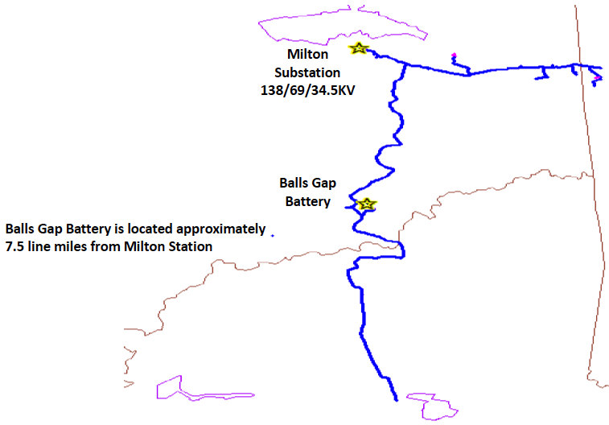
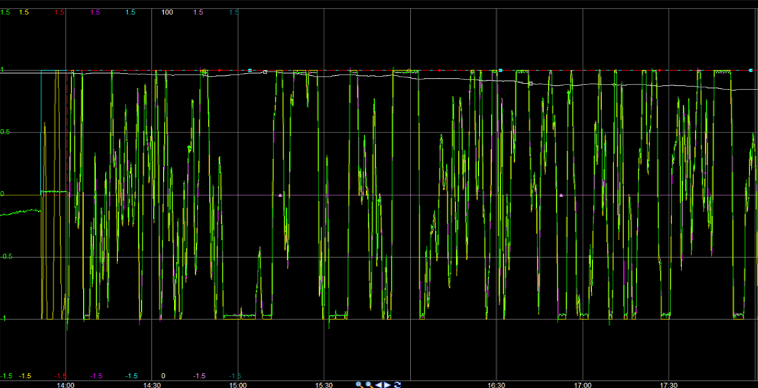
Subcommittee Work
Presentation by Tom Weaver (AEP) on “Applying DER for Resiliency on Distribution Circuits” on 11/16/17
The Balls Gap project: 2 MW NAS Battery
Constructed in 2008 and placed in service in January, 2009
Peak Shaving – Reduced load on the Milton 2, 138-34.5 KV transformer
Islanding – Ability to separate from the Milton and serve up to 800 customers for 6 hours
Battery output in PJM market
1 MW
0
-1 MW
14:30 15:00 15:30
Notes:
Initially, the station feeding this area was nearing overload. The implementation of the 2 MW NAS battery helped reduce load on the Milton #2 transformer. The battery also has the capability of islanding and serving up to 800 customers for 6 hours.

Slide 5
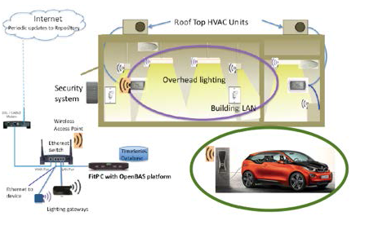
Subcommittee Work
Presentation by Timothy Lipman (UC-Berkeley) on “Open Source Platform for Plug-in EV Smart Charging in California” on 1/18/18
Develop open-source software code to interface with EV chargers for load control
Develop algorithms for congestion relief and voltage regulation through smart charging
Decentralized and Open-Source Architecture Platform

Slide 6
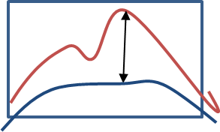
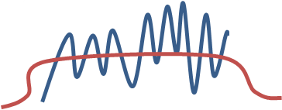
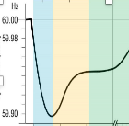
Subcommittee Work: Foundations for White Paper on EV Integration*
Mode of EV Integration Defines Resiliency Impacts & Services
Grid to vehicle
(G2V)
Vehicle to building
(V2B)
Vehicle to grid
(V2G)
Demand Charge Reduction
Capacity firming
Demand Response
Valley Filling
Reserves
Voltage Control
Negative Demand Response
Negative Demand Response
Reserves
Coordinated Charging
Emergency Back-up
Frequency Regulation
*Support for this research was provided by Georgia Tech’s Energy Policy and Innovation Center and Brook Byers Institute for Sustainable Systems: https://cepl.gatech.edu/projects/sgp/GIV.
Notes:
Grid to vehicle (G2V) - Refers to services based on smart and coordinated charging for dynamic balancing; the purpose is to make vehicle charging more efficient and ensure that EVs positively impact the grid.
Vehicle to building (V2B) - Refers to the provision of building electricity management, back-up and emergency services to homes and businesses.
Vehicle to grid (V2G) - Refers to EVs providing the grid with ancillary services, including storage for frequency and balancing of the local distribution system; it requires a bi-directional flow of power between the grid and the vehicle to enable provision of advanced grid services.

Slide 7
Types of Barriers and Challenges to Grid-Integrated Vehicles
Technological Factors
Socioeconomic/
Financial factors
Policy/Regulatory Factors
Degradation of batteries
Transaction costs with EV owners
Tariff or rate design policies
Warranties provided by EV manufacturers
Valuing ancillary services in a vertically integrated market
Surge in demand with DC fast charging
Payments to charging station owners for ancillary services
DC compatibility with bidirectional flows
Open source architecture platform
Unclear conformance with cost-recovery utility financing
Latency following signal inputs from aggregators
Creating resiliency service products in wholesale markets
Range anxiety
Access to charging infrastructure
Certification of charging infrastructure
Notes:
“SAE J3072 and UL 1741 forms the bridge to enable V2G. But vehicle manufacturers should certify for SAE J3072”

Slide 8
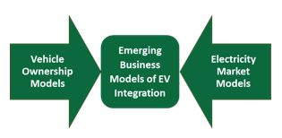
Business Models for Grid-Integrated Vehicles
Asset Ownership
Interaction with Utilities
Mobility Services
Battery Management
Owning vehicles
Owning charging equipment
Leasing the vehicles and charging equipment
Managing and coordinating charging
Contracts with utilities for retail services
Contracts with grid operators
Resiliency services marketed as ancillary products in wholesale markets
Leasing cars to customers
Contracting with fleet owners
Contracting with ride share services
Contracting with car rental services
Providing subscription services for recharging
Battery Swapping
Aggregator Coverage
Manufacturer warranty
Fleet owner warranty

Slide 9
Timeline and Next Steps
1. A Google survey has been drafted and field-tested; finalize it and initiate the survey of EAC members
2. EERE speaker at March subcommittee phone call
3. Analyze survey results and discuss them during April call
4. Complete white paper for review at July 2018 EAC meeting
For more information:
Dr. Marilyn A. Brown
Regents Professor of Sustainable Systems
Georgia Institute of Technology
Email: mbrown9@gatech.edu
Phone: 404-385-0303 (O) 404-275-0482 (C)
http://marilynbrown.gatech.edu/

