Slide 1
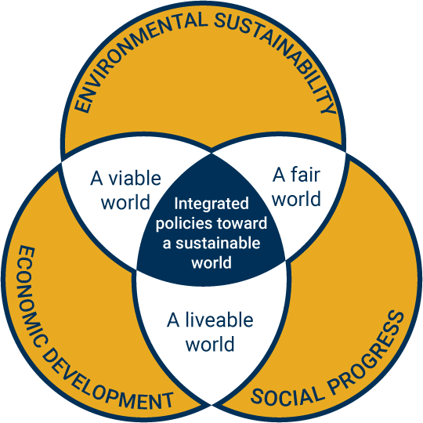
School of Public Policy Sustainable Energy & Environmental Management
Masters (MSEEM) & Certificate (CSEEM) Programs
Dr. Marilyn A. Brown Regents’ Professor mbrown9@gatech.edu | Dr. Daniel Matisoff Associate Professor Matisoff@gatech.edu | Dr. Alice Favero Program Coordinator alice.favero@gatech.edu
For more information: https://cepl.gatech.edu/

Slide 2
MSEEM & CSEEM Programs
School of Public Policy
About The Program:
The Sustainable Energy and Environmental Management master and certificate are a multidisciplinary programs with courses taught in schools across the Georgia Tech campus.
This curriculum is designed to allow students to develop individualized courses of study designed to supplement their current strengths and give them the skills necessary to achieve career goals.
Students completing the MSEEM program will be able to:
1. Assess the context of coupled human and natural systems in energy and environmental problems
2. Identify and describe ethical values associated with energy and environmental problems 3. Manage and design appropriate responses to energy and environmental sustainability problems 4. Apply tools and methods to develop solutions for energy and environmental problems

Slide 3
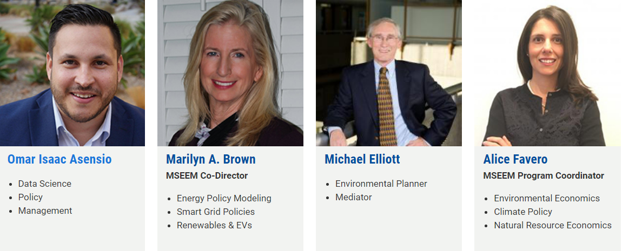
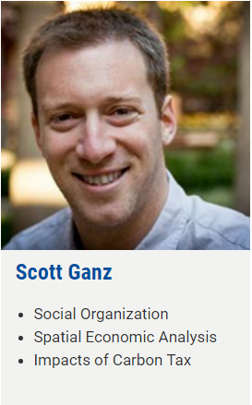
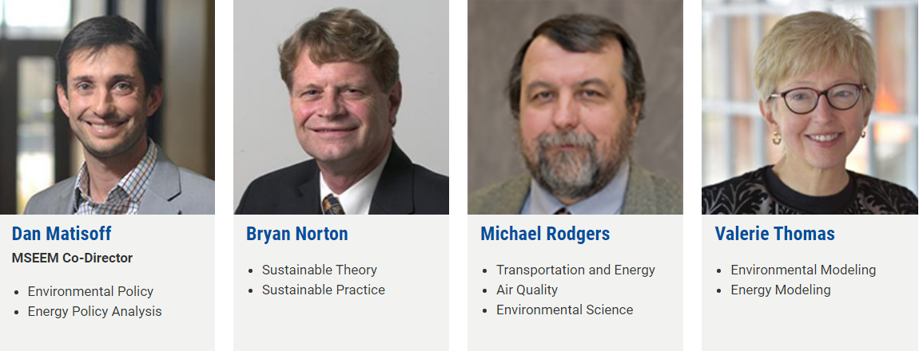
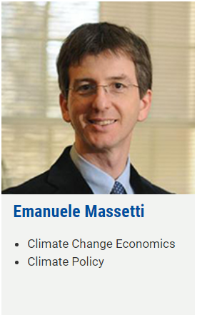
MSEEM Faculty – World Renowned

Slide 4
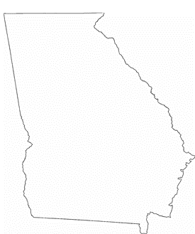
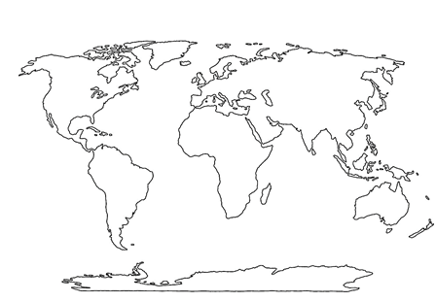
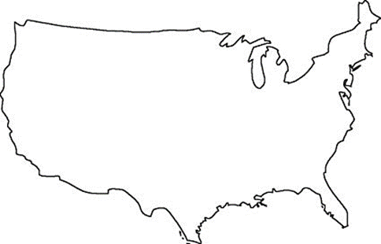
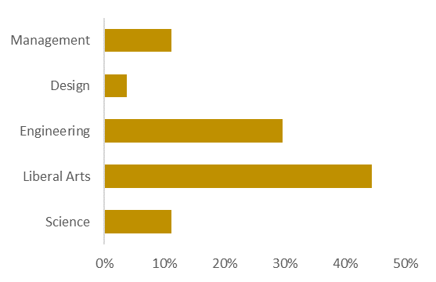
2020 Profile: Inaugural Class of MSEEM is the only sustainability-oriented Masters Program in Georgia
Applications from Coast to Coast and Around the Globe
37%
Georgia
37%
United States
26%
International
Highly Diverse Backgrounds
 | Year One – 2020 24 motivated & accomplished scholars selected for year one: Different schools Range of work experience & education 5 MSEEM Funded Fellows

Slide 5
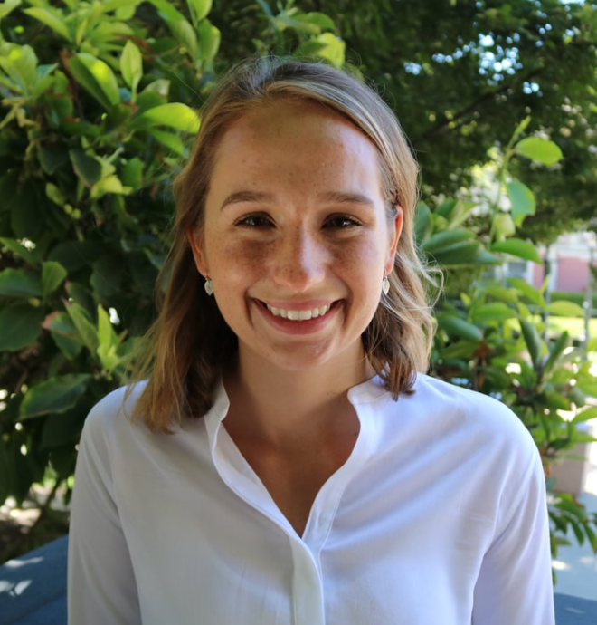
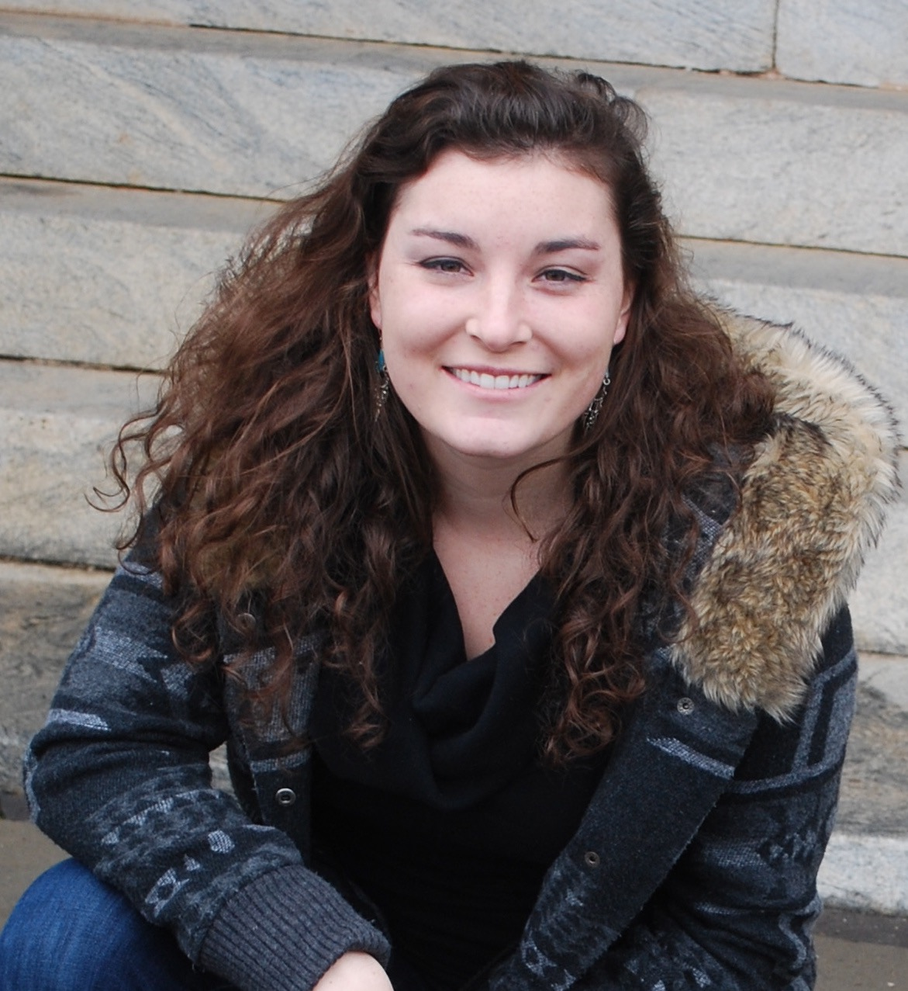
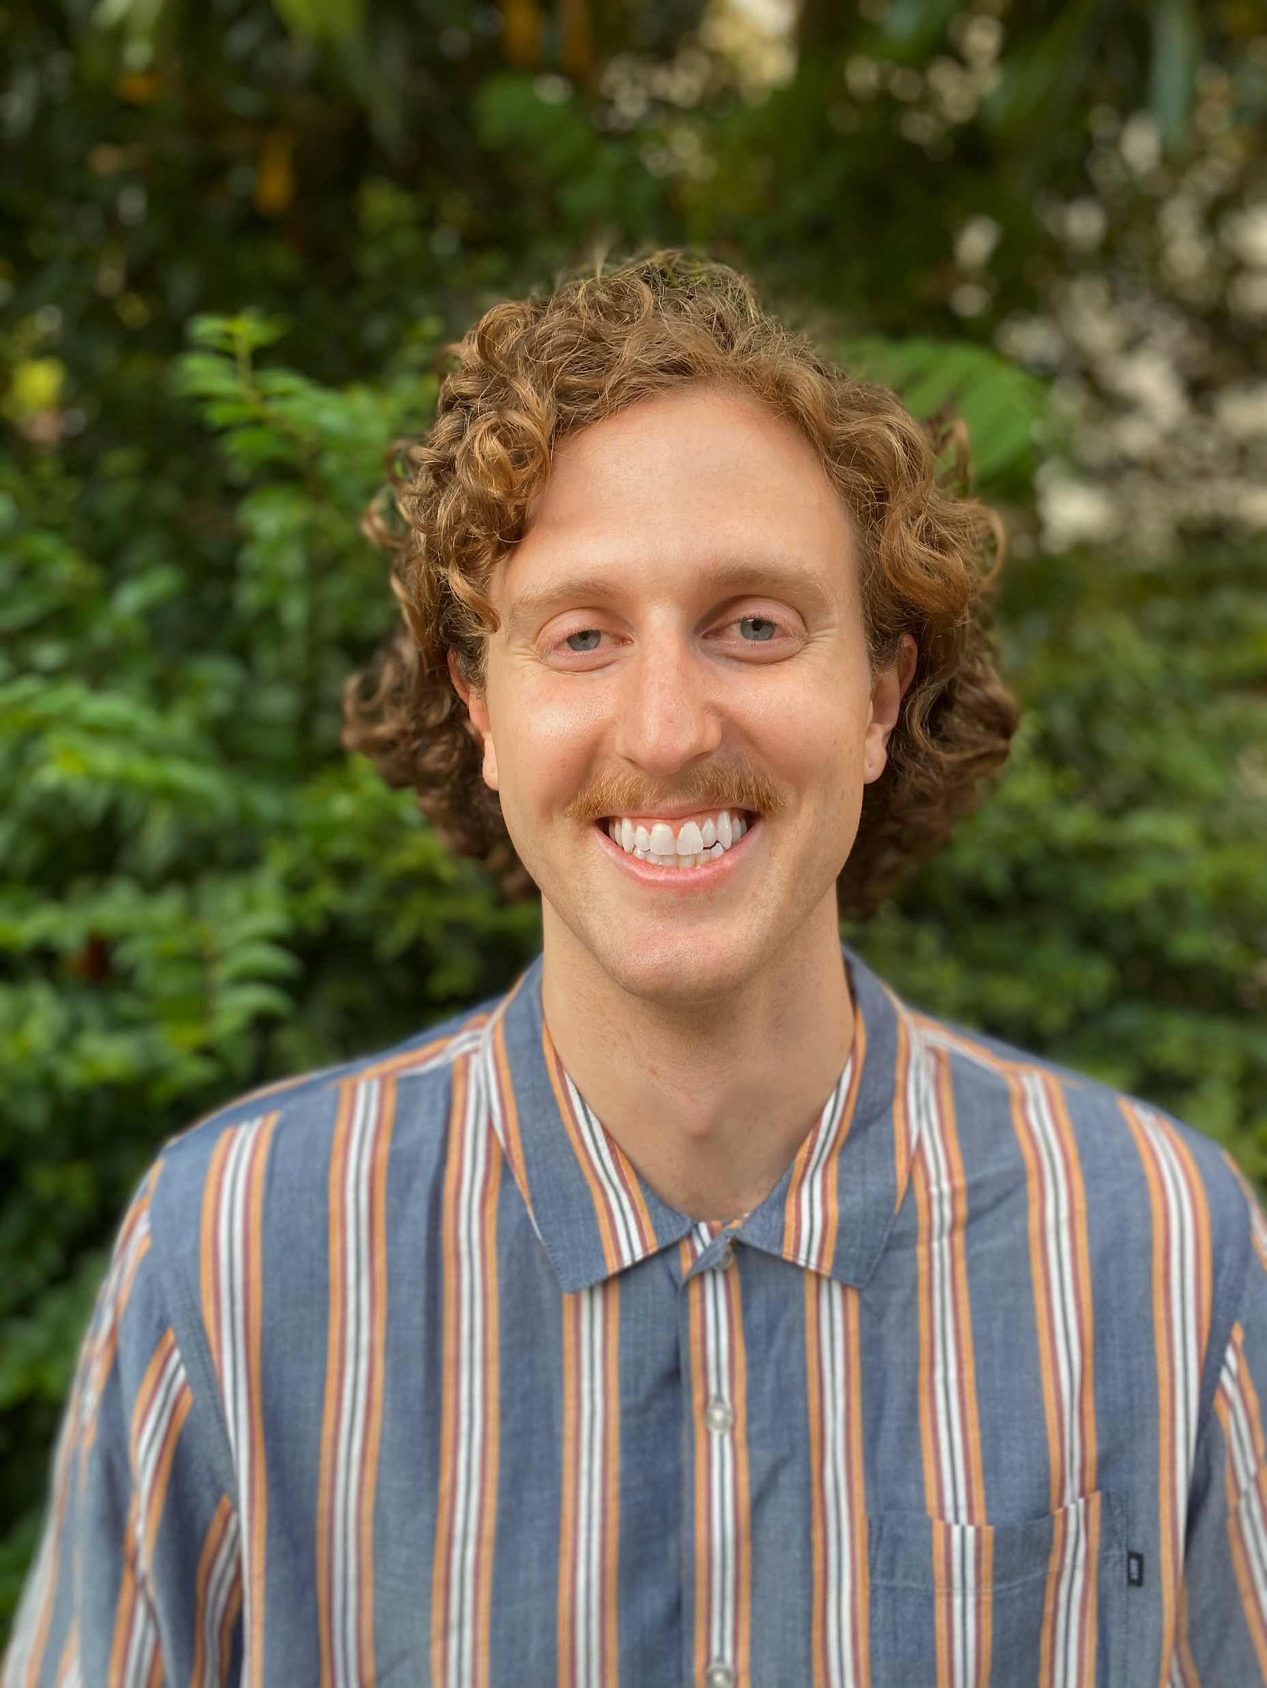
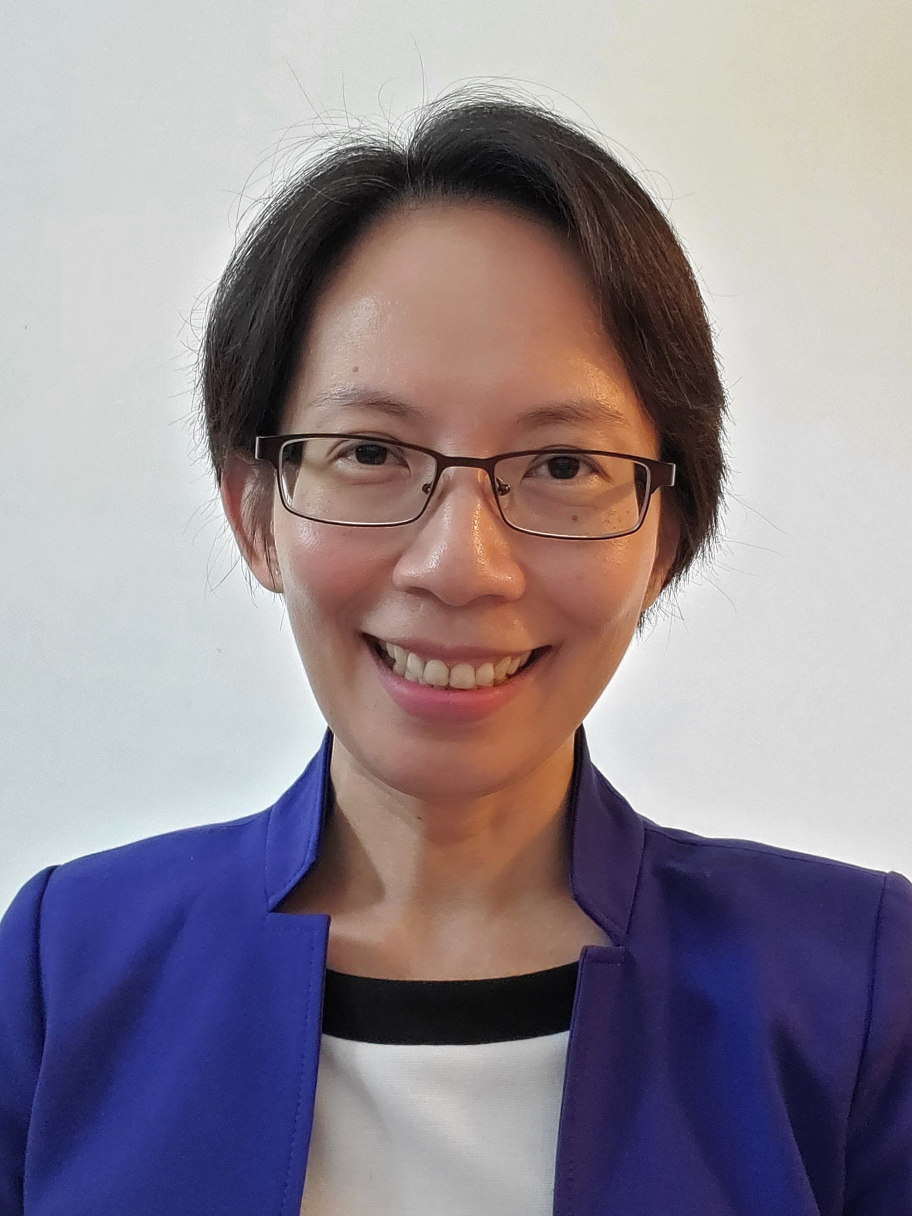
Meet the Fellows
The MSEEM offers fellowships for full-time students.
Carolyn Burch
Claire Cressman
Parker Hamilton
Gracy Wingkono
She received her undergraduate degree in environmental studies from UC Santa Cruz.
She received her undergraduate degree in business from Auburn International.
He received his undergraduate degree in environmental studies from Tulane University.
She received her undergraduate degree in chemical engineering from Universitas Surabaya.
Breakout session with Students

Slide 6
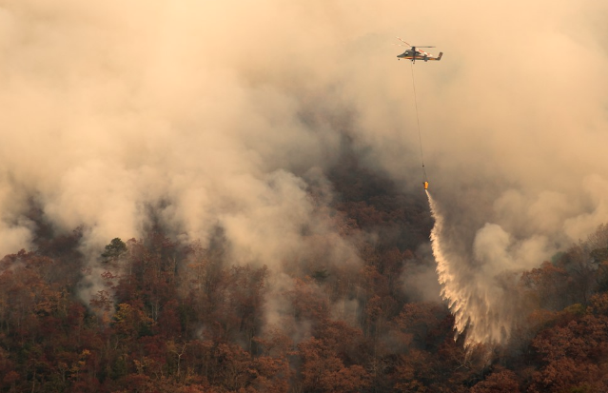
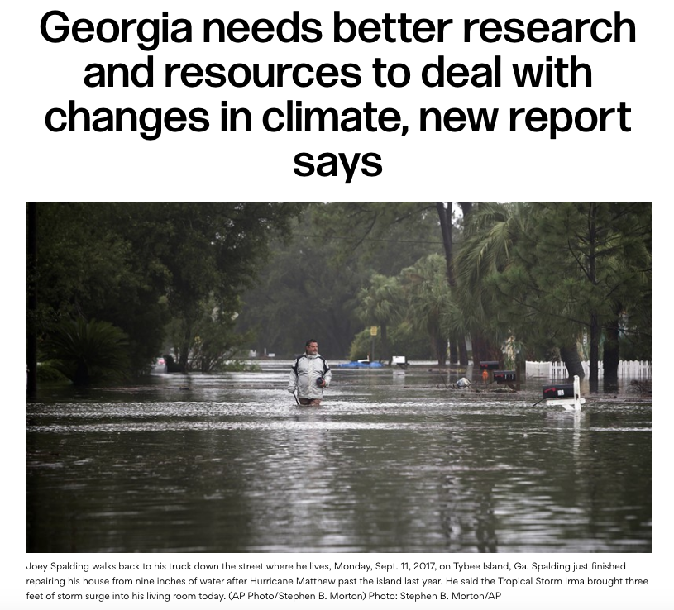
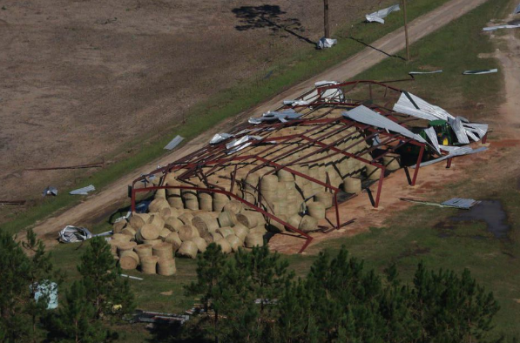
High Demand for Accredited Sustainability Skills
North Georgia Fires in 2016
Job Forecast by the numbers
Between 2012 – 2022, increasing by 15% Source: Bureau of Labor Statistics
These job categories include:
Clean Energy Sector
Conservation & Nonprofits
Corporate Social Responsibility
Regulatory & Governmental
Environmental Engineering
Consulting
Flood water after Hurricane Matthew
Farm damage from Hurricane Michael
6
Notes:
Websites for graphics
https://www.nytimes.com/2018/08/17/books/review/rising-elizabeth-rush.html
https://www.ajc.com/news/local-education/georgia-needs-better-research-and-resources-deal-with-changes-climate-new-report-says/ocfbjSBFnPxEJf4qVjVdQK/
https://www.forbes.com/sites/marshallshepherd/2018/10/13/the-hidden-tragedy-of-hurricane-michael-and-georgia-agriculture-how-it-affects-you/#7efc17151513
Currently, Georgia Tech graduate students can concentrate on Energy & Environment as part of a theory and research-oriented Master of Science in Public Policy program that offers students the flexibility of embarking upon an academic or professional career, but there is a need for a professional Masters degree that is more explicitly geared towards students pursuing careers that bring sustainability solutions to government agencies, NGOs, and the business community.
6

Slide 7
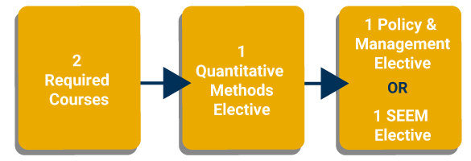
Stackable and Flexible Programs MSEEM on campus or via distance learning* CSEEM can feed into MSEEM
CSEEM 12 credit hours
MSEEM 30 credit hours
* Should courses permit
*Required courses: Sustainable Energy & Environmental Management & Economics of Environmental Policy
Notes:
MSEEM can be completed either full time (4-4-2 courses in a single year) or part time (2-2-1 courses each year for 2 years).
CSEEM students can seek admission to the MSEEM program, and apply the 12 credits from CSEEM to MSEEM’s 30-credit requirement within 6 years. Additionally, students could use CSEEM credit toward one other program but couldn’t come back after a PhD/MS was awarded to again use the certificate coursework and then use the certificate coursework again toward the MS program.

Slide 8
PUBP Class Listings – Fall 2020
Required courses
PUBP 8803 | Sustainable Energy and Environmental Management Policy and Management – Dr. Matisoff
Quantitative Methods elective (need 2 in total)
PUBP 6114 | Applied Policy Methods and Data Analysis – Dr. Rogers
PUBP 8200 | Advanced Research Methods I – Dr. Rogers
PUBP 6120 | Policy Cost Ben Analysis – Dr. Massetti
Sustainable Energy & Environmental Management (need 3 in total)
PUBP 6300 | Earth Systems – Dr. Rodgers
PUBP 6330 | Environmental Law – Dr. Slieper
PUBP 6352 | Utility Regulation & Policy – Dr. Brown
Policy & Management (need 1 in total)
PUBP 6116 | Microeconomic Analysis in Public Policymaking – Dr. Marco
PUBP 6201 | Public Policy Analysis – Dr. Bullinger
PUBP 6314 | Policy Tools for Environmental Management – Dr. Elliott

Slide 9
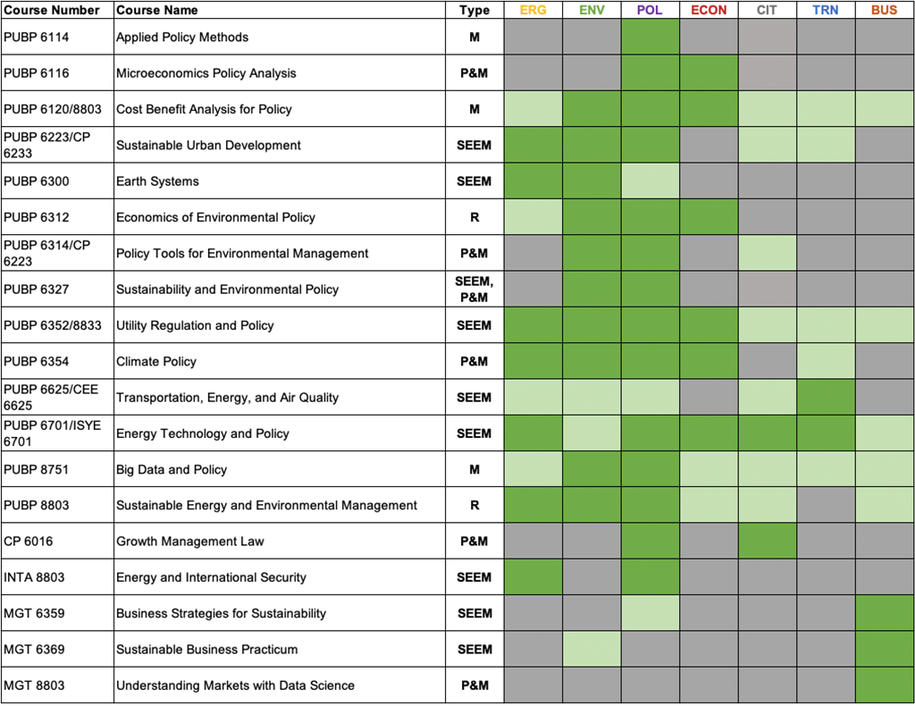
Popular Courses
View the complete course list at https://cepl.gatech.edu/degrees/courses.

Slide 10
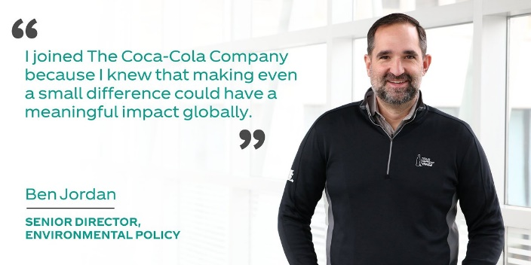
PUBP 8803: Sustainable Energy and Environmental Management (Required)
Professor: Dr. Daniel Matisoff
Part 1:
Sustainability Theory and Philosophy
Tragedy of the Commons; Conservationism; Preservationism; Sustainable Development; Malthus vs. Prometheus
Part 2:
Tools for Managing Sustainability
Regulations; Markets; Participatory Processes; Corporate Social Responsibility
Part 3:
Case Analysis
Guest Lectures:

Slide 11
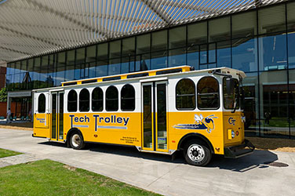
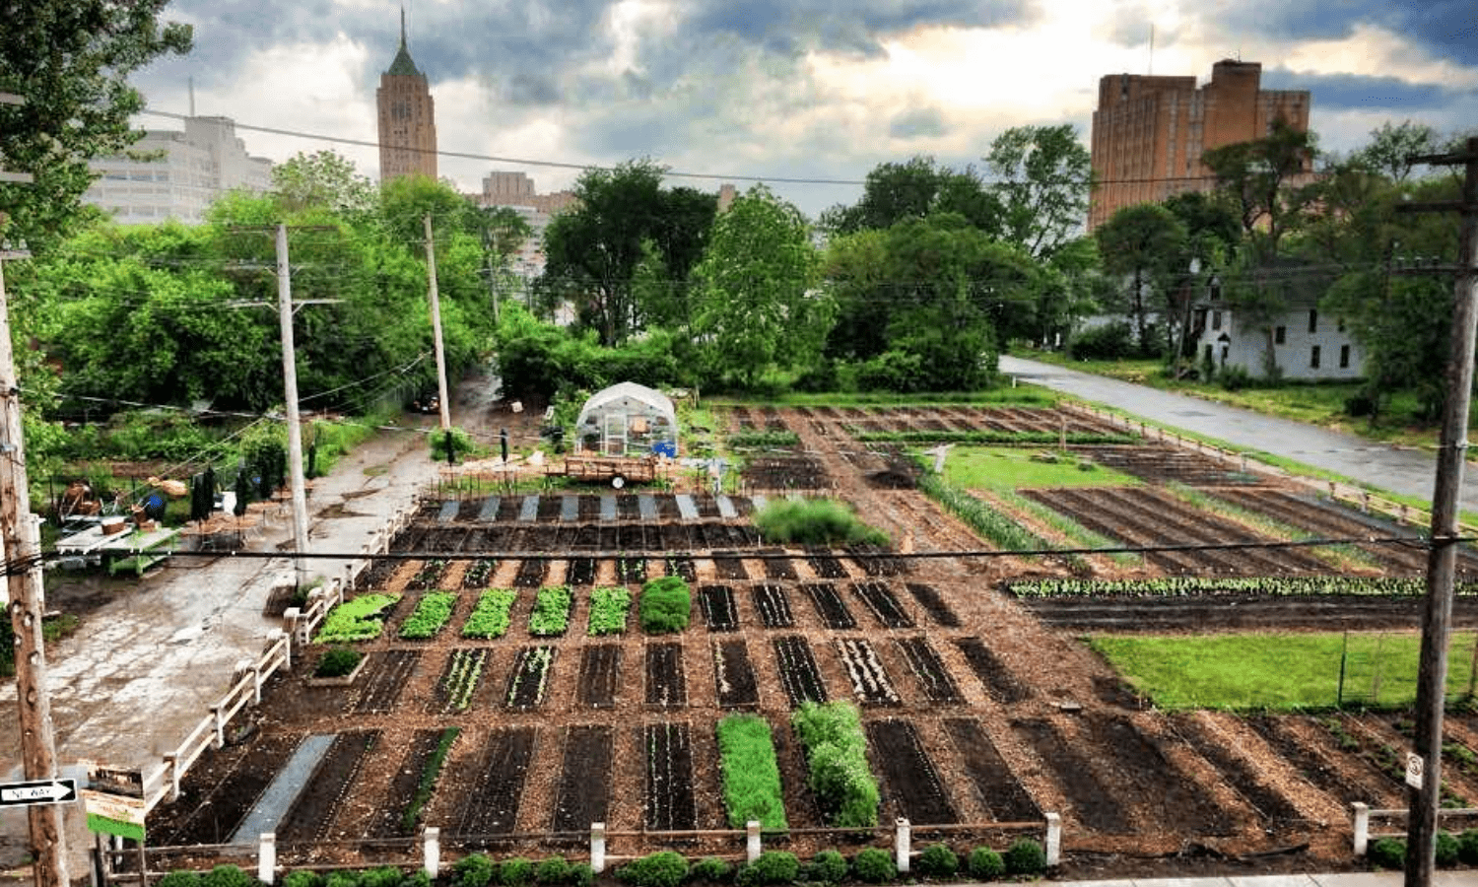
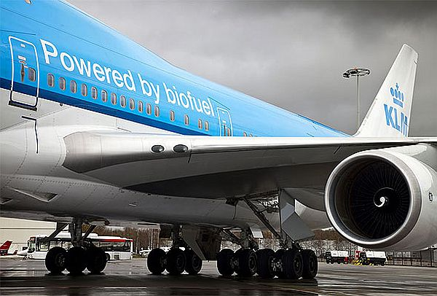
Capstone Project
The MSEEM summer term focuses on the Research Capstone Project (6 credits).
Students identify and define a real-world problem in the SEEM area and select a methodology to assess valuable solutions.
Illustrative Capstone Case Examples
GT as a learning laboratory
Environmental and economic impacts of car rental services at GT
Community-based projects
How sustainable is urban agroforestry?
Integrating community needs into regional resilience planning
Evaluating Contaminated Lands for Solar PV in Georgia
Business-related projects
Value of incorporating Sustainable Development Goals (SDGs) in business
Airline Sustainable Supply Chain
Notes:
Websites for graphics
https://www.nytimes.com/2018/08/17/books/review/rising-elizabeth-rush.html
https://www.ajc.com/news/local-education/georgia-needs-better-research-and-resources-deal-with-changes-climate-new-report-says/ocfbjSBFnPxEJf4qVjVdQK/
https://www.forbes.com/sites/marshallshepherd/2018/10/13/the-hidden-tragedy-of-hurricane-michael-and-georgia-agriculture-how-it-affects-you/#7efc17151513
Currently, Georgia Tech graduate students can concentrate on Energy & Environment as part of a theory and research-oriented Master of Science in Public Policy program that offers students the flexibility of embarking upon an academic or professional career, but there is a need for a professional Masters degree that is more explicitly geared towards students pursuing careers that bring sustainability solutions to government agencies, NGOs, and the business community.

Slide 12
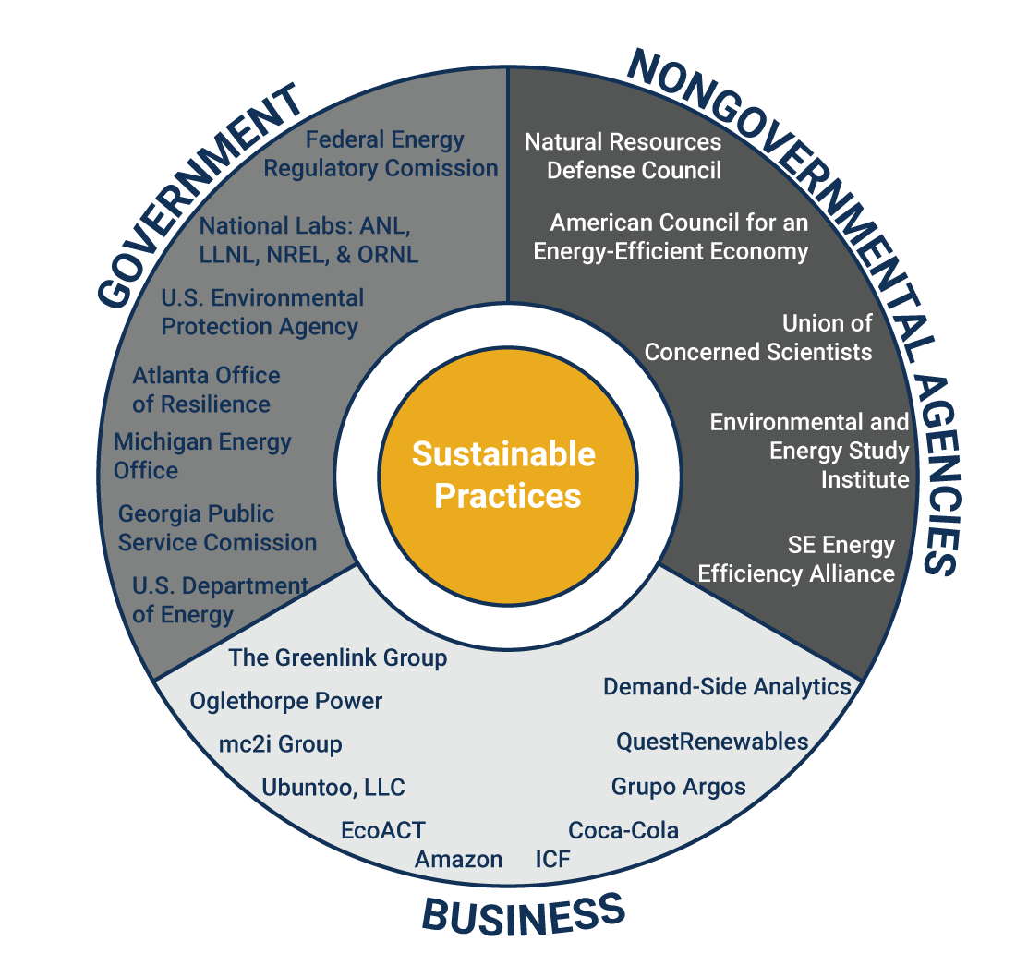
Graduates Making A Difference

Slide 13
Frequently Asked Questions
What about COVID?
What are the backgrounds of C/MSEEM students?
What kind of opportunities are available for graduates of the C/MSEEM?
How many students are likely to be in each class?
How long does it take to complete the MSEEM?
Can we take the C/MSEEM part-time while working?
What courses do I need to take to complete the degree program?
Can we use the CSEEM credits for the MSEEM?
What kind of financial aid is available?
Can C/MSEEM students get credit for an elective course that is not currently on our approved list?
Notes:
13

