Slide 1
IGERT
Energy Materials
& Policy
ENERGY STORAGE FOR PV AND EV SYSTEMS
Setting the stage by Georgia Tech NSF IGERT Faculty: --Steve Usselman, History, Technology and Society --Matthew McDowell, Mechanical Engineering Research results presented by Georgia Tech NSF Fellows: Materials and Systems --Eric Tervo, Mechanical Engineering Policy and Economics --Wale Odukomaiya, Mechanical Engineering --Caroline Golin, Vote Solar
Forum and Celebration of Energy Transitions

Slide 2
IGERT
Energy Materials
& Policy
An Economic Analysis of Residential Photovoltaic Systems with Battery Storage in the United States
Presented by Eric Tervo Ph.D. Candidate, G.W.W. School of Mechanical Engineering eric.tervo@gatech.edu July 25, 2017 In collaboration with Kenechi Agbim, Alfred DeAngelis, Jeffrey Hernandez, Hye Kyung Kim, and Wale Odukomaiya
Forum and Celebration of Energy Transitions
Notes:
Co-authors are mostly IGERT fellows
From ME and School of Chemistry & Biochemistry
Preliminary Results - Currently finalizing work and writing manuscript

Slide 3
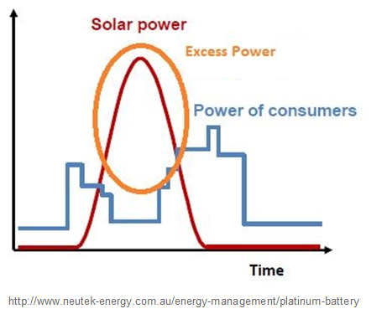
IGERT
Energy Materials
& Policy
Motivation
Excess PV generation during the day must be utilized to achieve low LCOEs
Net or Bi-Directional Metering
Battery Storage
Forum and Celebration of Energy Transitions
Notes:
Define LCOE
Headline LCOE numbers are production costs
Same cost to consumer assumes full utilization ($/kWh)
2 methods to use excess production: net metering or batteries (define)

Slide 4
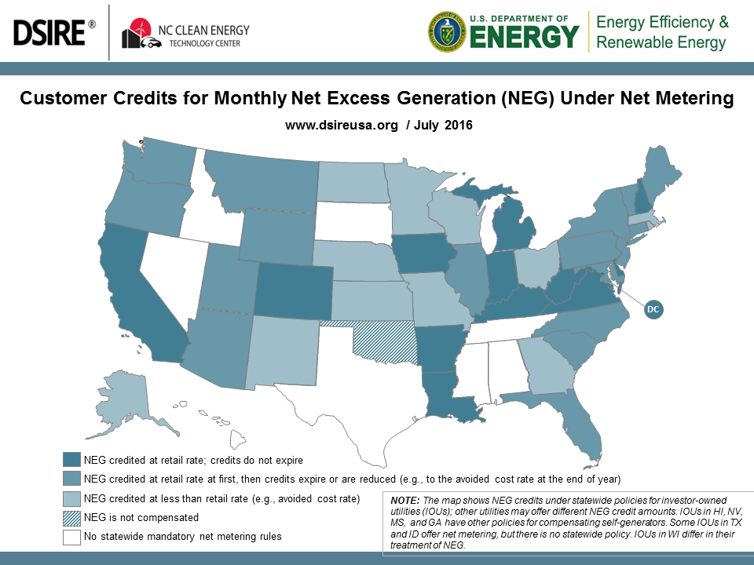
IGERT
Energy Materials
& Policy
Forum and Celebration of Energy Transitions
Notes:
Net metering policies are fragmented
Map doesn’t capture limits and variation within states (GA example)

Slide 5
IGERT
Energy Materials
& Policy
Objectives
Develop model to predict cost/performance of residential PV with battery storage – without bi-directional metering
  Capture geographical variation in solar insolation and household load profiles
  Define and predict a battery LCOE that can be compared against net- or bi-directional metering schemes
Forum and Celebration of Energy Transitions
Notes:
Model: most literature focuses on German market, few US studies. Cost comparison when discussing NEG policy
State-to-state variations
Battery LCOE

Slide 6
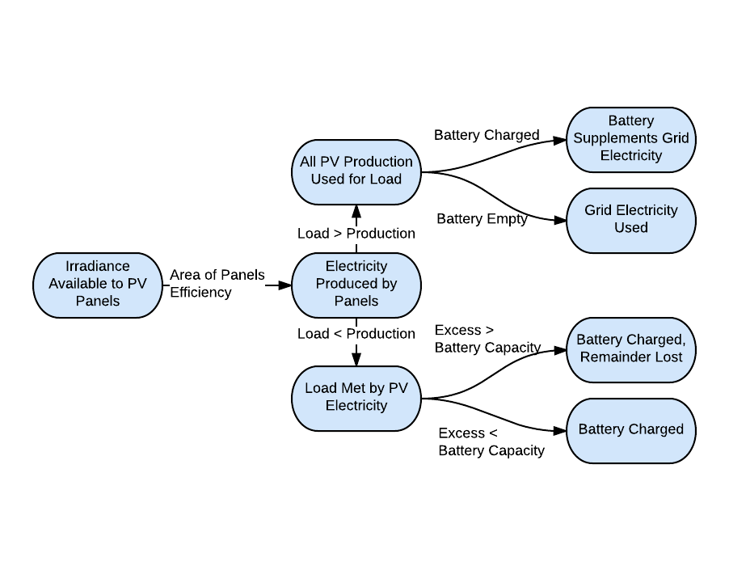
IGERT
Energy Materials
& Policy
Model: System Performance
Forum and Celebration of Energy Transitions
Notes:
Custom MATLAB model simulates DC-tied PV/battery system on hourly basis for 30 years in every state. High-level overview
TMY3 data for irradiance
Variable PV size, 2016 average efficiencies, losses to find production
Load profiles corresponding to TMY3 location from DOE Building America B10 Benchmark (3 bed 1 story to 2009/2010 standards)
Top then bottom cases.
Battery performance corresponds to specs for Tesla’s powerwall – lowest cost/kWh, variable size
Account for losses (inverters, batteries, dust, MPP tracker, degradation, replacement)
Repeated hourly for 30 yrs, tracking electricity production, storage, use, and loss

Slide 7
IGERT
Energy Materials
& Policy
Model: System Finances
Financing
  4%, 30 year home-equity loan
  20% down payment
Taxes
  Exempt (or negligible) property tax
  Interest payments are tax-deductible (25% federal)
Levelized Costs
  6% discount rate
  2% inflation
Incentives
  30% investment tax credit
Forum and Celebration of Energy Transitions
Notes:
Some key financial inputs for modeling costs of system

Slide 8
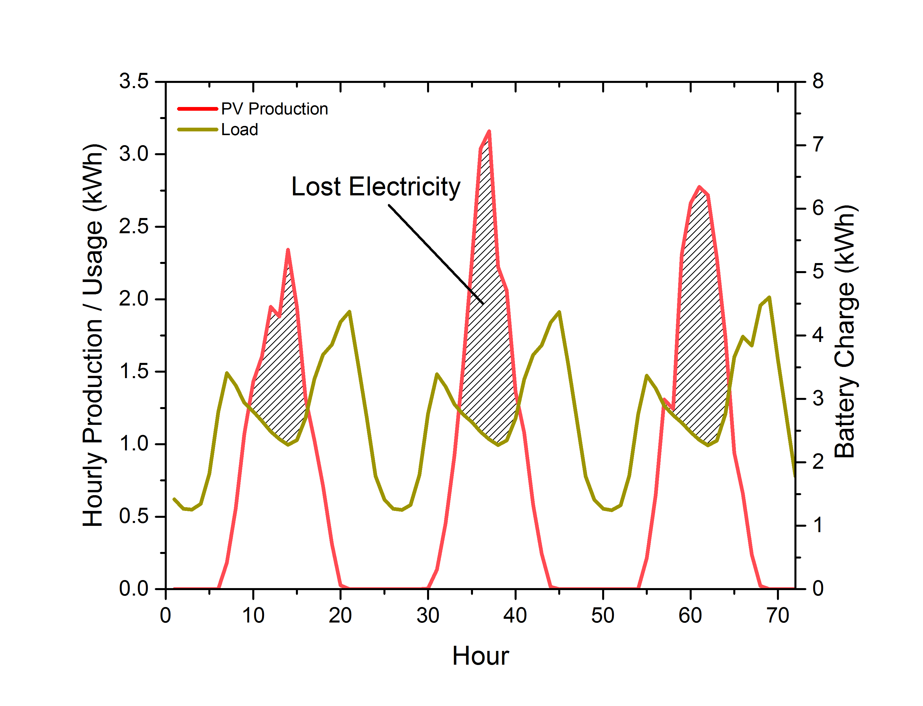
IGERT
Energy Materials
& Policy
Results: Impact of Using Batteries
For Atlanta, GA with 5 kW PV system and no battery
Forum and Celebration of Energy Transitions
Notes:
3 days in May, Atlanta with 5 kW PV system (typical)
Excess generation would be lost without PV or battery system – significant portion

Slide 9
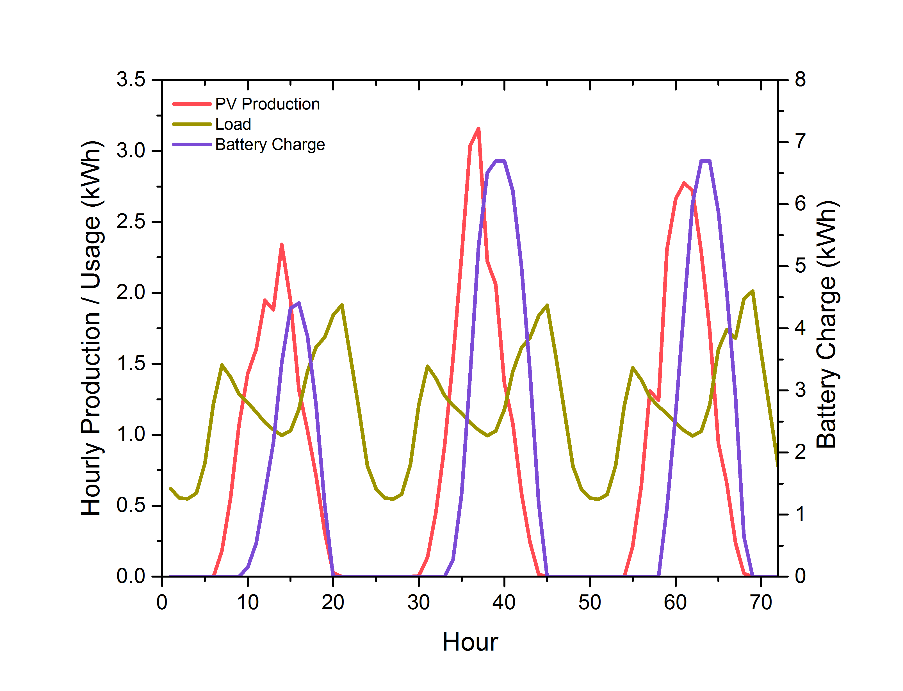
IGERT
Energy Materials
& Policy
Results: Impact of Using Batteries
For Atlanta, GA with 5 kW PV system and 7 kWh battery
Forum and Celebration of Energy Transitions
Notes:
Add 7 kWh battery and nearly all PV production is used
Flat portions indicate battery is max or production = load
Nowhere near “off-grid”

Slide 10
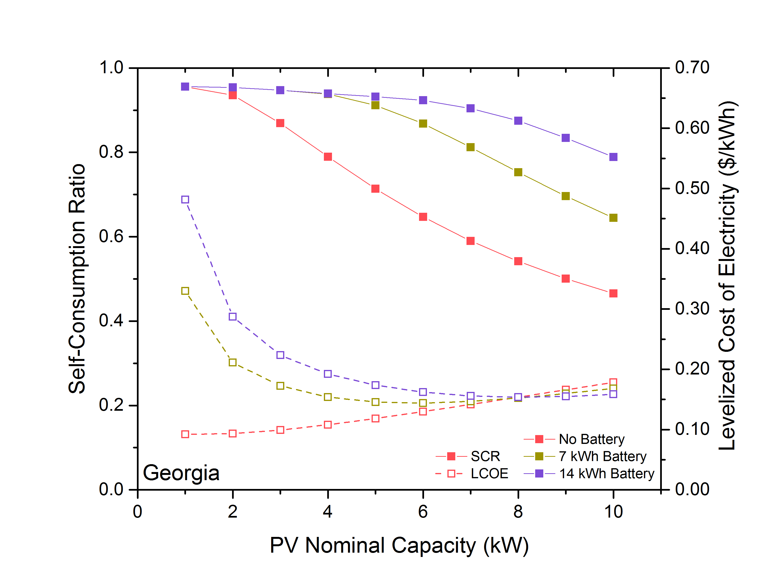
IGERT
Energy Materials
& Policy
Results: LCOE & Self-Consumption Ratio
Forum and Celebration of Energy Transitions
Notes:
Define SCR = Total Used from system / Total Production (percentage of production that is used)
Low PV size means electricity used immediately (high SCR, low LCOE)
Decreasing SCR, increasing LCOE means electricity wasted
Adding batteries increases SCR substantially
For larger PV sizes, having batteries can result in lower LCOE

Slide 11
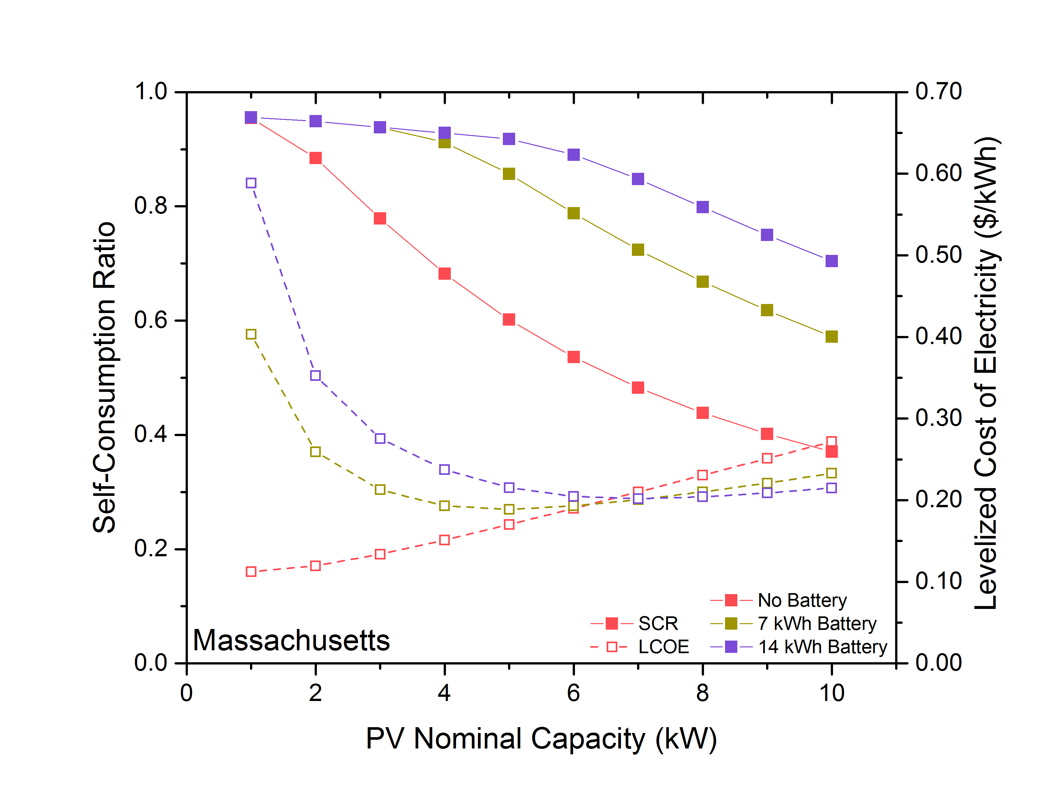
IGERT
Energy Materials
& Policy
Results: LCOE & Self-Consumption Ratio
Forum and Celebration of Energy Transitions
Notes:
Geographical differences – insolation and load profiles

Slide 12
IGERT
Energy Materials
& Policy
Results: LCOE for Batteries Alone
5 kW PV system, 7 kWh battery system
LCOE above PV “production cost” can be compared to costs in net-metering schemes
Georgia
  0.054 $/kWh raises SCR from 71% to 91%
Massachussetts
  0.076 $/kWh raises SCR from 60% to 85%
Forum and Celebration of Energy Transitions
Notes:
Battery LCOE defined as LCOE above low-size PV LCOE without batteries – describe by flipping to prev. slide
Georgia – an additional 5 cents per kWh is what the battery system costs
MA – additional 8 cents
Actual battery LCOE is much lower or negative

Slide 13
IGERT
Energy Materials
& Policy
Conclusions
Created detailed, flexible model to analyze residential PV and battery systems
Batteries can effectively utilize excess PV generation
For larger PV installations (> 6 kW), battery systems can lower the LCOE
Created cost metric to compare to net-metering policies
Caveat: Despite promise, not grid competitive yet
Forum and Celebration of Energy Transitions

Slide 14






IGERT
Energy Materials
& Policy
Thank you!
Drs. Marilyn Brown, Samuel Graham, and Valerie Thomas My Co-Authors
Forum and Celebration of Energy Transitions

Slide 15
IGERT
Energy Materials
& Policy
ENERGY STORAGE FOR PV AND EV SYSTEMS
Setting the stage by Georgia Tech NSF IGERT Faculty: --Professor Gleb Yushin, Materials Science and Engineering --Steve Usselman, History, Technology and Society Research results presented by Georgia Tech NSF Fellows: Materials and Systems --Professor Eric Tervo, Mechanical Engineering Policy and Economics --Caroline Golin, Vote Solar --Wale Odukomaiya, Mechanical Engineering
Forum and Celebration of Energy Transitions

Slide 16
IGERT
Energy Materials
& Policy
The Value of Energy Storage in Buildings
Wale Odukomaiya PhD Candidate G.W. Woodruff School of Mechanical Engineering Energy and Transportation Science Division, Oak Ridge National Laboratory 07/25/2017
Forum and Celebration of Energy Transitions

Slide 17
Talk Outline
IGERT
Energy Materials
& Policy
Overview of the GLIDES energy storage technology
Motivation for this work
Cost model (buildings use-case)
Results
Conclusions and future work
Forum and Celebration of Energy Transitions

Slide 18
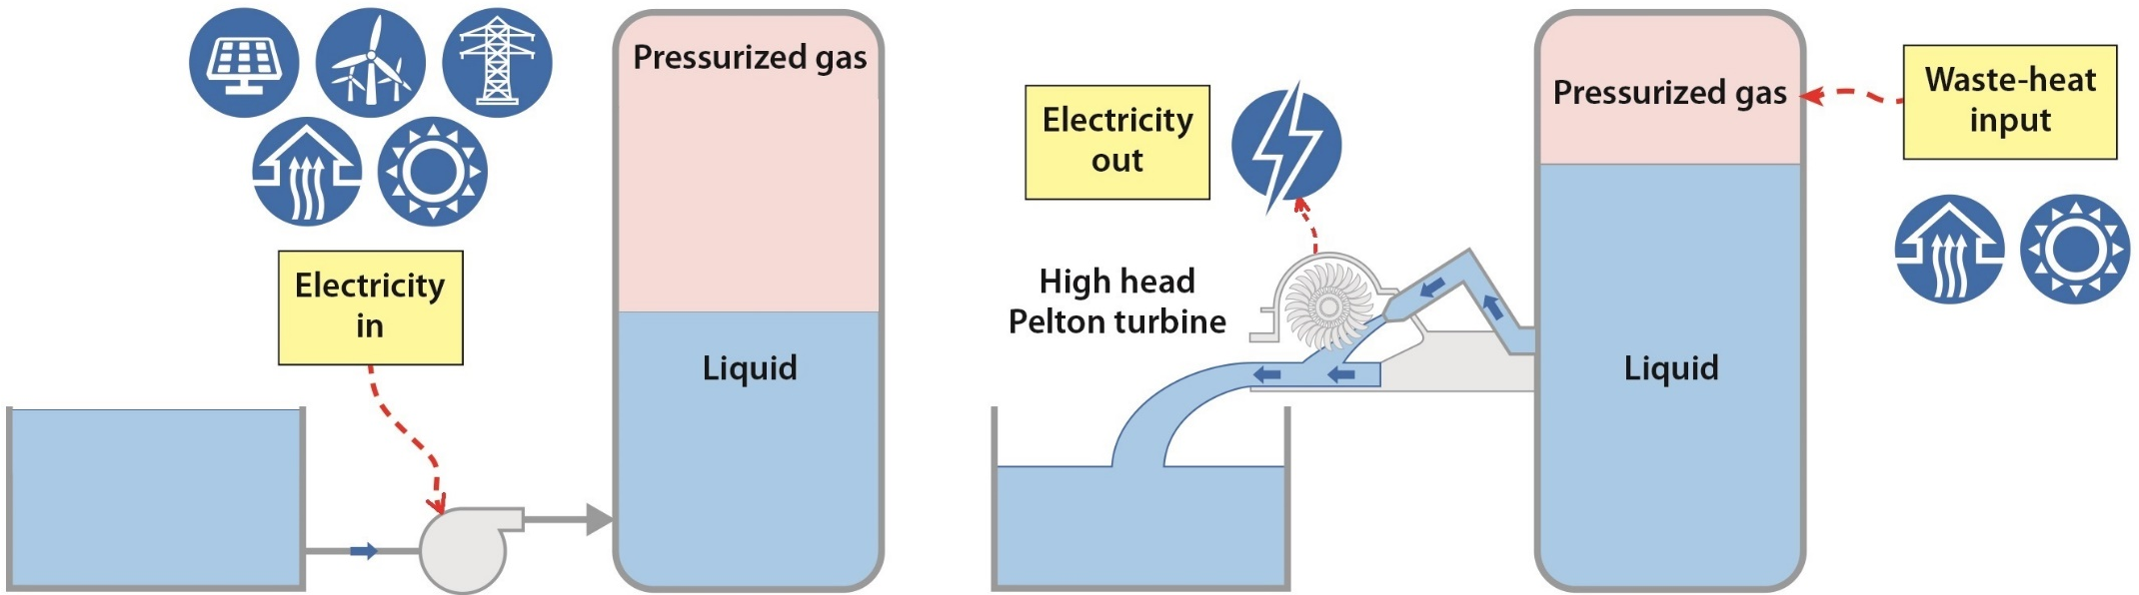
The GLIDES concept
IGERT
Energy Materials
& Policy
Objective: Develop a unique, low-cost, high round trip efficiency storage technology for a) small scale building applications b) large scale modular pump hydro storage.
Key advantages
Simple, low cost | Dispatchable, scaleable
Accepts heat and/or electricity as inputs | Decouples power/energy storage capacity
High round-trip efficiency | Terrain independent
Forum and Celebration of Energy Transitions

Slide 19
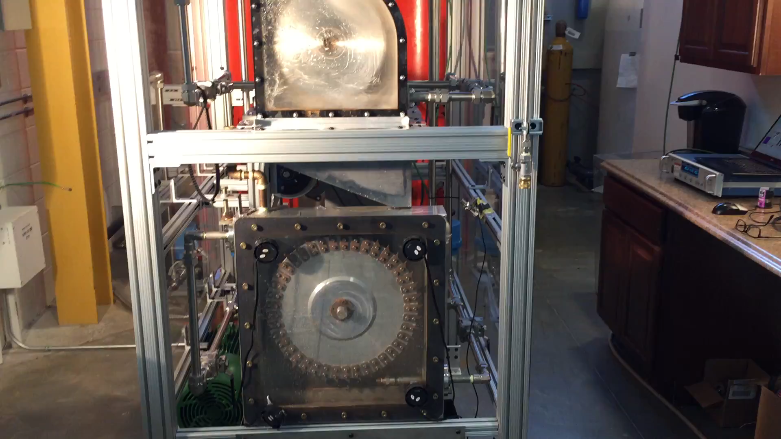
The GLIDES concept
IGERT
Energy Materials
& Policy
Forum and Celebration of Energy Transitions

Slide 20
ES for Buildings
IGERT
Energy Materials
& Policy
Utility companies charge buildings with high power draws a monthly demand charge (based on the highest draw sustained for a certain length of time, usually 15 minutes).
Demand charge and energy charge vary throughout the day (highest during peak periods).
Storage can provide value by reducing peak draw and shifting time of use.
Question: At what storage cost ($/kWh) does investment make sense, based on resulting savings?
Forum and Celebration of Energy Transitions

Slide 21
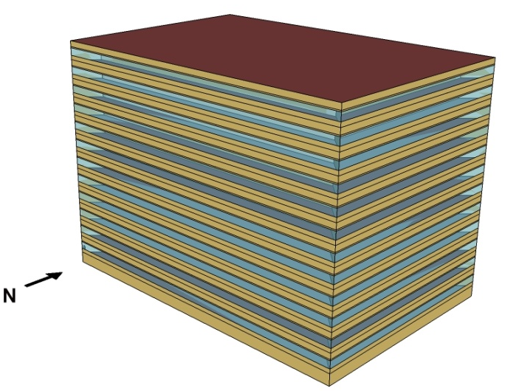
ES for Buildings
IGERT
Energy Materials
& Policy
Study:
  Determine target storage system cost ($/kWh) based on electric utility bill savings resulting from peak reduction and time-of-use shifting.
  Use EnergyPlus and DOE Large Office reference building as case study.
  Optimization model to determine when to charge/discharge storage to maximize savings.
DOE E+ Large Office reference building (498, 600 ft²)
Forum and Celebration of Energy Transitions

Slide 22


ES for Buildings
IGERT
Energy Materials
& Policy
Optimization model:
  Built using MATLAB optimization toolbox
  Building load in 15 minute timesteps (output from E+) is fed in.
  Storage is modeled as a load additional to building load (positive when charging, negative when discharging).
LOAD
P_{G}
P_{L}
P_{S}
(+ive for charging)
(-ive for discharging)
Total consumption = storage consumption ∙ η + building consumption
Cost = energy charge ∙ total kWh + demand charge ∙ maximum power draw
Forum and Celebration of Energy Transitions

Slide 23
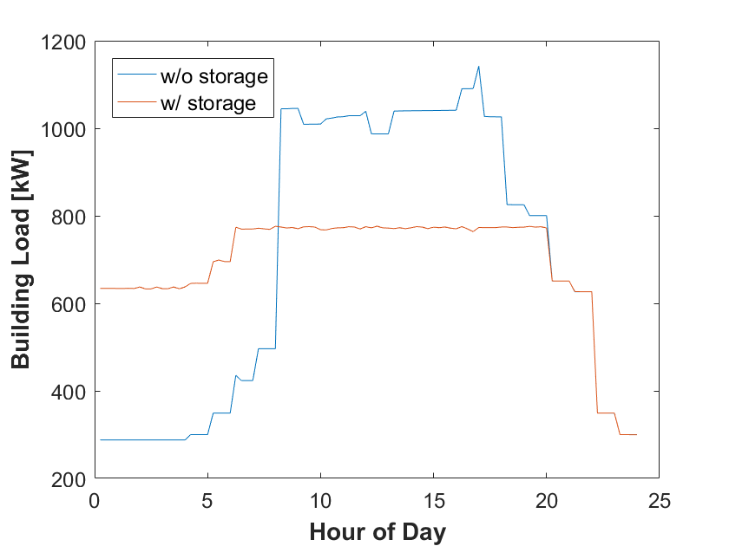
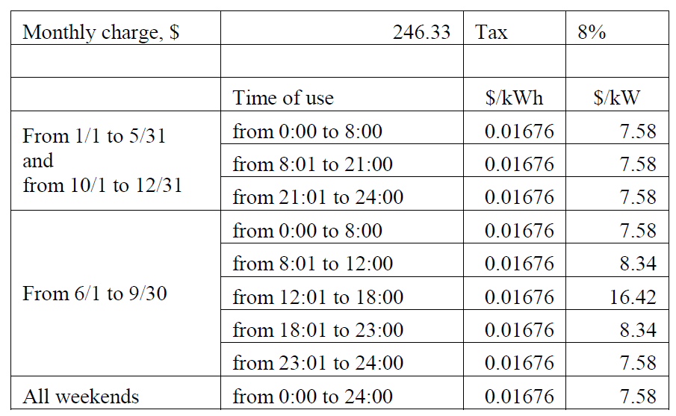
Case Study – Los Angeles
IGERT
Energy Materials
& Policy
Sample daily power demand profile
Los Angeles area electric utility rate structure
(source: https://www.sce.com/NR/sc3/tm2/pdf/ce54-12.pdf)
Cost savings for various system sizes and storage times

Slide 24
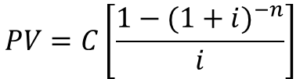
Case Study – Los Angeles
IGERT
Energy Materials
& Policy
Estimating target initial capital cost:
  Calculate present value of annual savings over target payback period
$$PV=C\left[\frac{{1−(1+i)}^{−n}}{i}\right]$$
* i = 4% interest rate assumed
Forum and Celebration of Energy Transitions

Slide 25
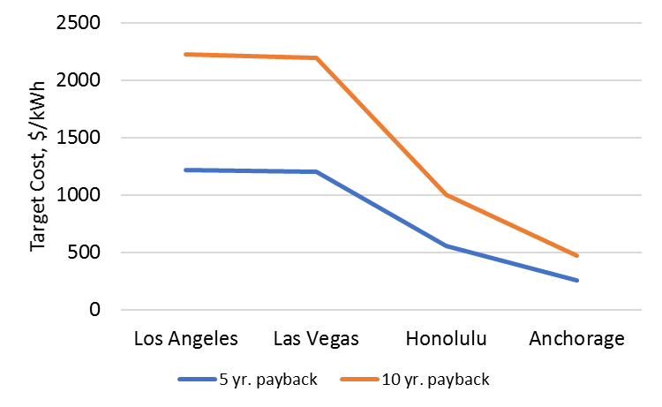
Other U.S. Locations
IGERT
Energy Materials
& Policy
Forum and Celebration of Energy Transitions

Slide 26
Conclusions
IGERT
Energy Materials
& Policy
Stand-alone, ‘behind the meter’ storage can provide value in certain markets.
Can afford to spend generous amounts on storage in some cases, depending on desired payback period.
Small storage capacity (relative to peak building load) and storage times provide highest value.
Next steps:
  Expand study to include more locations, building sizes, and building types.
Forum and Celebration of Energy Transitions

Slide 27

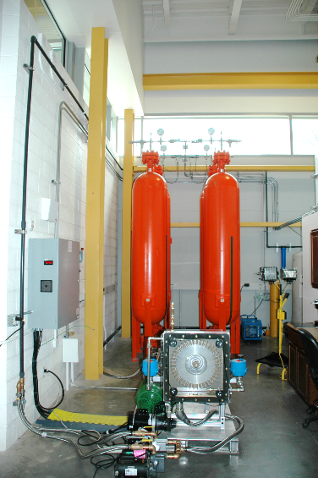
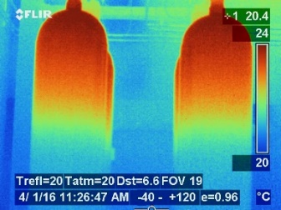



IGERT
Energy Materials
& Policy
Infrared thermal image of GLIDES prototype storage vessels during charging
GLIDES first- generation proof-of-concept prototype
Forum and Celebration of Energy Transitions

Slide 28


The Future of Solar + Storage is Non-Wires Alternatives
Forum and Celebration of Energy Transitions
Caroline Golin, Regulatory Director
1

Slide 29

Distributed Energy Resources (DER) as Non-Wire Alternatives (NWAs)
Using DERs as non-traditional investments to defer or replace the need for specific equipment upgrades or replacements in the Transmission and Distribution (T&D) system.
Recognizing the current and future role of DERs in the distribution planning process.
Not just including DER growth in Distributed Resource Planning but
utilizing DERs to serve grid needs
Determining the ‘right’ business and regulatory model
2
7/24/17

Slide 30



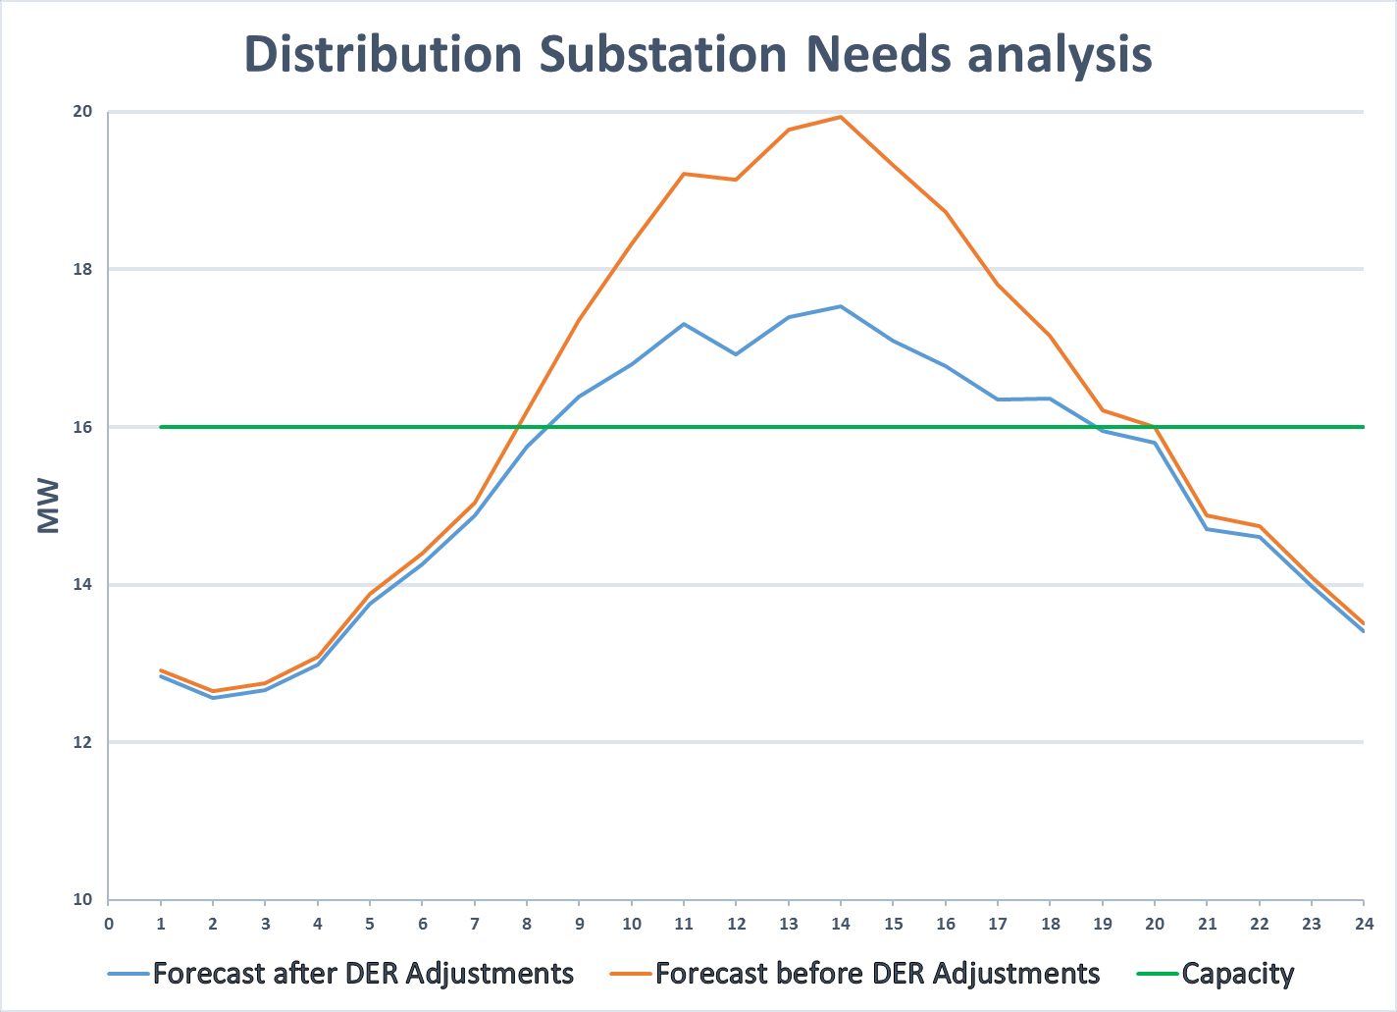




















A Graphical Representation of the Issue
Load reduction due to forecasted DER adoption
Tranche 3: Wholly Sourced Through Another Channel
Circuit Capacity
Tranche 2: Partially Sourced Through Another Channel
Additional DER Needed
Tranche 1: Not Already Sourced Through Another Channel
Forecasted DER Adoptions Include:
impacts of future energy efficiency programs , codes and standards
impacts of future time dependent rates (load modifying demand response)
impacts of future behind the meter distributed generation (primarily PV)
impacts of future electric vehicle adoption
3
PG&E, SDGE, SoCal Edison. IDER Incentive Pilots DPAG Meeting # 4. Joint IOU Presentation. Double Counting / Incrementality. March 30, 2017
7/24/17

Slide 31
















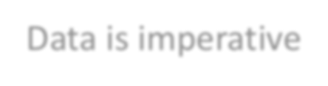
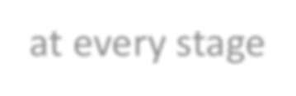










Illustrative: ‘Wires’ Project Timeline 4.
Jan Feb Mar April May June July Aug Sep Oct Nov Dec
Collect peak demand on all banks and feeders
Develop annual forecast using recent peak demand and known new loads. Identify new projects
Year 1: Route Draft Preliminary Project Alternative Reports that include multiple mitigation alternatives for identified needs
Select best alternative mitigation project
Preferred alternative submitted to project managment team to develop detailed project scope, plan and budget
Year 2: Begin detailed project scope development, engineering, design, materials Specifiications and construction scheduling
Procure long lead-time materials, permits etc.
Year 3: Continue engineering, design, and material procurement. (Includes buffer between engineering and construction to ensure complete engineering package ready for execution)
Construction starts, aligned with clearance window opportunity
Year 4: Construction continues, aligned with clearance window opportunity. Energize new equipment and restore system
STAGE 4
Fully Integrated DER Value Assessments
STAGE 3
Advanced Hosting Capacity Evaluations
STAGE 2
Hosting Capacity Evaluations
Illustrative: ‘Non-Wires’ Project Timeline
STAGE 1
Distribution Indicators
Jan Feb Mar April May June July Aug Sep Oct Nov Dec
Collect peak demand on all banks and feeders
Develop annual forecast using recent peak demand and known new loads. Identify new projects
Data is imperative at every stage
Getting the Value Right will set a better market and outcome for utility
Year 1: Route Draft Preliminary Project Alternatives Reports that include multiple mitigation alternatives for identified needs
Select best alernative mitigation proejct
Develop and administer RFO process for DER alternative projects
Year 2: Review and select winning bids, negotiate contracts, secure needed regulatory approvals
Secure regulatory approvals for contracts and cost recovery
Winning vendors begin sourcing and deployment process for DER alternative mitigations
Year 3: Winning vendors continue sourcing and deployment for DER alternative mitigation selected in RFO
Year 4: Vendors work with Utilities to test and commission DER alternatives
4
Joint Utilities of New York, Supplemental Distributed System Implementation Plans (SDSIP) Final, 2016. http://jointutilitiesofny.org/wp-content/uploads/2016/10/3A80BFC9-CBD4-4DFD-AE62-831271013816.pdf
PG&E, SDGE, SoCal Edison. IDER Incentive Pilots DPAG Meeting # 2. Joint IOU Presentation Distribution Planning Process & Proposed Distribution Investment Deferral Framework March 16, 2017
7/24/17

Slide 32
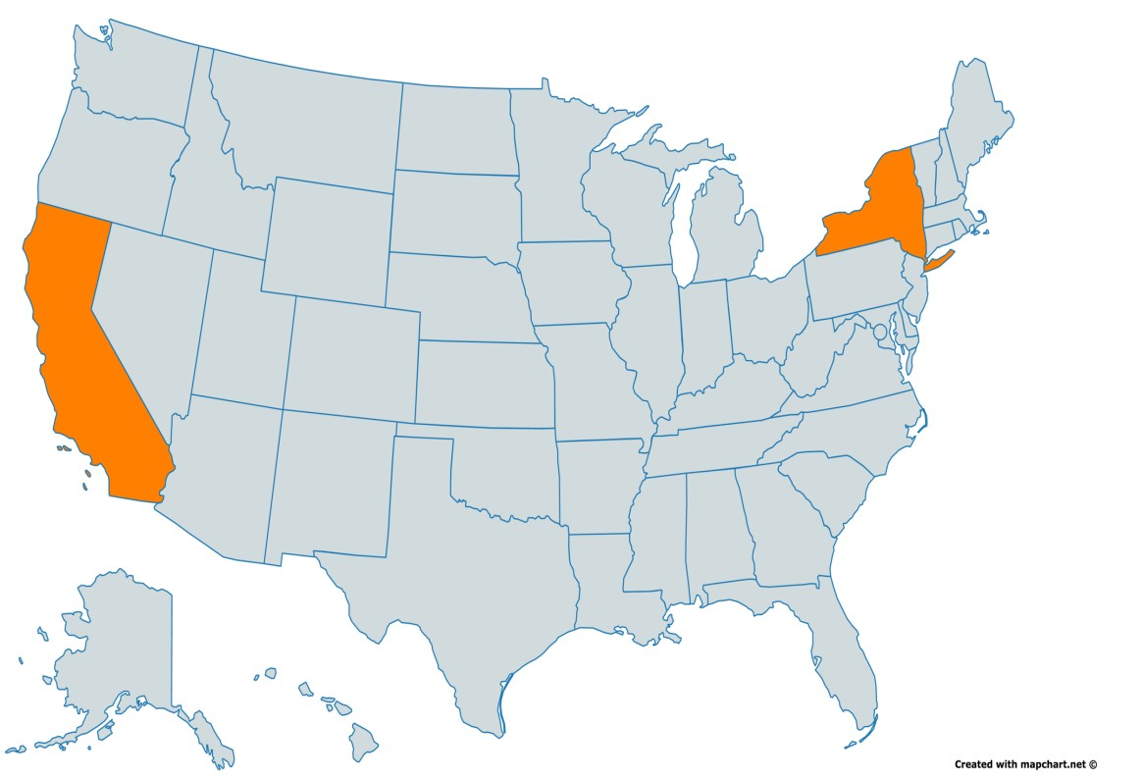
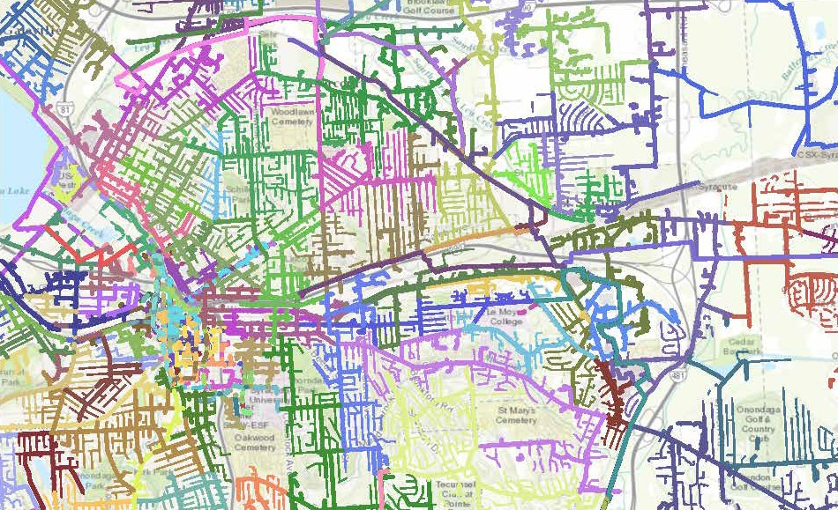
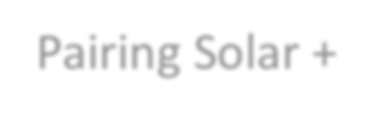

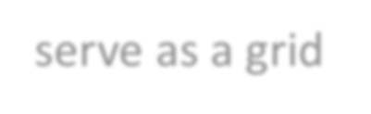
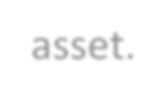



Two Case Studies: DERs as NWAs
NEW YORK, Reforming Energy Vision (REV)
Con Edison, Brooklyn- Queens Demand Management Program
Pairing Solar with EE, Storage, and DR
Central Hudson Gas and Electric, Shared savings with customers
Pairing Solar + Storage to serve as a grid asset.
National Grid: Hosting Map and Grid Needs
CALIFORNIA, PG&E:
Distribution Infrastructure Deferral Framework
(DIDF) and Demand-side Management Framework (DSM)
For the purpose of procuring the DER solutions and prioritizing distribution infrastructure projects for potential cost- effective DER
solutions.
Critical in advancing the market!
5
http://ngrid.maps.arcgis.com/apps/MapSeries/index. html?appid=4c8cfd75800b469abb8febca4d5dab59&folderid=8 a8a74bf834613a04c19a68eefb43b.
7/24/17

Slide 33
What do we need to utilize DERs as NWAs?
Strong Distributed Resource Planning (DRP) Process, including third- party providers and detailed forecasting/mapping of DERs on the system
Develop integrated distribution resource planning framework wherein distributed energy resources are explicitly considered as resource options in the T&D Planning Process.
Evaluation of DER locational net benefits versus traditional infrastructure upgrades or resources
6
Strong Request for Proposal Process (RFP) that allows for all technologies to compete to service a specific grid need
7/24/17

Slide 34
Questions
7
7/24/17

