Slide 1

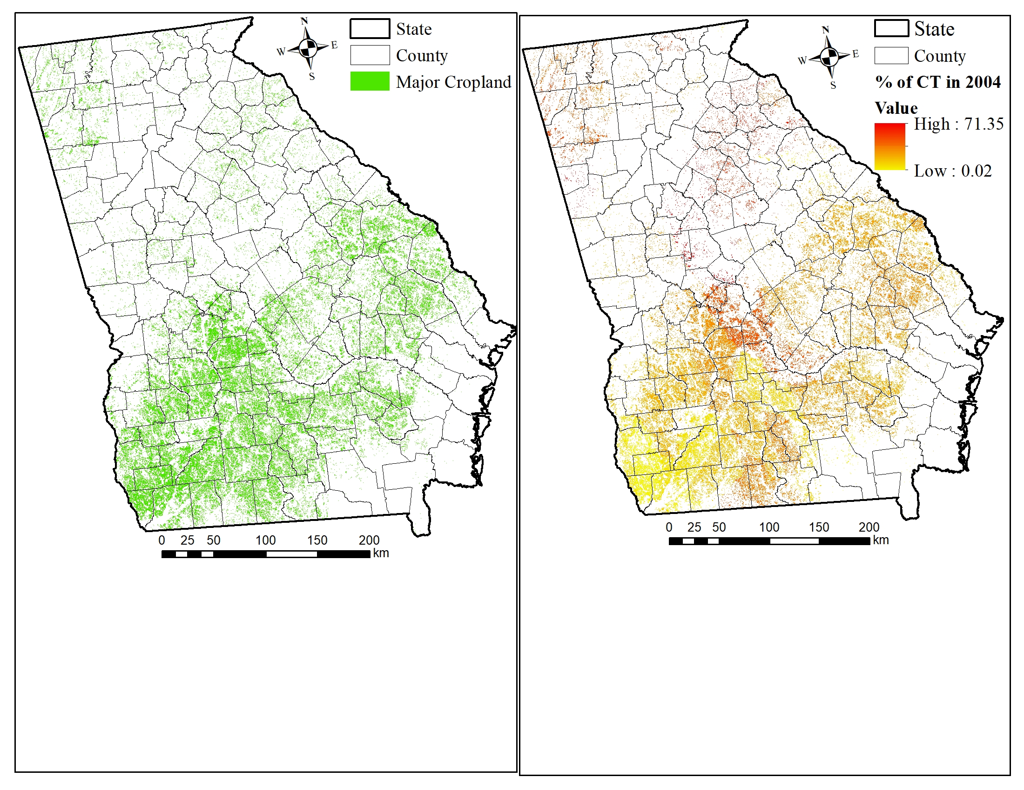
CONSERVATION
AGRICULTURE
Current Capacity:
0.75 Million ha cropland
Achievable Potential:
Reduction of
0.5 Mt CO₂ in 2030
Technical Potential: Reduction of
0.7 Mt CO₂ in 2030
In 2017, Georgia has about 1.5 million ha of cropland and majority of the cropland are distributed in the southern region.
On average, about 50% of the current cropland are under conservation agriculture practices in Georgia (about 1.5% adoption rate).
Higher cost to certain crops, lack of awareness and credible information, higher uncertainties are key obstacles for fully adopting conservation agriculture practices in Georgia.

Slide 2
Conservation Agriculture
Future trends: Base line, achievable and technical potential
Baseline = The current adoption rate of 1.5% annual growth decreases about 0.03 MtCO₂-e in yearly emissions by 2030.
Achievable Potential = Reduction of 0.46 MtCO ₂-e in 2030 by doubling the baseline adoption rate between 2020 and 2030.
Technical Potential = Adoption of 100% cropland into conservation agriculture practices yields 0.7 MtCO₂-e reduction in 2030.
 | Avoided CO₂eq (MMt) in 2030
Achievable | 0.5
Technical | 0.7
About 0.75 million ha of cropland are currently under conservation agriculture
An additional 0.75 million ha of cropland available in Georgia to adopt conservation agriculture
+ Enhanced soil health
+ Less soil erosion
+ Less water, soil and air pollution
+ Low food prices

Slide 3
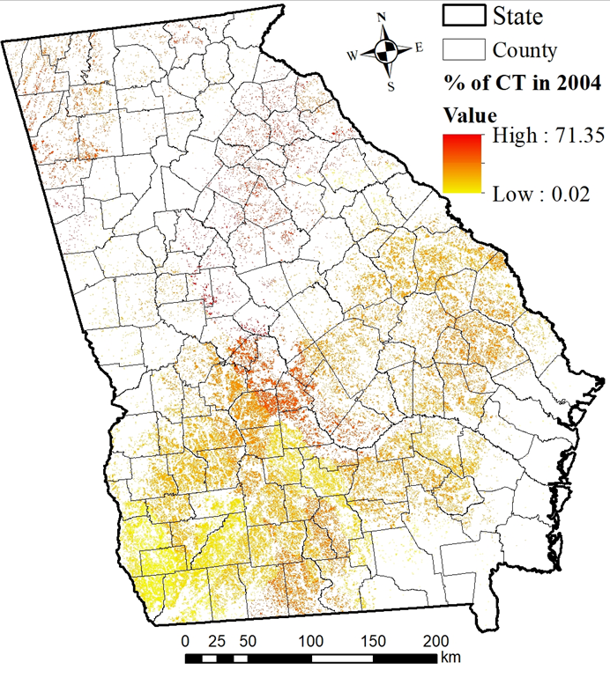
Conservation Agriculture Achievable Potential
Substantial reductions possible by 2030
About 3% adoption rate of conservation agriculture by 2030
––––––––––––––––––––
0.6 million ha of cropland shifts to conservation agriculture practices

Slide 4
Costs and Benefits of Ad0pting Conservation Agriculture Practices
Improvements in soil health and carbon sequestration leads to high net benefits
Achievable potential: 3% adaption rate

Slide 5
Stakeholder Analysis of Conservation Agriculture
GA Farm Bureau
Natural Resources Conservation Service (NRCS), Economic Research Services (ERS)
Rewards
U.S. Department of Agriculture (USDA)
State and County Extension Agencies
Farmers Group
Potential Champions
Trade/Commodity Groups
Conservation & Environmental NGOs
Consumers
Georgia Department of Agriculture, UGA Extension Services.
GA Cotton Commission, GA Peanut Commission
Risks

Slide 6
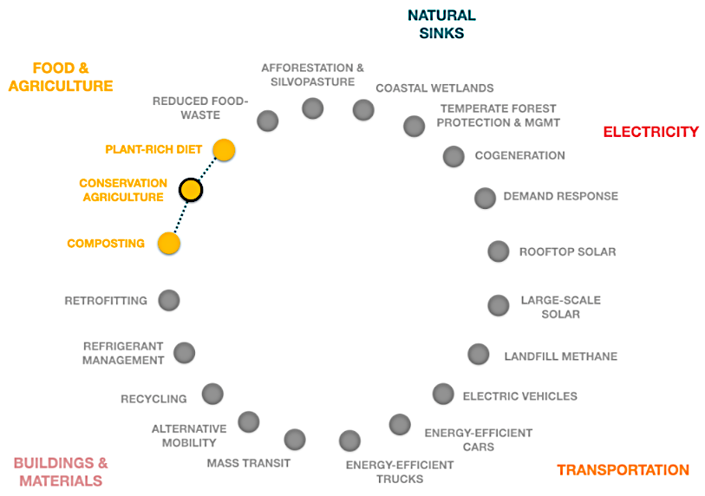

Conservation Ag. Solution Interactions
Composting
Conservation agriculture practices benefits from composts by displacing fossil-derived fertilizers
Plant-Rich Diet
Conservation agriculture practices improve crop yields and reduce carbon footprints of plant-rich foods.

Slide 7
Conservation Agriculture: Challenges and Promising Approaches
Barriers & Challenges
Promising Approaches
Tools & Accelerants
Weed competition with organic farming
Optimization of equipment
Market and policy innovations to promote low- and no-tillage
Crop insurance policies
Land tenure & pressure for land development
Markets for additional crops
Farmer perceptions and lack of role models
Extension & Peer Netork Initiatives
Peer networks
Crop residue trade offs
Cover crop initiative
Public-private collaborations
Management costs
7
Notes:
Garry

Slide 8
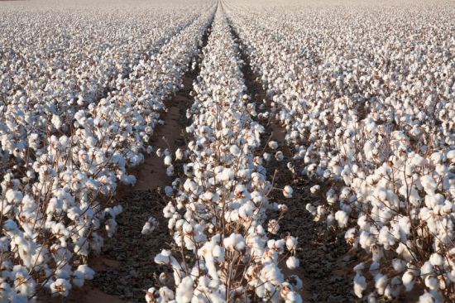
Promising Solution for Cropland in Georgia
Improved soil health enhances the long-term soil fertility for food production
Minimizes nutrient losses by maintaining soli cover with minimal soil disturbance/erosion
Decarbonizes the soil by crop rotation and leaving the residues in the soil.
Increased productivity is expected in some crops due to increased soil organic matter and results in lower food prices.
Source: UGA Extension

Slide 9









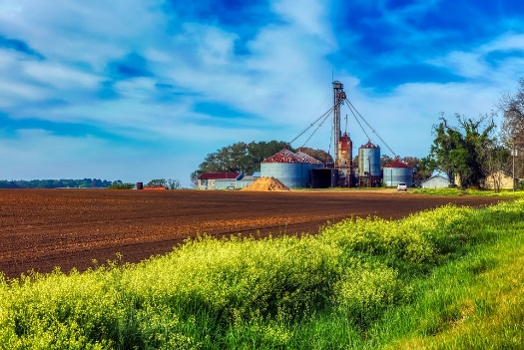
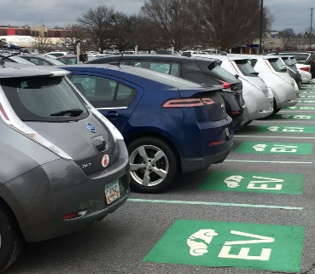
Corresponding author:
Dr. Sudhagar Mani
Professor, School of Chemicals, Materials, and Biomedical Engineering
University of Georgia
Phone: 706-542-2358
Email: smani@engr.uga.edu
0155F Riverbend Research Center North
110 Riverbend Road, Athens, GA, 30602

