Slide 1
IGERT
Energy Materials
& Policy
SOLAR PV SYSTEMS
Setting the stage by Georgia Tech NSF IGERT Faculty: --Professor Dan Matisoff, School of Public Policy --Professor Martha Grover, Chemical and Biomolecular Engineering Research results presented by Georgia Tech NSF Fellows: Materials and Systems: --Michael McBride, Chemical and Biomolecular Engineering --Rebecca Hill, Chemistry and Biochemistry --Matt Smith, Materials Science and Engineering Policy and Economics: --Ross Beppler, School of Public Policy
Forum and Celebration of Energy Transitions

Slide 2
Solar Economics and Policy
Trends and Implications
Daniel Matisoff
Associate Professor

Slide 3
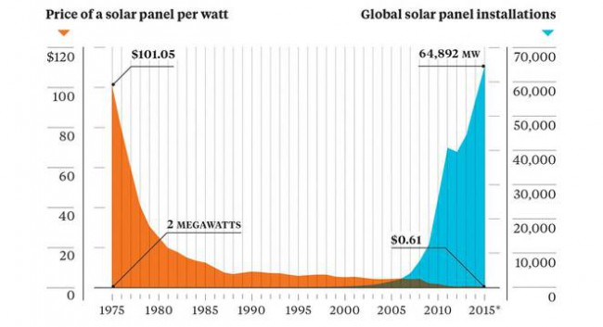
Dropping Solar Costs

Slide 4
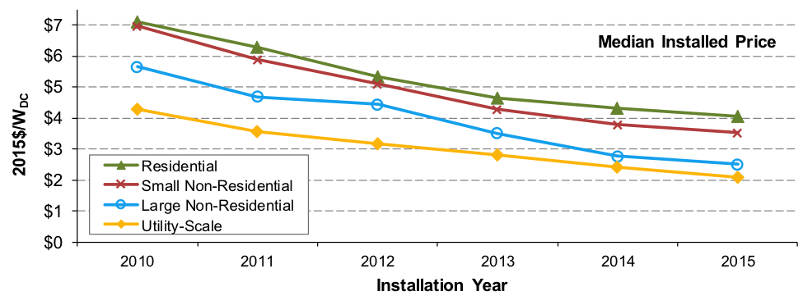
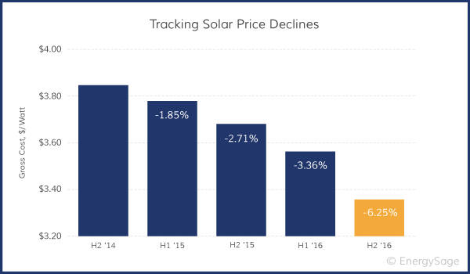
Panel costs vs. Balance of Systems
Decreasing Panel Costs
Efficiencies in Balance of Systems
Decreases in Soft Costs
Financing Innovations
Price decreases have continued to decrease rapidly!

Slide 5
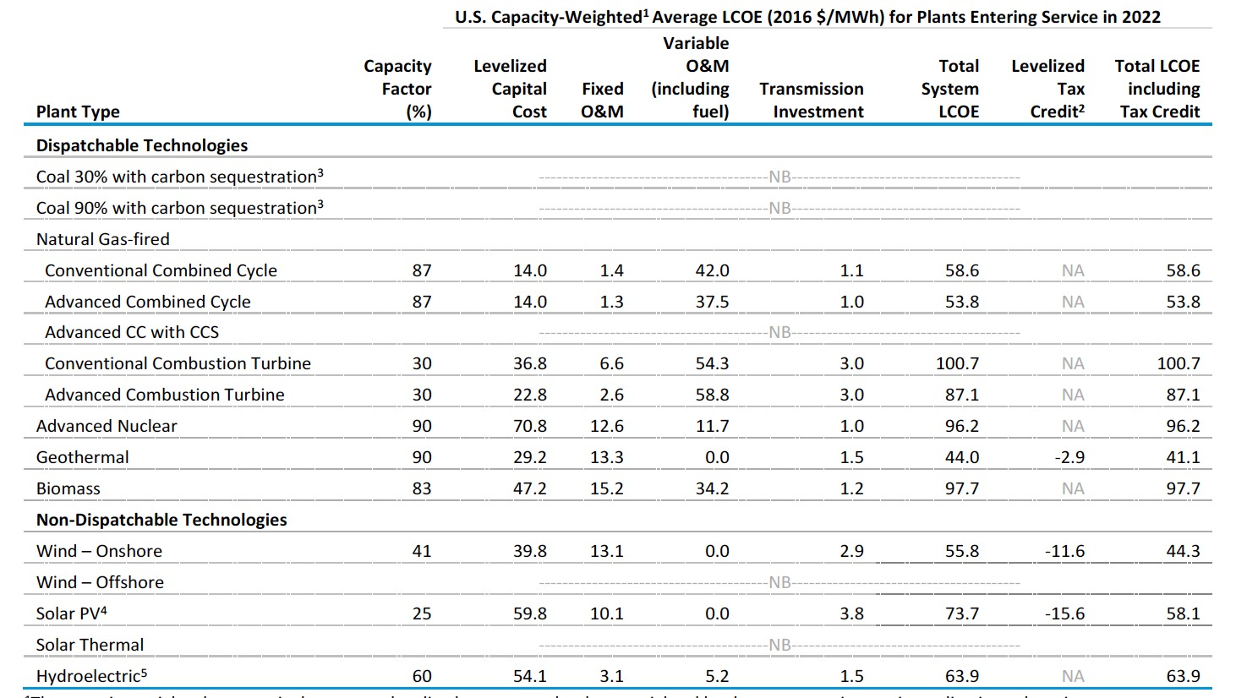
Competitiveness of Renewable Costs

Slide 6
But despite Favorable prices, policy can Either help or hinder

Slide 7
Key Policy Issues
Solar incentives
30% Federal Tax Credit
Many state level incentives
Net Metering Policies
How to pay for distributed energy resources
Impacts on rates and bills
Implications for utility business model
Renewable Portfolio Standards
In the face of stagnant federal policy
The Adoption and Diffusion of Innovative Technologies

Slide 8
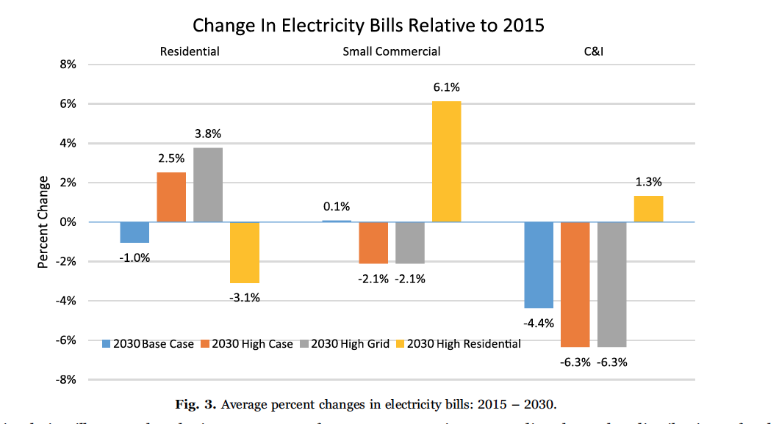
And IGERT efforts have Supported Research to answer these questions

Slide 9
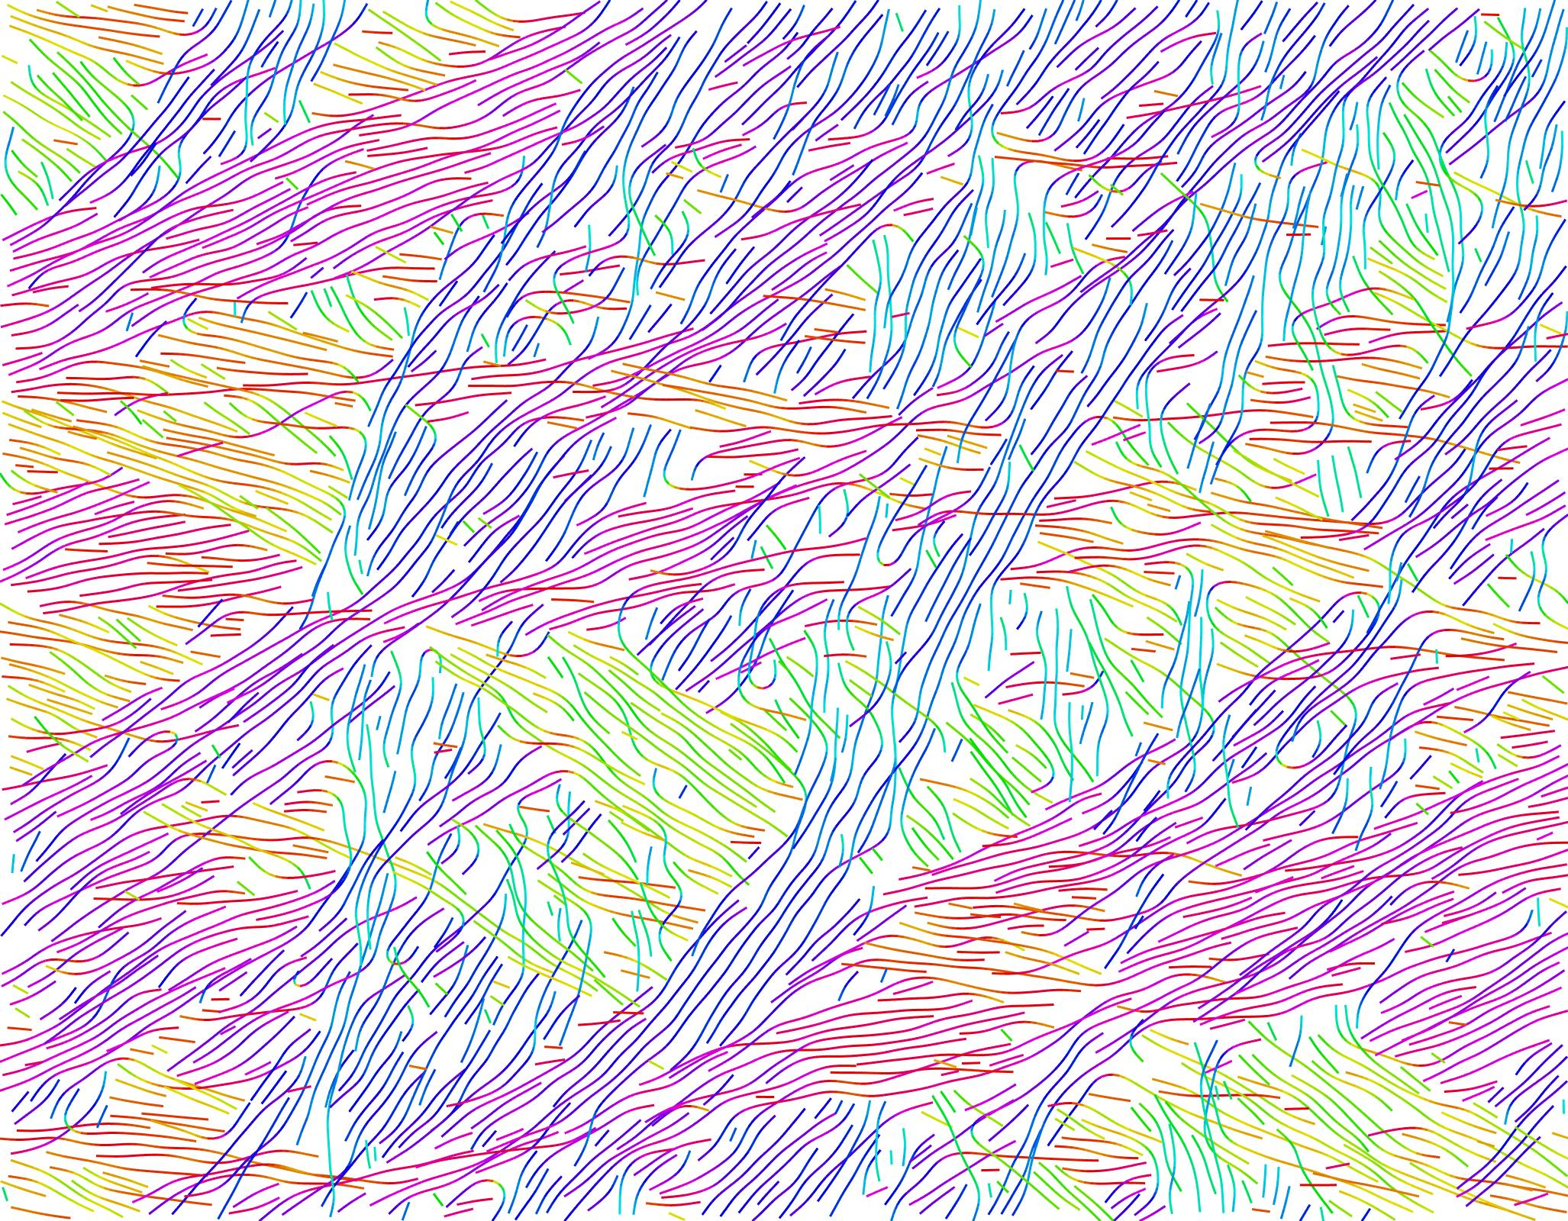

Process-Structure-Property Relationships
Nils Persson,
Michael McBride,
Elsa Reichmanis,
Martha Grover
Chemical & Biomolecular Engineering
Georgia Institute of Technology
Tuesday July 25th, 2017
Notes:
Materials Knowledge Extraction from Centralized Experimental Databases

Slide 10
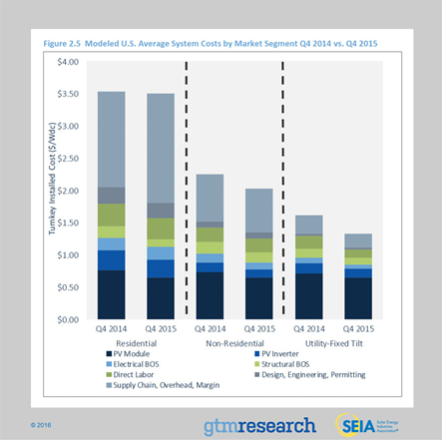
Module Costs are Significant

Slide 11
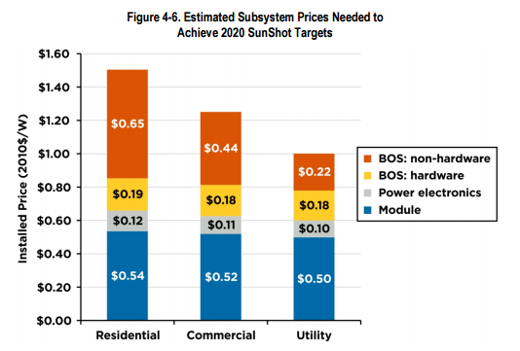
Module Costs Need to be Reduced

Slide 12
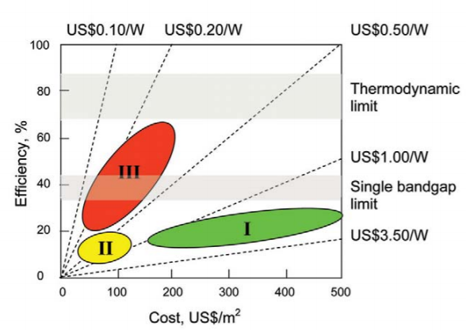
Solar Cell Technology Nodes
1st Generation: “Wafer Based”
Monocrystalline silicon
Polycrystalline Silicon
2nd Generation: “Thin Films”
Copper Indium Gallium Selenide
Cadmium Telluride
Amorphous Silicon
3rd Generation: “Advanced Materials”
Organic Photovoltaics (OPV)
Perovskites
Quantum Dot Solar Cells
Dye Sensitized Solar Cells
G. Conibeer, “Third-Generation Photovoltaics,” Materials Today, vol. 10, no. 11, Nov. 2007.

Slide 13
Approach
Employ all sources of information available to extract knowledge
Emphasis on process-structure relationship
Apply manual text mining to the scientific literature
  Give structure to unstructured data
  What a Watson-style text miner would do in an ideal case
Data extraction from figures for property values
Enable better searching and filtering of literature results
Sumpter, B. G.; Vasudevan, R. K.; Potok, T.; Kalinin, S. V. “A Bridge for Accelerating Materials by Design,” Computational Materials 2015.
Potyrailo, R.; Raja, K.; Stoewe, K.; Takeuchi, I; Chisholm, B.; Lam, H. “Combinatorial and High-Throughput Screening of Materials Libraries: Review of State of the Art,” ACS Combinatorial Science 2011.

Slide 14
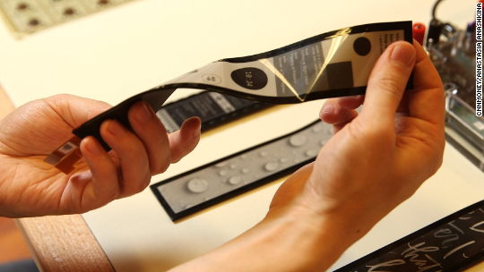



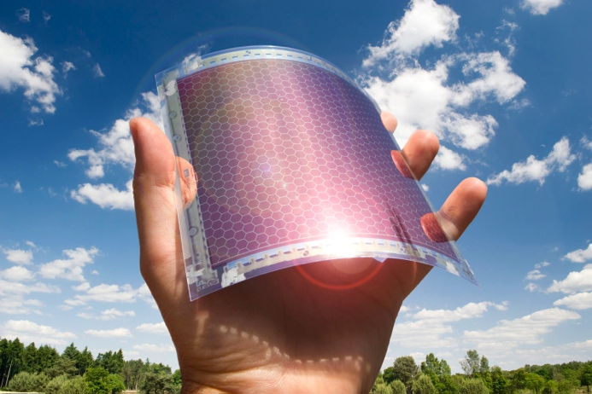
Large area, flexible electronic devices
Images: CNN Money, Blah, blah! Technology, Progress Lighting, International Business Times, Business Korea

Slide 15
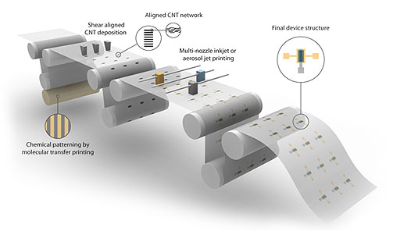

Roll-to-roll printing processes
MURI, University of Minnesota

Slide 16

The OFET
Field effect transistors (FETs) drive many electronics applications and provide a platform to study process-structure-property relationships.
Mobility (µ) is a model parameter fitted from electrical characterization that determines attainable switching frequencies in transistors.
V_{DS}
µ: Charge velocity/applied field
+
Organic Semiconductor-
P3HT
Source
Drain
Insulator – SiO₂
Gate – highly n-doped Si
V_{G}

Slide 17
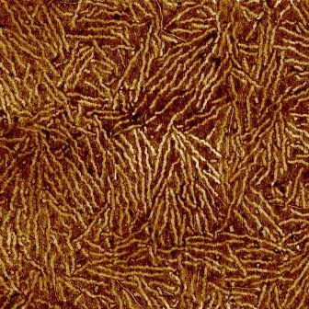
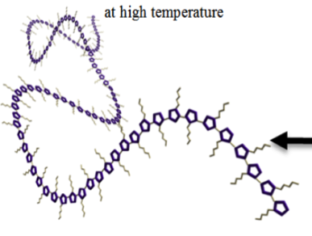
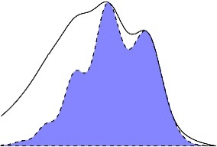
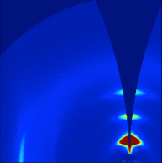
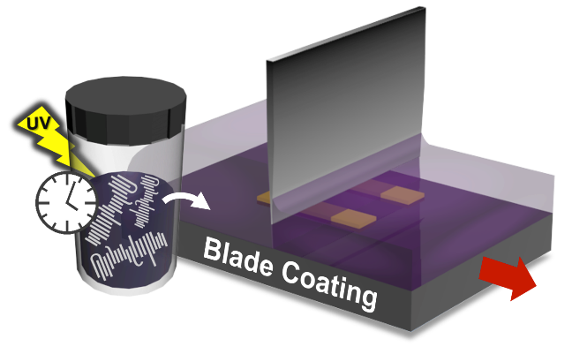
Solution Processing
Process
Structure
Property
P3HT – model semiconducting polymer
Charge Carrier Mobility (µ)
OFET
Johnson, C. E.; Gordon, M. P.; Boucher, D. S. “Rationalizing the Self-Assembly of Poly-(3-hexylthiophene) Using Solubility and Solvachromic Parameters,” Journal of Polymer Science: Polymer Physics 2015.

Slide 18

The OFET Database
Electrical Properties
OFET
Solution Treatment
Device Architecture
Material
Deposition
Post-Processing
Characterization
Number Average Molecular Weight (M_{n})
Polydispersity (PDI)
Regioregularity (RR)
Initial Concentration
Solvents:
- Volume Fractions
- Boiling Point
- Hansen Radius
Aging Time/Temp.
Sonication Time
UV Irradiation Time
Cooling Regimen
Substrate Treatment
Deposition Method
Spin Coated:
- RPM
- Time
Dip Coated:
- Dip Rate
- Time
Blade Coated:
- Velocity
- Temperature
Film Thickness
Environment (N₂/Air)
Annealing Time
Annealing Temp.
Film Thickness
Electrode Configuration
Electrode Material
Channel Length
Channel Width
Mobility
Mobility Regime
Environment
Many process parameters influence mobility
Reporting is generally incomplete
What can we learn?
Persson, N.; McBride, M.; Grover, M. A.; Reichmanis, E. Current Opinion in Solid State and Materials Science 2016, 20, 338–343.

Slide 19
The OFET Database
Author/Year | Aiyar 2011 | Bielecka 2011 | Chang 2013 | Park 2014 | Verilhac 2006
Mn (kD) | 24 |  | 40.3 | 24 | 27
Mw (kD) | 47.7 | 65.5 | 91.5 | 47.7 | 60.8
PDI | 2.0 |  | 2.27 | 2.0 | 2.25
R.R. (%) | 93 | 96.6 | 92 | 92 | 98
Solvent | CHCl3 | CHCl3 | CHCl3 | CHCl3 | CHCl3
Init. Conc. (mg/mL) | 4 | 10 | 5 | 3 | 2
Substrate Treatment |  |  |  |  | HMDS
Deposition Method | Spin-coated | Spin-coated | Spin-coated | Spin-coated | Spin-coated
Spin Rate (rpm) | 1500 | 900 | 1500 | 2000 | 300
Spin Time (s) |  |  | 60 | 60 | 30
Processing Environment | Air | Air | Air | N2 | Air
Mobility Environment | Air | Vacuum | N2 | Vacuum | N2
Mobility Regime | Linear | Saturation | Saturation | Linear | Saturation
Electrode Configuration | BGBC | BGBC | BGBC | BGBC | BGBC
Electrode Material | Au | Au | Au | Au | Au
Channel Length (µm) | 50 | 10 | 50 | 200 | 20
Channel Width (mm) | 2 | 10 | 2 | 0.5 | 9
Mobility (cm²/Vs) | 0.000202 | 0.00073 | 0.00423 | 0.005 | 0.0229
This study demonstrated the value of a searchable device data repository and the need for greater standardization.
Persson, N.; McBride, M.; Grover, M. A.; Reichmanis, E. Current Opinion in Solid State and Materials Science 2016, 20, 338–343.

Slide 20
The OFET Database
Challenges
How to maintain such a database with minimal effort from researchers?
How to extract more quantitative knowledge when information is composed of mixed data types?
Who hosts and pays for the data storage?

Slide 21


Process-Structure Relationships
Sonication + Poor Solvent
Microfluidic Processing + UV
Sonication + Aging
P3HT in chloroform
+ 2-methyl pentane
Spin coating
Choi et al., Adv. Funct. Mater. 2015, 25, 920–927
Kleinhenz et al., Chem. Mater. 2016, 28, 3905−3913
Wang et al., ACS Nano 2015, 9, 8220–8230

Slide 22
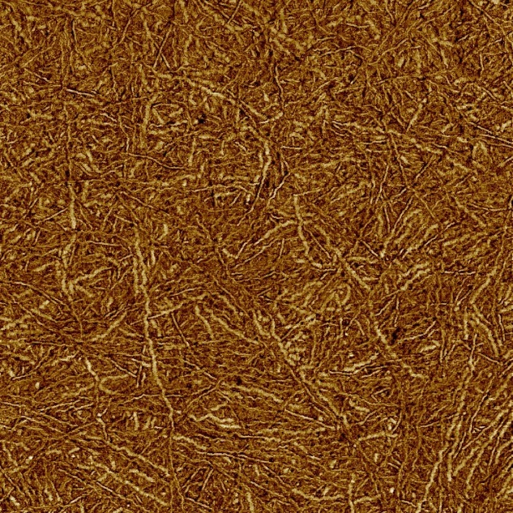
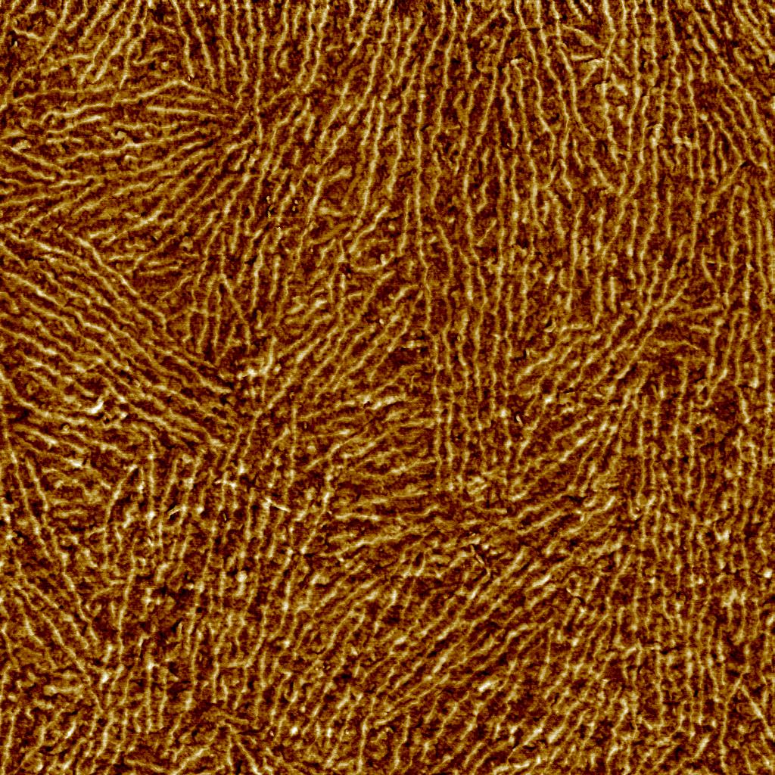
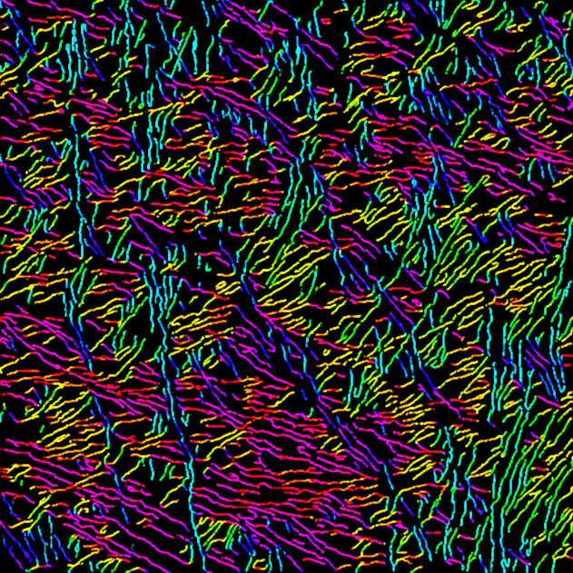
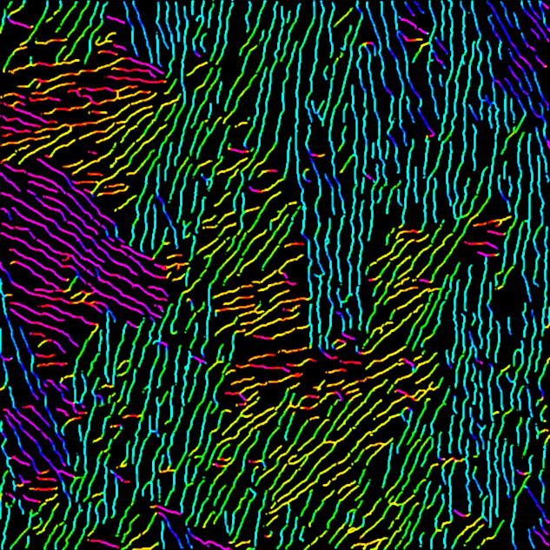
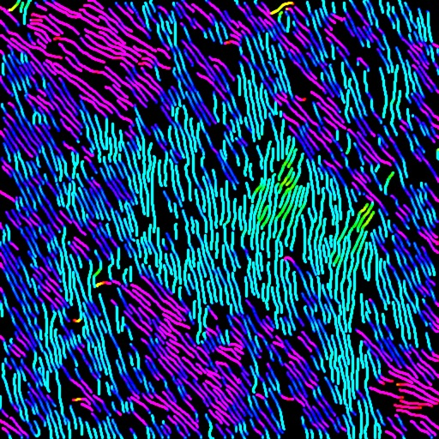

Process-Structure Relationships
Sonication + Poor Solvent
10.1°
Sonication + Aging
Microfluidics + UV
-13.8°
1 µm
90°
180°
0°
Persson, N.; McBride, M.; Grover, M. A.; Reichmanis, E. Chemistry of Materials 2016, 29, 3–14.

Slide 23
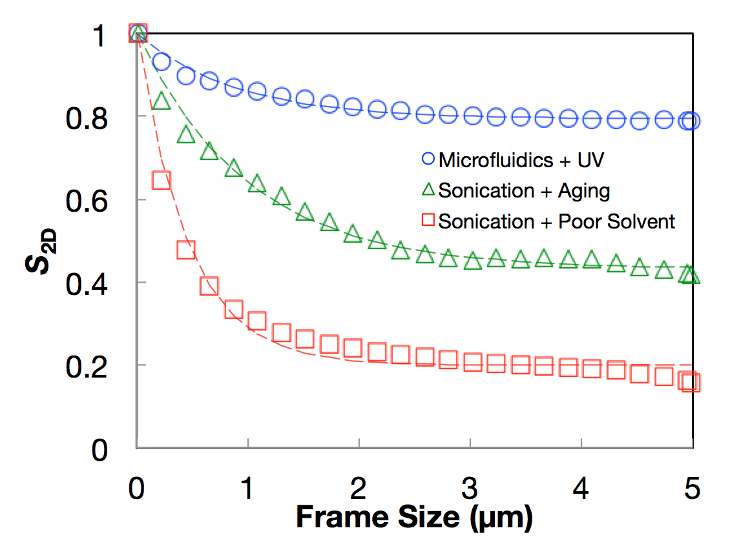
Process-Structure Relationships
Sonication + Poor Solvent
10.1°
Sonication + Aging
Microfluidics + UV
-13.8°
1 µm
 | S_{full} | λ_{C} (nm)
Microfluidics + UV | 0.79 | 886
Sonication + Aging | 0.45 | 977
Sonication + Poor Solvent | 0.20 | 434

Slide 24
Process-Structure Relationships
Sonication + Poor Solvent
10.1°
Sonication + Aging
Microfluidics + UV
-13.8°
1 µm
Solvent-phobic, retracted fringe chains
Extended, interacting fringe chains
Shish-kebab nuclei
Persson, N.; McBride, M.; Grover, M. A.; Reichmanis, E. Chemistry of Materials 2016, 29, 3–14.

Slide 25
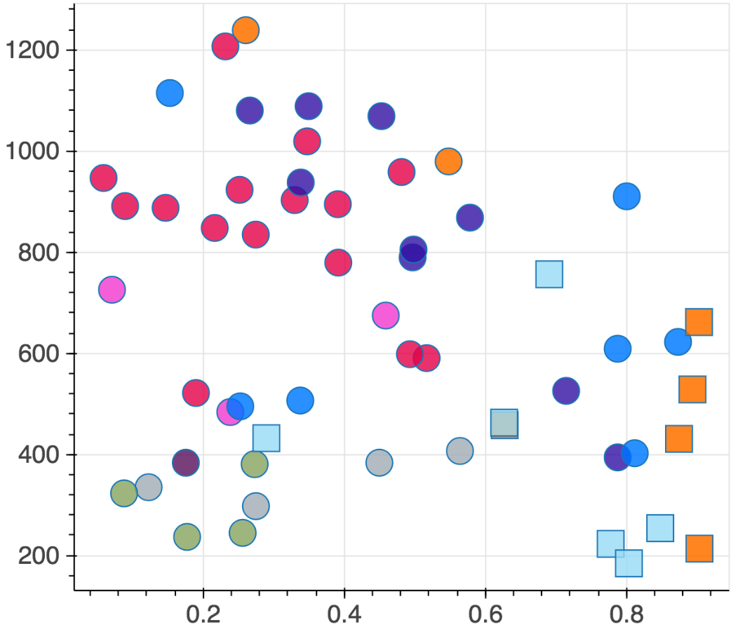
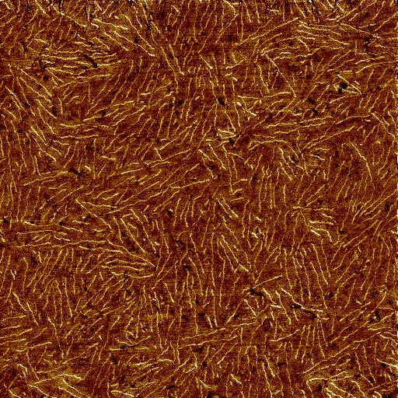
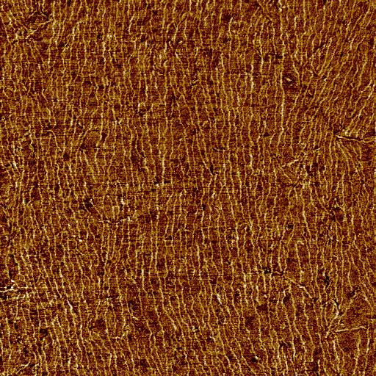
Visualization of Structural Parameters
Deposition
Spun
Blade
Solution Process
Age
Son. + Age
Decay Length (nm)
Poor Solvent
Son. + Poor Solvent
Son. + UV
Microfluidic + UV
UV
UV + Age
S_{Full}

Slide 26
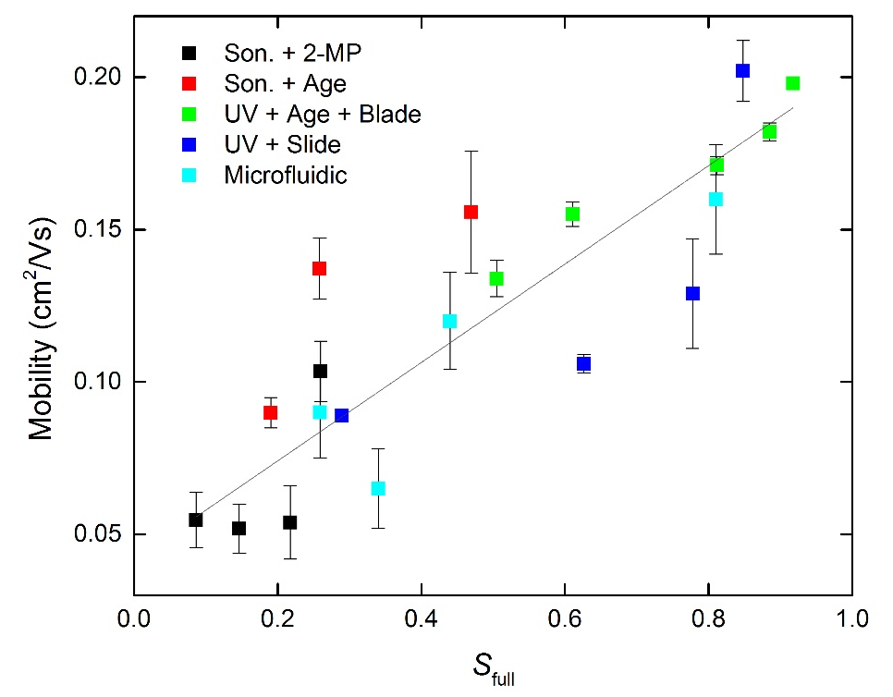
11.6°
Structure-Property Relationships
A general relationship emerged between fiber alignment and mobility.
A similar relationship was not found with UV-Vis and GIWAXS due to buried raw data and changing models.
A centralized database with version-controlled analysis could reveal more informative trends.
Note: All data is from the Reichmanis group.
Persson, N.; Chu, P.H.; McBride, M.; Grover, M. A.; Reichmanis, E. Accounts of Chemical Research 2017, DOI: 10.1021/acs.accounts.6b00639.

Slide 27
Conclusions
Centralized process-structure-property databases enable high level materials knowledge extraction
GTFiber automates fiber extraction and measurement from images
Orientational order is fundamentally linked with mobility and fiber growth in P3HT-based transistors
GTFiber: gtfiber.github.io
OFET Database: github.com/Imperssonator/OFET-Database

Slide 28
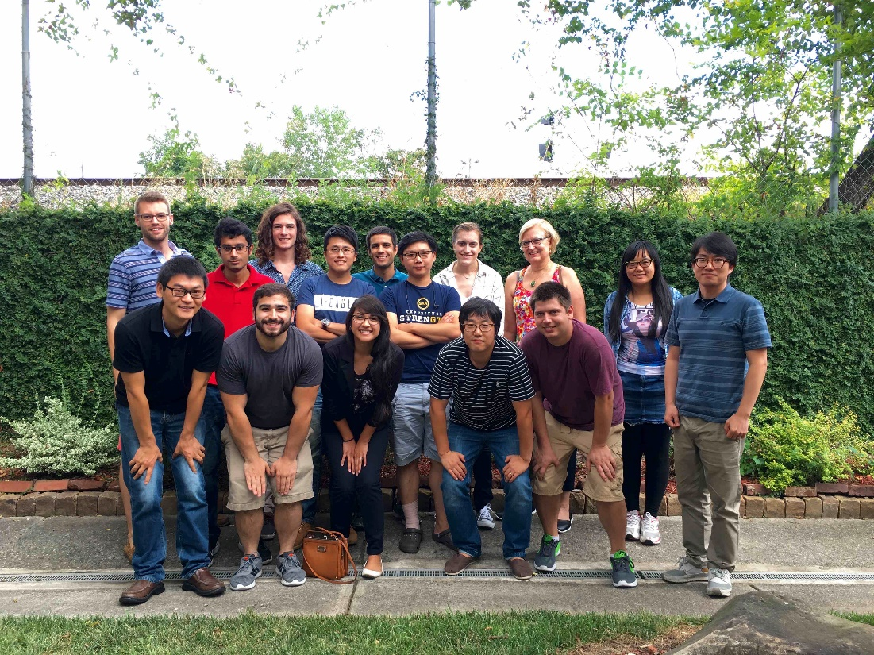

Acknowledgements
Mike McBride
Ping-Hsun Chu
Dr. Nabil Kleinhenz
Dr. Tony Fast
Dr. Gang Wang
Prof. Surya Kalidindi
Kaylie Naghshpour
Josh Rafshoon
Funding
NSF CBET-1264555, “Morphology and Mobility Control for Functional Robust Flexible Electronics and Photovoltaics”
NSF IGERT FLAMEL Traineeship
GA Tech IMAT Fellowship
FLAMEL IGERT

Slide 29
Thank you!

Slide 30
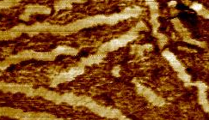
Transistor layout and thin film characterization
Source
Drain
50 nm gold electrodes
Atomic Force Microscopy (AFM) reveals fibrillar regions, their length and orientation.
Initial droplet placement
Gate on Backside
Source
Organic Semiconductor-
P3HT
Drain
P3HT
Channel length 50 µm
Insulator – SiO₂
Gold
Gate – highly n-doped Si
SiO₂
n-doped Si
Film thickness 20-40 nm

Slide 31
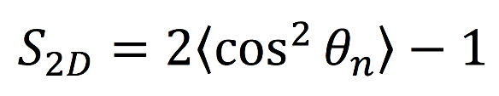
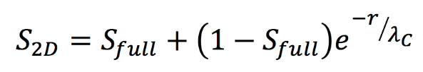
Quantifying Orientational Order
Director, n
Sampled frame from image
Angle, θ_{n}
λ_{C}
Fiber segment
S_{full}
Orientational Order Parameter for each frame
Model for the decay of orientational order with increasing frame size:
S_{full}: How aligned is the structure at long range?
λ_{C}: How quickly does alignment decay?
Persson et al., ACS Chem. Mat., 2016, accepted

Slide 32
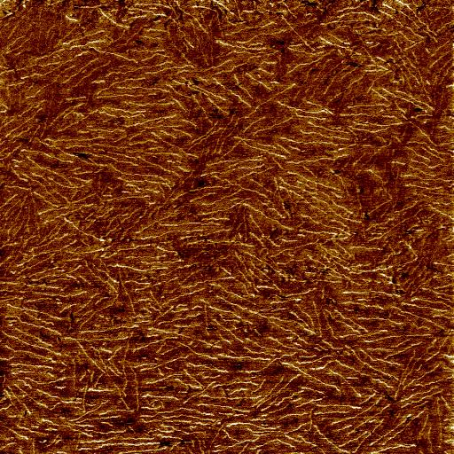
Effect of deposition method on fiber orientation
Spin coating
2 µm
Top
Spin direction and initial droplet size and position
Side
If the solution can be oriented, it follows the expected radial flow profile.
Persson et al., ACS Chem. Mat., 2016, In Press

Slide 33
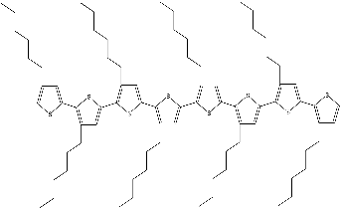
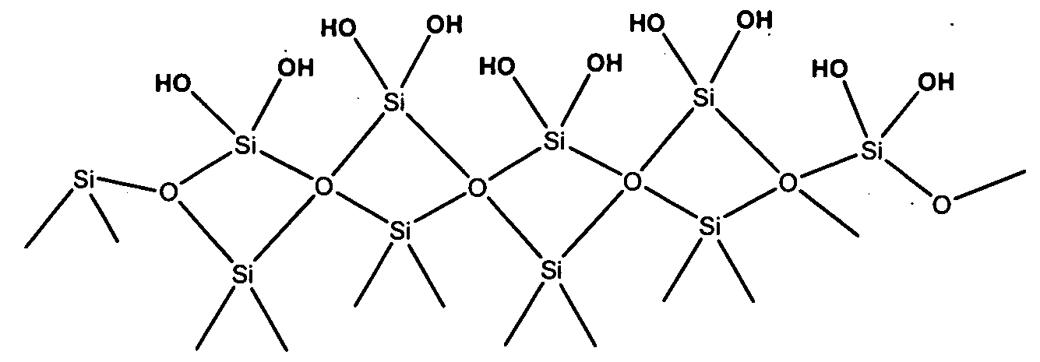
Inter-fiber connectivity
Au electrode
High mobility
(010)
Contact Point
(001)
Low mobility
(100)
Bridging Chain
Both local (λ_{C}) and global (S_{full}) orientational order influence charge transport. Local ordering promotes planarization of the P3HT backbone and inter-fiber connectivity, while global ordering reduces the number of grain boundaries charges must cross.

Slide 34

Introduction to Photovoltaic Technologies
Michael McBride
Chemical & Biomolecular Engineering
Tuesday, July 25th, 2017

Slide 35

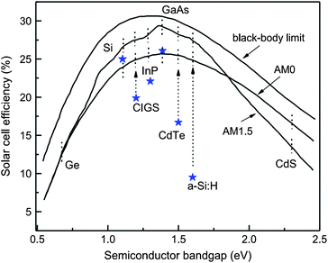
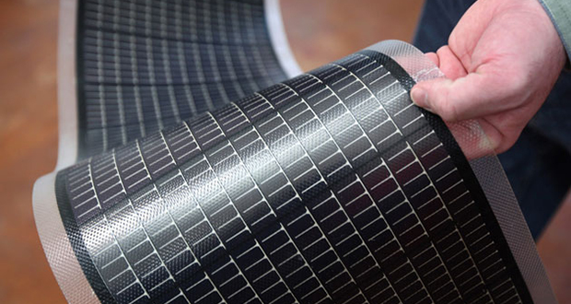
A Plethora of PV Materials

Slide 36
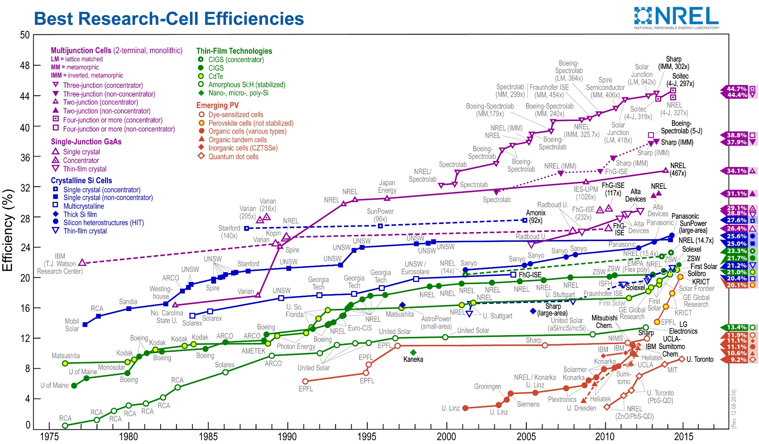

Slide 37
Solar Cell Technology Nodes
1st Generation: “Wafer Based”
Monocrystalline silicon
Polycrystalline Silicon
2nd Generation: “Thin Films”
Copper Indium Gallium Selenide
Cadmium Telluride
Amorphous Silicon
3rd Generation: “Advanced Materials”
Organic Photovoltaics (OPV)
Perovskites
Quantum Dot Solar Cells
Dye Sensitized Solar Cells

Slide 38
Solar Cell Technology Nodes
1st Generation: “Wafer Based”
Monocrystalline silicon
Polycrystalline Silicon
2nd Generation: “Thin Films”
Copper Indium Gallium Selenide
Cadmium Telluride
Amorphous Silicon
3rd Generation: “Advanced Materials”
Organic Photovoltaics (OPV)
Perovskites
Quantum Dot Solar Cells
Dye Sensitized Solar Cells

Slide 39
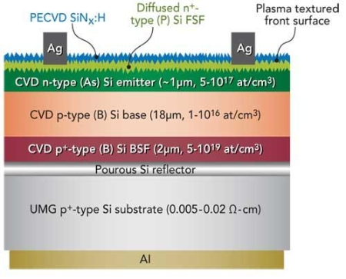
The Silicon Solar Cell
Expensive processing cost
Wasteful
  ~50% of silicon material is lost during manufacturing
Limited light absorbance
  Band gap=1.1 eV
Potential for higher balance of system costs (BOS)

Slide 40
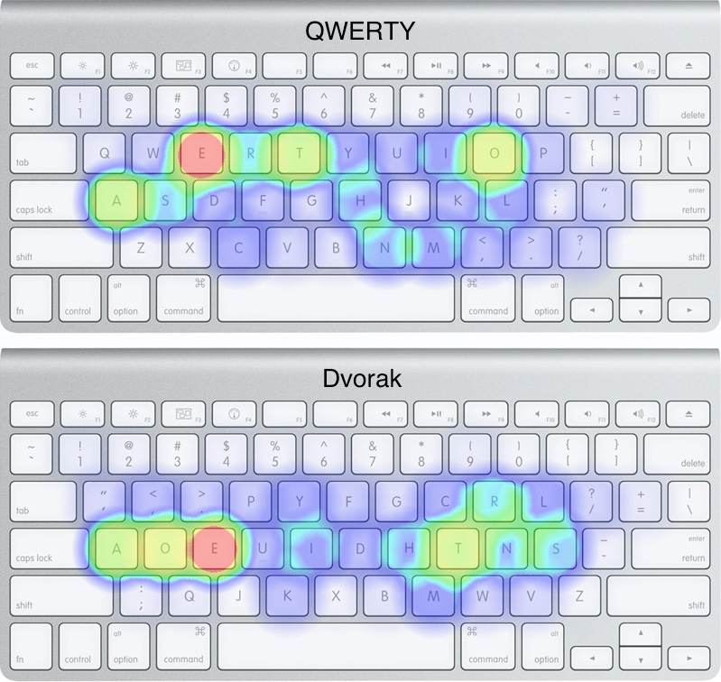
Prevalence of Silicon PV Systems
Path Dependent Technologies
History of technology matters

Slide 41
Prevalence of Silicon PV Systems
Technological Momentum
Time
Technological Determinism
Social Determinism
When a new technology emerges, society can deliberately control usage
As technology matures, society is modified itself by technology

Slide 42
Solar Cell Technology Nodes
1st Generation: “Wafer Based”
Monocrystalline silicon
Polycrystalline Silicon
2nd Generation: “Thin Films”
Copper Indium Gallium Selenide
Cadmium Telluride
Amorphous Silicon
3rd Generation: “Advanced Materials”
Organic Photovoltaics (OPV)
Perovskites
Quantum Dot Solar Cells
Dye Sensitized Solar Cells

Slide 43
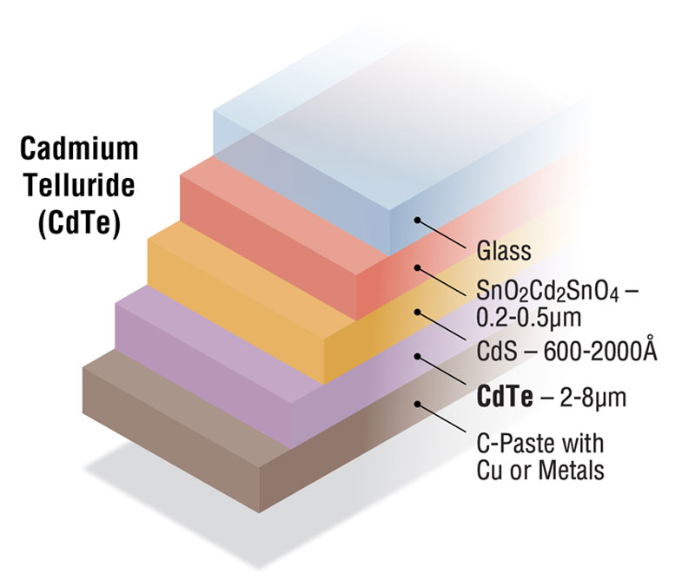
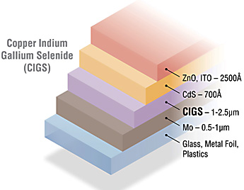
2nd Generation Devices Provide Opportunity for Cost Effective Production
 |  | Efficiency (%)
Gen. | Node | Theo. Max | Best R&D | Typical Module | Bottom-Up cost (2015$/W) | Degradation Rate (%/yr) | EPBT (yrs)
1st | C-Si | 29 | 27.6 | 18 | 0.74 | 0.65 | 1.7-2.7
2nd | CIGS | 29 | 20.3 | 13 | 0.67 | 0.85 | 1.5-2.2
2nd | CdTe | 29 | 17.3 | 12 | 0.51 | 0.85 | 0.8-2.1
2nd | a-Si | 20 | 12.5 | 10 | - | 1.15 | 1.8-3.5

Slide 44
Health and Safety Concerns
Cadmium
Kidney Damage
Bone Damage
Cancer
Reproductive hormones
Regulated by:
EPA
-Clean Air Act
-Toxic Substance Control Act
-Water standards
-Soil standards
OSHA
-Exposure limits

Slide 45
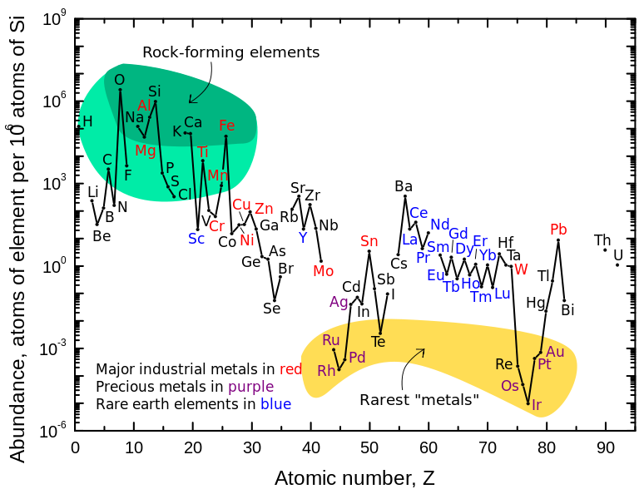
Material Availability

Slide 46
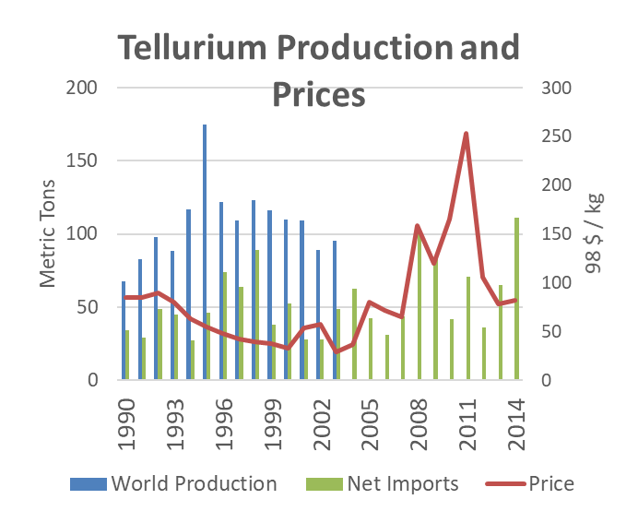
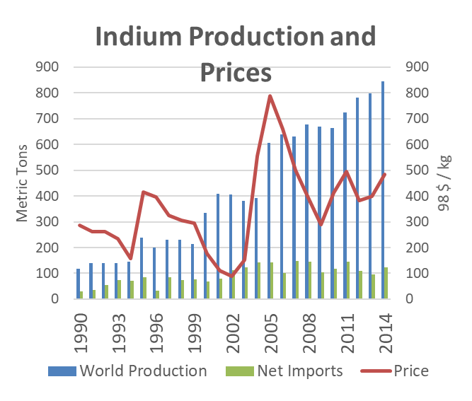
Production & Prices
Import Sources (2011–14): Canada, 21%; China, 16%; Belgium, 15%; Republic of Korea, 10%; and other, 38%.
Import Sources (2011–14): Canada, 59%; China, 21%; Philippines, 9%; Belgium, 9%; and other, 2%

Slide 47
Solar Cell Technology Nodes
1st Generation: “Wafer Based”
Monocrystalline silicon
Polycrystalline Silicon
2nd Generation: “Thin Films”
Copper Indium Gallium Selenide
Cadmium Telluride
Amorphous Silicon
3rd Generation: “Advanced Materials”
Organic Photovoltaics (OPV)
Perovskites
Quantum Dot Solar Cells
Dye Sensitized Solar Cells

Slide 48
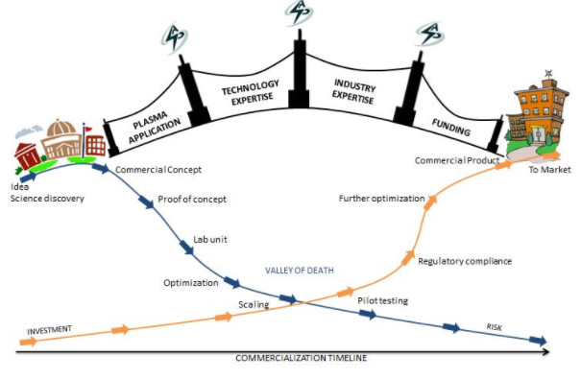
New Product Development Cycles
Advanced Plasma Solutions, 2017

Slide 49
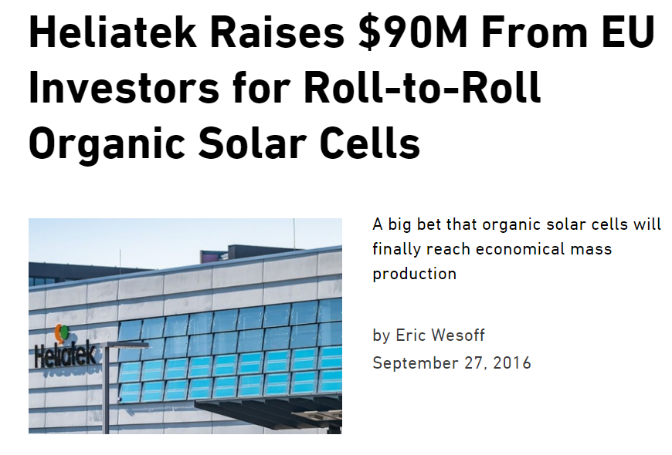
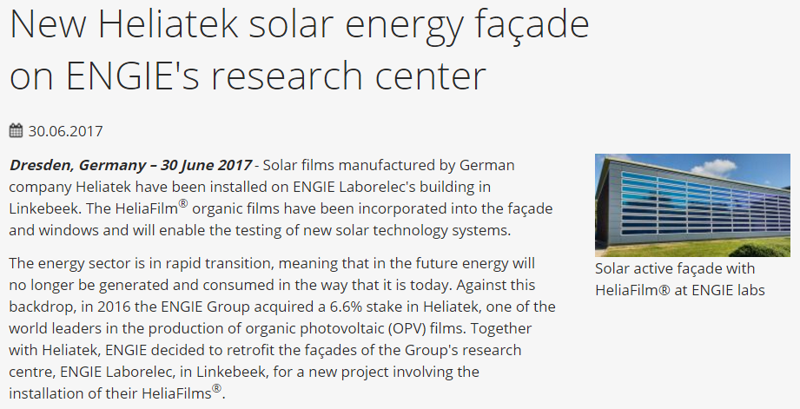

Slide 50
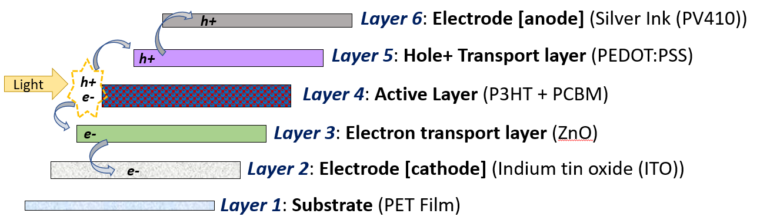
The Organic Photovoltaic Sandwich

Slide 51
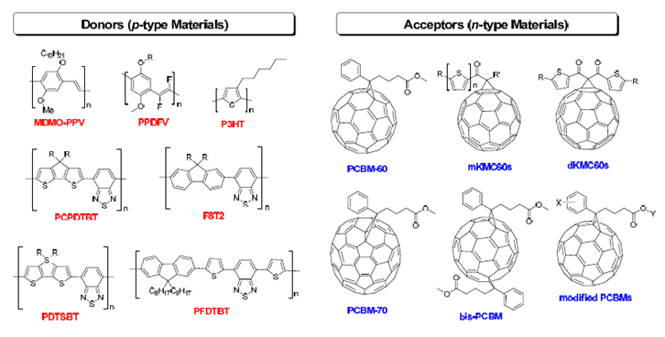
Technical Issues with Organic Photovoltaics
Degradation
  Heat and moisture
Low efficiency
Scale up feasibility
Material availability
Halogenated solvents

Slide 52


Slide 53

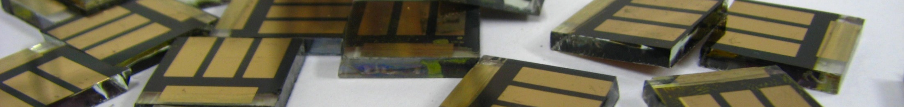
Hybrid Organic–Inorganic Photovoltaics
Rebecca Hill
IGERT Review
July 25, 2017

Slide 54

Hybrid Organic-Inorganic Photovoltaics (HOPV)
Inorganic quantum dots used as sensitizer or in active layer: quantum dot solar cells
Metal oxide used as electron transporting layer (ETL) with organic active layer or sensitizer: organic or dye-sensitized solar cells
Hybrid organic-inorganic crystal used as the active layer: perovskite solar cells
(1) Romande Energie. EPFL News Mediacom. Lausanne, Switzerland May 11, 2013. (2) Adikaari, A. A. et al. IEEE J. Sel. Top. Qu. Electr. 2010, 16 (6), 1595–1606.
Notes:
(1)
Adikaari, A. A. D. T.; Dissanayake, D. M. N. M.; Silva, S. R. P. IEEE Journal of Selected Topics in Quantum Electronics 2010, 16 (6), 1595–1606.

Slide 55

Progress in Photovoltaics
(1) Photovoltaic Research | NREL https://www.nrel.gov/pv/ (accessed Feb 17, 2017).

Slide 56



Progress in Photovoltaics
(1) Photovoltaic Research | NREL https://www.nrel.gov/pv/ (accessed Feb 17, 2017).
Notes:
Dye-sensitized solar cells (DSSCs)
Increasing near-infrared absorption
Lead organo-halide perovskite solar cells
Modifying C₆₀ surface for decreased hysteresis

Slide 57

Dye sensitized solar cells

Slide 58

Dye-Sensitized Solar Cells
S*/S⁺
S/S⁺
With modification from Hardin, B. E.; Snaith, H. J.; McGehee, M. D. Nature, 2012, 6, 162–169
Notes:
Basic operating principles
(1)
Snaith, H. J. Estimating the Maximum Attainable Efficiency in Dye-Sensitized Solar Cells. Advanced Functional Materials 2010, 20 (1), 13–19 DOI: 10.1002/adfm.200901476.
1.
Snaith, H. J. Estimating the Maximum Attainable Efficiency in Dye-Sensitized Solar Cells. Advanced Functional Materials 20, 13–19 (2010).

Slide 59
Photovoltaic device parameters
Abbotto, A.; Manfredi, N. Dalton Trans. 2011, 40, 12421. http://www.mibsolar.mater.unimib.it/
Notes:
The incident photon to current conversion efficiency (IPCE) is a measurement of the photocurrent density produced under monochromatic illumination divided by the photon flux, basically the electrons out over the photons in.

Slide 60

Increasing Power Conversion Efficiency
 | V_{oc} [V] | J_{sc} [mAcm⁻²] | FF | η [%]
Theoretical (λ_{onset}= 940 nm) | 0.92 | 30.8 | 0.73 | 20
SM315 | 0.91 | 18.1 | 0.78 | 13
SM315, Feb 2014
Red-shifted absorption onset
Increased Jsc
Decreased recombination
[1].
Notes:
ΔG_{rn} = 0.5ΔG_{diss} – F × [E(A^{0/–}) – E(M^{+/0})]

Slide 61

Squaraine sensitizers for DSSCs
Red-shift λ_{max}
Increase high energy absorption
Absorption spectra of YR6 in ethanol (solid line) and on TiO₂ (dotted line).¹
(1) Shi, Y. et al. Angew. Chem., Int. Ed. 2011, 50, 6619.

Slide 62
Examining the Effect of the Donor

Slide 63
Examining the Effect of the Donor
in EtOH
on TiO₂
[[1] Hill, R.; Kang, X.; et al.; in preparation

Slide 64
Examining an Out-of-plane End Group

Slide 65
Examining an Out-of-plane End Group
in EtOH
on TiO₂
Hill, R.; Kang, X.; et al.; in preparation
Notes:
a) Absorption in ethanol solution, b) absorption when adsorbed on mesoporous TiO₂, c) photovoltaic device current-voltage curves, and d) IPCE plots of devices from squaraine dyes YR6 (IndSq-T-CAA) and IH1 (Mes-IndSq-T-CAA).

Slide 66
Out-of-plane Groups and the π-bridge
Notes:
a) Absorption in ethanol solution, b) absorption when adsorbed on mesoporous TiO₂, c) photovoltaic device current-voltage curves, and d) IPCE plots of devices from squaraine dyes RH1, RH3, and RH4

Slide 67
Out-of-plane Groups and the π-bridge
in EtOH
on TiO₂
Hill, R.; Kang, X.; et al.; in preparation

Slide 68
Future challenges
Understand origin of low fill factor and open circuit voltage
 | V_{oc} [V] | J_{sc} [mAcm⁻²] | FF | η [%]
Theoretical (λ_{onset}= 940 nm) | 0.92 | 30.8 | 0.73 | 20.3
RH4 | 0.68 | 21.1 | 0.67 | 9.6

Slide 69

Lead Organo-halide Perovskite Solar Cells
Perovskite used as active layer
  Absorbs light to ~800 nm
  Hole and electron transport
Au
Spiro-MeOTAD
CH₃NH₃PbI_{3-x}Cl_{x}
Mesoporous TiO₂
Compact TiO₂
FTO
Glass
Song, Z.; Watthage, S. C.; Phillips, A. B.; Heben, M. J. J. Photon. Energy 2016, 6 (2), 022001.
Notes:
(1)
Song, Z.; Watthage, S. C.; Phillips, A. B.; Heben, M. J. J. Photon. Energy 2016, 6 (2), 022001–022001.

Slide 70
Perovskite Solar Cell Architecture Evolution
Au
Spiro-MeOTAD
CH₃NH₃PbI_{3-x}Cl_{x}
Mesoporous Al₂O₃
Mesoporous TiO₂
Compact TiO₂
Compact TiO₂
FTO
Glass
Mesoporous TiO₂ ETL
Mesoporous Al₂O₃ ETL
Planar TiO₂ ETL
C₆₀
Planar C₆₀ ETL
Notes:
Need to add reference in prep

Slide 71
Fullerene-amine reactivity
Ramírez-Calera, I. J.; Meza-Laguna, V.; Gromovoy, T. Y.; Chávez-Uribe, M. I.; Basiuk, V. A.; Basiuk, E. V. Appl. Surf. Sci. 2015, 328, 45–62.
Notes:
Need to add reference in prep

Slide 72
Evidence of bond formation
Covalent binding
XPS N 1s peak (in navy blue), and deconvoluted peaks assigned to the protonated or hydrogen bonded amine, the primary amine, and the fullerene-bound amine.
Notes:
Need to add reference in prep

Slide 73

Work function shift
UPS secondary electron edge cutoffs.
Notes:
Need to add reference in prep

Slide 74


Solar cell device data
Increased average power conversion efficiency (PCE)
Decreased hysteresis
No amine
Optimal amount of amine
(J-V) curves of the best device employing C60-PAA ETLs.
Notes:
Need to add reference in prep

Slide 75

Acknowledgements
Georgia Tech
Prof. Seth R. Marder
Dr. Timothy C. Parker
Dr. Stephen Barlow
Dr. Junxiang Zhang
Iryna Davydenko
Marder lab members
Prof. Jean-Luc Brédas
Dr. Paul Winget
Brédas lab members
Prof. Mostafa El-Sayed
Dr. Xiongwu Kang
Dr. Paul Szymanski
Daniel O’Neil
University of Oxford
Prof. Henry Snaith
Dr. Nakita K. Noel
Dr. Maximillian Hoerantner
Konrad Wojciechowski
POSTECH
Prof. Taiho Park
Seulki Song
Kyoungwon Choi
EPFL
Prof. Anders Hagfeldt
Dr. Juan-Pablo Correa-Baena
Silver Hamill Turren-Cruz
Wolfgang Tress
EPFL
Prof. Anders Hagfeldt
Dr. M.K. Zakeeruddin
Dye-sensitized solar cells
Perovskite solar cells

Slide 76
Squaraine Sensitizer Modifications
Red-shift the main absorption band
Influence dye-dye and dye-electrolyte interactions
Notes:
Add bullet points with hypothesis for each (anticipated to limit aggre, etc)

Slide 77
Sample Squaraine Synthesis

Slide 78
IGERT
Energy Materials
& Policy
SOLAR PV SYSTEMS DEGRADATION AND MITIGATION
Power output loss in solar panels from field exposure Impact of climate on power loss Amorphous vs. silicon materials degradation Water cooling to mitigate power output losses (boosting)
Forum and Celebration of Energy Transitions

Slide 79


IGERT
Energy Materials
& Policy
Environmental Output losses
Dirty Solar Panels
Solar Panels Covered in Snow
Forum and Celebration of Energy Transitions

Slide 80



IGERT
Energy Materials
& Policy
Impact of Panel Temperature
Field studies show performance is temperature and technology dependent
Cadmium Telluride (CdTe) thin film technology
Forum and Celebration of Energy Transitions

Slide 81


IGERT
Energy Materials
& Policy
Impact of Panel Temperature
Forum and Celebration of Energy Transitions

Slide 82

IGERT
Energy Materials
& Policy
US Climate Zones
Climate Zones of the Continental United States
Hot & Dry
Hot & Humid
Cool & Humid
Forum and Celebration of Energy Transitions

Slide 83

IGERT
Energy Materials
& Policy
Climate Impact On Degradation
Forum and Celebration of Energy Transitions

Slide 84

IGERT
Energy Materials
& Policy
LCOE for Region and Technology
Forum and Celebration of Energy Transitions

Slide 85

IGERT
Energy Materials
& Policy
AMANZI SOLAR
Maximizing Solar Panel Performance
Forum and Celebration of Energy Transitions

Slide 86



IGERT
Energy Materials
& Policy
AMANZI SOLAR PROTOTYPE
COOLING WITH STORED WATER
Forum and Celebration of Energy Transitions

Slide 87


IGERT
Energy Materials
& Policy
SYSTEM BENEFITS
TEMPERATURE REDUCTION
CLEANING
THE AMANZI DIFFERENCE
CLEAN
DIRTY
2 PENDING PATENTS
Forum and Celebration of Energy Transitions

Slide 88
The Policy Implications of Solar Penetration
Ross Beppler
IGERT Fellow – Public Policy

Slide 89
Outline
Solar Policy History
Solar impacts on rates and bills
The state of the debate on solar
Rate design goals (equity; efficiency; rate design)
What is the “Value of Solar”
Barriers
Recommendations and conclusions

Slide 90


What IS Driving PV Installation?
Until recently the growth in PV was largely policy driven (tax credits, renewable portfolio standards, net metering…)
The price of PV has continued to decline to the point where some jurisdictions are approaching grid parity
Matisoff, Daniel C., and Erik P. Johnson. "The comparative effectiveness of residential solar incentives." Energy Policy 108 (2017): 44-54.
Notes:
Figure 1: There are a variety of different policy incentives used to support PV. At the federal level ITC… At the state and local level, much more variety of incentive offerings and magnitude of those incentives.
PV prices continued to decline in part driven by panels from east China. Suniva filed a petition with U.S. International Trade Commission calling for new tariffs (40c per watt) on solar cells and minimum prices for solar modules imported from around the globe
Figure 2: Not entirely driven by incentive amount, also by solar resource, state environmental attitudes, regulatory and utility policy…

Slide 91

Policy Incentives
In 2015 44 states had net-metering policies
22 states had renewable portfolio standards with solar or distributed generation provisions
Notes:
Net metering has been the biggest policy driver of rooftop solar and has become the subject of intense debate between utilities, the solar industry, regulators, etc.
With a net-metering policy in place production in excess of local consumption is credited at the retail rate. The retail rate is 2-3 times higher than the wholesale rate (the price at which utilities purchase electricity on the market in deregulated territories)
This leads to questions about cost recovery, cross-subsidies between participants and non-participants, and equity.

Slide 92


Utility “Death Spiral”
Fixed Cost Recovery – Utilities argue that solar adopters are not paying for the grid services that they still use
Even without net metering rooftop solar leads to an erosion of sales
Coupled with flat load growth utilities may have to raise rates to recover costs
Notes:
The death spiral is not a new idea, but it has seen a resurgence following faster than expected growth in distributed solar
A en vogue comparison is to the telecom industry, but I think its overstated. I don’t have a landline. Vast majority of solar adopters still need the grid (nighttime, cloudy, plus use the grid to distribute excess solar generation)

Slide 93



IGERT Funded REsearch
Base Case (5% solar) non-participant impacts are minimal
High Case (15% solar) significant cross-subsidies begin to develop
Johnson, E., Beppler, R., Blackburn, C., Staver, B., Brown, M., & Matisoff, D. (2017). Peak shifting and cross-class subsidization: The impacts of solar PV on changes in electricity costs. Energy Policy, 106, 436-444.
Notes:
% solar means total annual generation
At low penetrations of solar concerns may be overblown
Once you approach 15% then concerns begin to develop
Peak shifts which changes cost allocations
Start having to worry about significant ramp rates and bottom-outs in shoulder months

Slide 94
Policy Options
Goals: Economic efficiency, consumer equity, positive environmental and social impacts
Retail Rate Design – AMI provides the opportunity for more sophisticated rate designs which allow costs to be recovered outside the traditional volumetric (per kWh) charges
  Increased Fixed Charges
  Residential Demand Charges
  Minimum Bill
  Time-of- Use Pricing
  Alternative Class for Distributed Energy Resource Adopters
  Value of Resource Methodologies
Alternative Business Models –
  Community Solar
  Third-Party Ownership/Financing
  Rooftop Rental

Slide 95
Q: What is the Value of Solar?
A: Well… It depends.
Value of Solar to who? Solar adopters, utility ratepayers, utility, society at large?
What Benefits and Costs will be considered?
What techniques are used, assumptions made, and forecasts applied?
Component | Utility Scale |  | Distributed Generation
Avoided Fuel and Purchased Power Costs | Benefit |  | Benefit
Avoided Generation VO&M Costs | Benefit |  | Benefit
Avoided Environmental Compliance Costs | Benefit |  | Benefit
Deferred Generation Capacity Costs | Benefit |  | Benefit
Deferred Generation FO&M Costs | Benefit |  | Benefit
Reduced Transmission Losses (Energy Related) | Benefit |  | Benefit
Reduced Transmission Losses (Capacity Related) | Case by Case |  | Benefit
Deferred Transmission Investment | Case by Case |  | Benefit
Reduced Distribution Losses (Energy Related) | N/A |  | Case by Case
Distribution Operations Costs | N/A |  | Cost
Generation Remix | Cost or Benefit |  | Cost or Benefit
Ancillary Services – Reactive Supply and Voltage Control | N/A | Cost
Ancillary Services – Regulation | Cost | Cost
Support Capacity (Flexible Reserves) | Cost | Cost
Bottom Out Costs | Cost | Cost
Source: A Framework for Determining The Costs and Benefits of Renewable Resources in Georgia
Notes:
Some of these costs and benefits are very difficult to calculate particularly across a 30 year time horizon.
Some impacts are yet well understood / have yet to be develop i.e. for ancillary services
Other potential components: Environmental and Health benefits: externalities from air pollution and water consumption, Land use, Economic Development, Fuel Price Hedge (diversification benefits), market price mitigation, grid security / disaster recovery / resilience, program administration costs

Slide 96



Q: IF We Agree On All that Will We Know the Value of Solar?
A: Well… It still depends.
Where is the solar being installed (geographically and electrically)?
How much solar is already installed?
Do the solar installations use smart inverters?
What other DERs does the solar interact with it?
How’s the weather?
What time is it?
Smith, Jeff, et al. "Time and Location: What Matters Most When Valuing Distributed Energy Resources." IEEE Power and Energy Magazine 15.2 (2017): 29-39.

Slide 97
COST-Reflective Rates
An Economist’s Dream:
“Implement efficient rates which reflect both short- and long-run marginal costs and provide clear and separate price signals for the electricity commodity and delivery services, which have very different cost structures. Ensuring that customers receive price signals that reflect the costs that their use imposes on the different parts of the system will result in more optimal use patterns. More cost-reflective rates reduce system costs: Having electricity prices reflect costs gives customers the ability to reduce their electricity bills by changing their use patterns and investing in DERs. These responses will decrease overall costs in the long run.”
Convery, Frank J., Kristina Mohlin, and Elisheba Spiller. "Policy Brief—Designing Electric Utility Rates: Insights on Achieving Efficiency, Equity, and Environmental Goals." Review of Environmental Economics and Policy 11.1 (2017): 156-164.

Slide 98
Barriers
Path Dependence – Particularly in regulated markets pricing for service would be a huge transition.
Technology – need near complete deployment of AMI before wide-spread opt-out cost-of-service rates
Computational and Communication Capacity – do all utilities have the capacity to manage data flows, information storage, and cyber security concerns
Residential Acceptance – historically, consumers aren’t great at understanding electricity rates or responding to price signals
Political – Can rate redesign get through the public service commissions?
  Competing interest groups include large utility lobbies, solar installers, environmental groups, solar adopters…
Institutional – How to address legacy plants such as nuclear which may no longer be cost competitive in the services they provide

Slide 99

Going Forward
Recommendations:
Better data collection and sharing practices
Holistic approach to electric sector changes
Pilot programs
Local policy variability
Align utility incentives with customer and societal needs
Drivers of new utility business models. (source: AEEI)

Slide 100
Conclusions
More questions than answers
This is an area in which interdisciplinary collaboration is crucial. The issue is technically complex, involves many disciplines, and engenders concerns for both efficiency and equity.
The IGERT program at Georgia Tech provided the resources and opportunities to work on these issues.
There remains a lot of work to do.
Questions?

