Slide 1
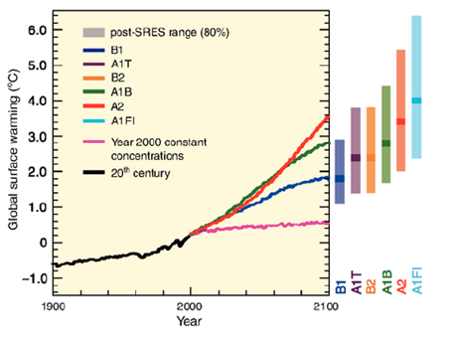
Policy Considerations for Adapting Power Systems to Climate Change
An examination of climate adaptation in other sectors and an exercise in modeling key considerations for adapting power
Alex Smith and Marilyn Brown
Georgia Institute of Technology
September 4, 2014
Energy Policy Research Conference
San Francisco, CA

Slide 2
What can Power Sector Resiliency Thinking Learn from Other Sectors?
Resiliency a new priority in utility thinking
Robustness to unforeseen changes – “disturbances”
In short-term trends, e.g. extreme weather
in long-term trends, e.g. average temperature
How do we model ever-more-uncertain futures?
Many utility resiliency analyses focus on large infrastructure projects, typical for utilities
E.g. PSE&G’s post-sandy grid hardening plan
Proposed as $3.9 Billion paid for in one year by ratepayers¹
Notes:
1. Lacey (2014)
Mention the vulnerability of the power sector to climate change
Mention the FEPS WG1 modeling philosophy of displaying the outcomes of “unforeseen” change
--”we should also consider work in other areas being done around the same subject...i.e. look at prior experience with climatic change”
Members of the FEPS Economics Working Group advocated the use of scenario modeling to “stretch the limitations” of popular thinking regarding the future of electric power, rather than simply forecasting expected trends.
“it is more important to develop scenarios that involve imperfect foresight to show the potential impact of hard-to-predict disturbances or sudden changes in trends affecting electric power systems”

Slide 3
Climate Adaptation Literature Calls for a Broad Focus in Assessing Potential Impacts
Prior experience in other sectors and other parts of the world offer lessons for future adaptation actions
Maladaptation: Large infrastructure investments can create “maladaptation” outcomes by
Constraining resources available for meeting future unforeseen challenges - imposing “path dependency”²
Discouraging individual actors from adapting³
Contributing to further climate change via GHG emissions⁴
Burdening those already most vulnerable, e.g. low-income ratepayers facing riders and tariffs for cost recovery⁵
Notes:
1. Barnett and O’Neil (2010)
2. Filatkova (2014)
3. Vine (2012)
4. NAPEE (2007)

Slide 4
Consideration of Local Knowledge and Other Policy Goals Also Important
Climate adaptation is a local problem, requiring local solutions, requiring local knowledge
Market-based instruments are lauded for promoting such knowledge integration^{3,6}
Command-and-control policies can also develop local knowledge by fostering innovation to meet standards⁷
But standards create risks of prescribing adaptive measures that do not universally work^{3,6}
Non-adaptive goals foster adaptive action
Much private adaptation measures taken due to co-benefits⁸
Much adaptation policy justified via economic development or resource management goal⁹
Notes:
Mention citations – include list of references at end, but don’t go into detail – just say e.g. “studies of tundra pastoralists responding to warming/cooling trends.” Give the key premise supporting each bullet point, and the citation in which that premise can be found
2. Filatkova (2014);
5. Saintilan et al. (2013)
6. Fu et al. (2012)
7. Tompkins (2010)
8. Aggarwal (2013)
“Thus adaptation measures will be evaluated with respect to non-adaptive goals”

Slide 5
Existing Tools can be Used to Account for these Important Considerations
Our study demonstrates one way of taking these adaptation considerations into account
We use an existing computable general equilibrium model, “GT_NEMS,” based upon EIA’s NEMS
We develop a scenario of demand disturbance representative of a potential effect of climate change
To the demand disturbance scenario, we introduce a measure expected to enhance adaptive capacity
We examine multiple outcomes from this scenario in order to assess the measure in light of the multiple considerations outlined by the climate adaptation literature
Notes:
The purpose of this exercise:
---to illustrate that existing tools can be used to answer the call by the adaptation literature to account for broader and more diverse considerations
---to inspire work toward doing more assessment of adaptation measures
---to reduce apprehension to adaptation assessments coming from a fear that current tools are inadequate

Slide 6
GT_NEMS Requires some Adjustment to Model Demand Disturbances
GT_NEMS is a computable general equilibrium model based upon EIA’s NEMS
Used to simulate US energy economy
Performs optimization in iterations until solutions converge
Reference case run matches AEO 2014 to greater than 99%
GT_NEMS uses “perfect foresight” in power planning, challenging disturbance modeling
Electric capacity built based upon expected demand
Actual outcomes of prior iterations are used as expected demand
Thus expectations of final iteration are “perfect” (match demand)
Thus, it is difficult to “surprise” GT_NEMS’ power sector model with unforeseen changes in demand
Notes:
Perfect Foresight = Default.
Solution: Perfect Foresight = 0
We use a table in a text file that allows you to tell the utilities what level of demand to expect when they’re making their capacity choices
It doesn’t have to be the level of demand they actually see in any year

Slide 7
We Introduce a Demand Disturbance and an Adaptive Measure to GT_NEMS
Substitute perfect expectations for “myopic” expectations of electricity demand growth
Base expectations upon prior two-year trend in demand
Overwrite myopic expectations with “under-expectations” of electricity demand growth
Use EIA’s Low Macroeconomic Growth case’s results as expectations
Average annual demand growth 0.5% less than in the reference case
Capacity planning thus expects less demand than it will encounter
Introduce “High Tech” assumptions as adaptive measure
EIA’s “Integrated High Efficiency Demand Technology” side case
Accelerated building code compliance for both residential and commercial buildings; across-the-board improvements in efficiency and cost-effectiveness of electricity end-use technologies¹⁰
Chosen in part because efficiency has been advocated for adaptation^{3,11}
Notes:
Perfect Foresight = Default.
Solution: Perfect Foresight = 0
We use a table in a text file that allows you to tell the utilities what level of demand to expect when they’re making their capacity choices
It doesn’t have to be the level of demand they actually see in any year
“The adaptation measure we choose to perform a preliminary assessment upon is a comprehensive improvement to US energy efficiency, represented by the assumptions for EIA’s Integrated High Demand Technology side case in the AEO2014. In this case, we use assumptions that reflect a greater push for energy efficiency in all sectors and through multiple means. Building code compliance increases beyond the reference case forecast. Fuel efficiency improvements are made for vehicles used to haul freight, e.g. trains, cargo airplanes, and freight trucks, and fuel economy improvement rates in passenger vehicles are also more optimistic. Building shell efficiencies for residential housing improve by 150% of the reference case improvements, meeting Energy Star standards by 2023. Commercial building shell efficiencies improve by 125% of the reference case value by the year 2040. Finally, several assumptions are made that accelerate the deployment, lower the costs, and increase the efficiency of equipment for the residential, commercial, and industrial demand sectors (US Energy Information Administration 2014, Table E1). “

Slide 8
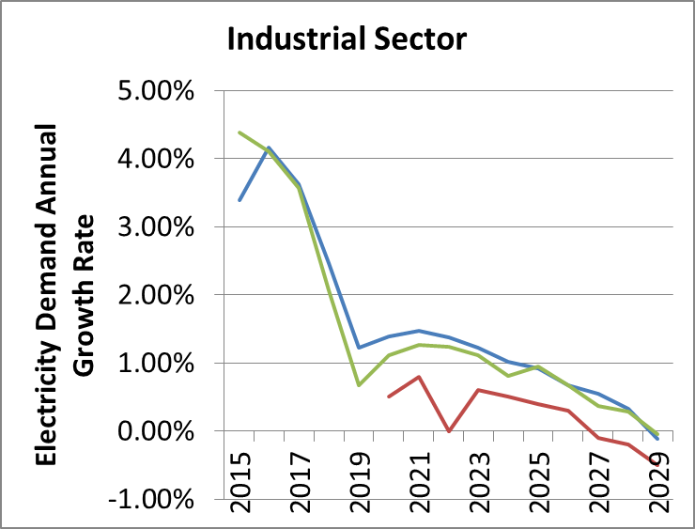
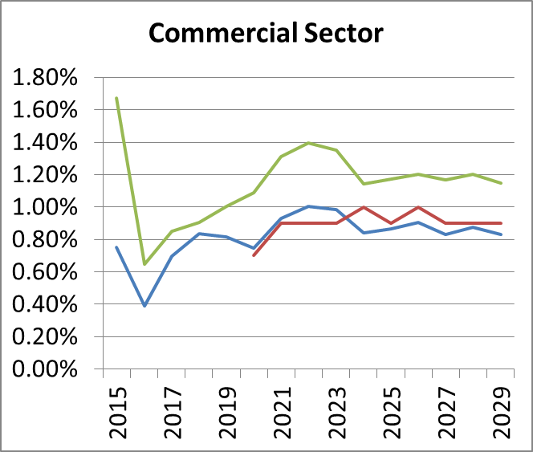
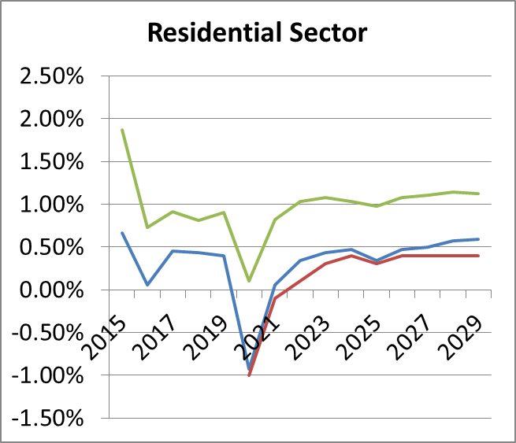
Reference Case Demand Exceeds Expectations, Creating Disturbance
Degree of demand under-expectation varies by sector
Uniform across nation; cannot program region-specific expectations
Gap between demand and expectations for the commercial and residential sectors are greater in the US South
Notes:
Cannot program regionally-specific expectations

Slide 9
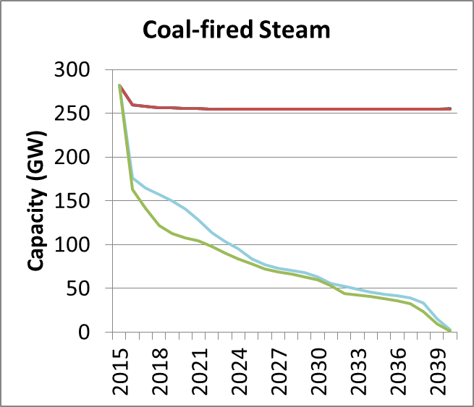
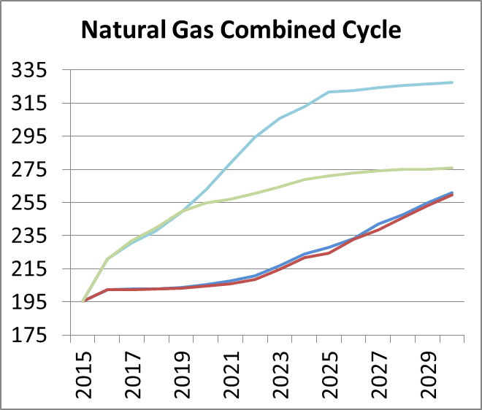
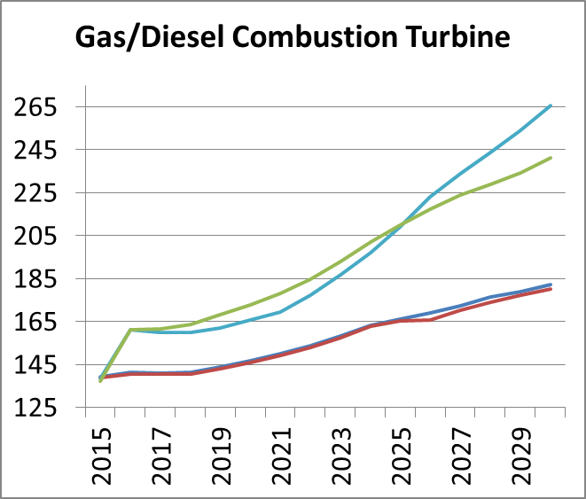
Disturbance Places Premium on Low-cost, Flexible-utilization Capacity Resources
Coal plants are rapidly retired and disappear by 2040, mostly due to the disturbance alone
Combined cycle and combustion turbines become preferred resources – ramping, low-cost capacity
Notes:
Cannot program regionally-specific expectations
The costs of capacity in NEMS put steam coal way above other resources – the switch is driven by the uncertainty of the disturbance scenario

Slide 10
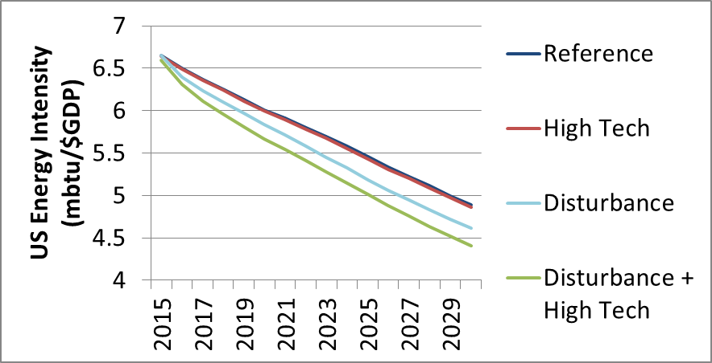
Disturbance Scenario Exhibits Improved Energy Efficiency of US Economy
Disturbance drives a ~5% decrease in energy intensity of US economy signaling improved
Notes:
For examining the influence of the measure upon incentives for individual adaptation…

Slide 11
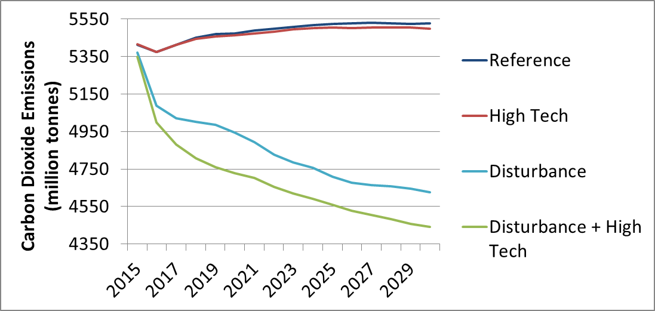
Disturbance Drives Reduction in Carbon Emissions, Augmented by Efficiency
Disturbance reduces carbon emissions, primarily caused by energy efficiency and fuel-switching; efficiency augments this effect
Notes:
For examining the maladaptation of exacerbating climate change…

Slide 12
Small Losses in Real GDP & Value of Shipments; Efficiency Helps Recovery
(Billion $2005) |  | Reference | High Tech | Disturbance | Disturbance + High Tech
Energy-Intensive Industries VOS | 2020 | 1,932 | 1,933 | 1,897 | 1,899
 | 2025 | 2,082 | 2,082 | 2,037 | 2,060
 | 2030 | 2,171 | 2,171 | 2,121 | 2,152
 | 2035 | 2,237 | 2,239 | 2,188 | 2,209
Non-Energy-Intensive Industries VOS | 2020 | 3,804 | 3,805 | 3,746 | 3,744
 | 2025 | 4,386 | 4,385 | 4,319 | 4,392
 | 2030 | 4,975 | 4,975 | 4,911 | 5,056
 | 2035 | 5,542 | 5,547 | 5,489 | 5,652
US Gross Domestic Product | 2020 | 16,753 | 16,758 | 16,681 | 16,662
 | 2025 | 18,770 | 18,772 | 18,676 | 18,727
 | 2030 | 21,136 | 21,143 | 21,032 | 21,147
 | 2035 | 23,747 | 23,758 | 23,619 | 23,733
Notes:
For examining the relevance of the measure toward economic development goals….

Slide 13
The Disturbance Increases Electricity Prices; Efficiency has Little Added Effect
($/kWh) |  | Reference | High Tech | Disturbance | Disturbance + High Tech
Residential Demand | 2020 | 0.1236 | 0.1232 | 0.1294 | 0.1315
 | 2025 | 0.1237 | 0.1232 | 0.1343 | 0.1348
 | 2030 | 0.1268 | 0.1264 | 0.1411 | 0.1418
 | 2035 | 0.1295 | 0.1291 | 0.1491 | 0.1481
Commercial Demand | 2020 | 0.1054 | 0.1050 | 0.1115 | 0.1122
 | 2025 | 0.1046 | 0.1042 | 0.1157 | 0.1141
 | 2030 | 0.1073 | 0.1069 | 0.1217 | 0.1216
 | 2035 | 0.1096 | 0.1091 | 0.1296 | 0.1286
Industrial Demand | 2020 | 0.0710 | 0.0708 | 0.0774 | 0.0775
 | 2025 | 0.0722 | 0.0720 | 0.0831 | 0.0802
 | 2030 | 0.0754 | 0.0753 | 0.0906 | 0.0880
 | 2035 | 0.0785 | 0.0784 | 0.0989 | 0.0961
Notes:
For examining the maladaptation of burdening the most vulnerable…

Slide 14
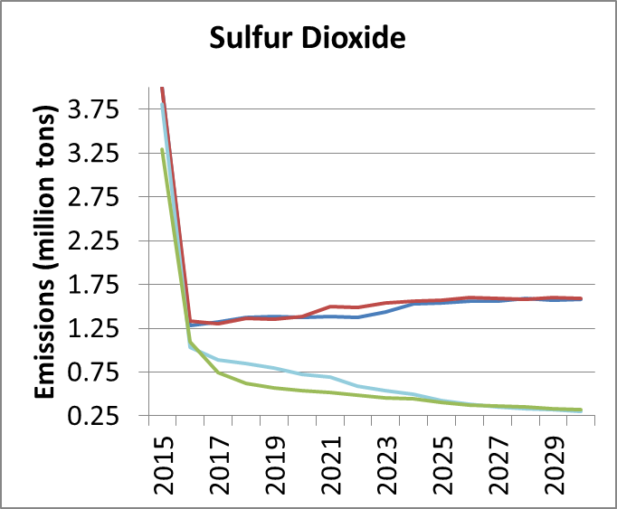
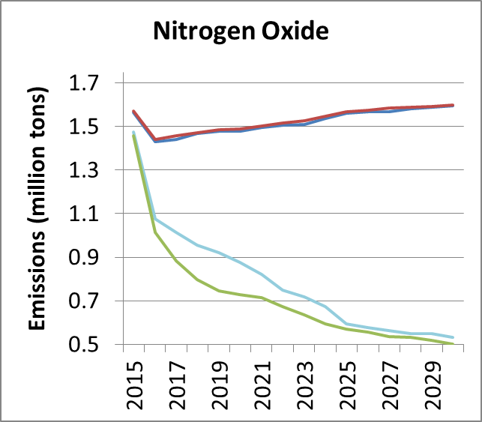
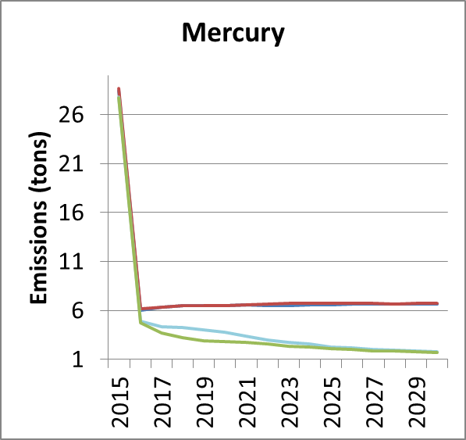
Disturbance Reduces Non-carbon Pollution; Efficiency has Minor Effects
Disturbance causes other pollutant emissions decline, consequence of coal capacity retirements
Measure slightly accelerates this effect
Notes:
For examining the relevance of the measure to the policy goal of public health

Slide 15
More Work to be Done, but Holistic Assessment of Adaptation is Feasible
Have demonstrated that existing tools can be used to address important adaptation considerations
Further work will examine models of path-dependent systems
Also, alternate adaptation measures (e.g. transmission builds)
Also, alternate disturbances (e.g. water shortages)
Current and future analyses will be embellished via calculation of costs of measure-creation
What are the costs of advancing technology for adaptation?
We hope to inspire further work into forming holistic assessments of adaptation options
Alternate methods should be considered, such as stakeholder-driven modeling and multi-criteria decision making analyses

Slide 16
For More Information
Alexander M. Smith
School of Public Policy
Georgia Institute of Technology
Atlanta, GA 30332-0345
asmith313@gatech.edu
Marilyn A. Brown
School of Public Policy
Georgia Institute of Technology
Atlanta, GA 30332-0345
Marilyn.Brown@pubpolicy.gatech.edu
Climate and Energy Policy Lab:
http://www.cepl.gatech.edu

Slide 17
Reference List
Lacey, Stephen (2014) Resiliency: How Superstorm Sandy changed America’s Grid. GreenTech Media report, Boston, Massachusetts, USA. Accessed 07/25/2014 from http://www.greentechmedia.com/articles/featured/resiliency-how-superstorm-sandy-changed-americas-grid
Filatova, T. (2014) Market-based instruments for flood risk management: A review of theory, practice, and perspectives for climate adaptation policy. Environmental Science & Policy, 37, 227-242
Barnett, J.; O’Neill,S. (2010) Maladaptation. Global Environmental Change, 20, 211-213
Vine, E. (2012) Adaptation of California’s electricity sector to climate change. Climatic Change, 111, 75-99. DOI: 10.1007/s10584-011-0242-2
National Action Plan for Energy Efficiency (2007) Aligning utility incentives with investment in energy efficiency. Prepared by Val R. Jensen, ICF International. www.epa.gov/eeactionplan
Saintilan, N.; Rogers, K.; and Ralph, T.J. (2013) Matching research and policy tools to scales of climate-change adaptation in the Murray-Darling, a large Australian river basin: A review. Hydrobiologia, 708, 97-109. DOI: 10.1007/s10750-011-0970-3
Fu, Y. et al. (2012) Climate change adaptation among Tibetan pastoralists: Challenges in enhancing local adaptation through policy support. Environmental Management, 50, 607-621. DOI: 10.1007/s00267-012-9918-2
Tompkins, E.L., et al. (2010) Observed adaptation to climate change: UK evidence of transition to a well-adapting society. Global Environmental Change, 20, 627-635. DOI: 10.1016/j.gloevncha.2010.05.001
Aggarwal, R.M. (2013) Strategic bundling of development policies with adaptation: An examination of Delhi’s climate change action plan. International Journal of Urban and Regional Research, 37(6), 1902-1915. DOI: 10.1111/1468-2427.12032
US Energy Information Administration (2014) Annual Energy Outlook 2014. Accessed June 15 from http://www.eia.gov/forecasts/aeo/pdf/0383(2014).pdf
US Congressional Budget Office (2012) Energy security in the United States. Washington, District of Columbia, USA. Accessed June 05, 2012 from http://www.cbo.gov/sites/default/files/cbofiles/attachments/05-09-EnergySecurity.pdf
Notes:
Lacey (2014)
Filatkova (2014)
Barnett and O’Neil (2010)
Vine (2012)
NAPEE (2007)
Saintilan et al. (2013)
Fu et al. (2012)
Tompkins (2010)
Aggarwal (2013)
(US Energy Information Administration 2014, Table E1).
CBO

