Slide 1



A Model for Estimating Costs of Demand Response Programs:
Providing Supplementary Analysis to the Eastern Interconnection Planning Collaborative
Stanton W. Hadley
Oak Ridge National Laboratory
Marilyn A. Brown
Georgia Institute of Technology
Alexander M. Smith
Georgia Institute of Technology
August 2011

Slide 2


Background and Purpose
EIPC Gathers Grid Planning Authorities
  Modeling Impacts of Grid Policy Options for the Eastern Interconnection
  Municipal, State, and Federal policy-makers
  Stakeholders: Environmental & Consumer Advocacy NPOs, Generation Industry
Using CRA’s NEEM Model
  General Equilibrium model for energy economics

Slide 3
Background and Purpose
NEEM models eight “futures” with sensitivities
  BAU: 55,096 MW-avoided of DR added by 2040
  Future 4: “Aggressive EE/DR/DG”
    179,498 MW-avoided of DR added by 2040
  Future 4, Sensitivity 3: “Hyper-Aggressive DR”
    227,069 MW-avoided of DR added by 2040
How to compare costs of DR to other options?
  DR considered equivalent to peak generation
    Can reduce demand instead of increasing supply
  Peak generator costs tractable: DR costs…not
Hence, a model for estimating DR costs

Slide 4
Part One: Creation of the
“Demand Response Incremental Program Costs by Region per Year” model (D.R.I.P.C.R.Y.)

Slide 5
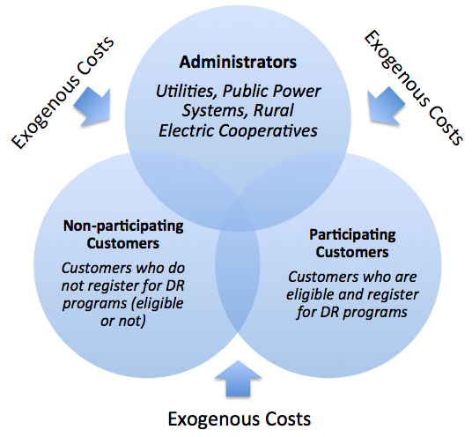
A “System Costs” Approach

Slide 6
A “System Costs” Approach
Three Main Categories:
  Administrative Program Costs (labor, data)
  Capital Program Costs (hardware, AMI)
  Transaction Costs (consumer informing self)
Exogenous Cost is price paid by “system”
Challenges:
  Non-competitive AMI markets (prices are chosen)
  No disclosure of operation & administrative costs
  Transaction costs difficult to quantify
Primary focus is capital costs (best-known)

Slide 7
“Taxonomy” of DR Programs
PROGRAM CATEGORY CODES AND CONSTITUENT PROGRAMS
DLC | ILD | DYN | ETC
Direct Load Control | Interruptible Load | Critical Peak Pricing | Emergency Demand Response
 |  | Critical Peak Pricing with Load Control | Load as a Capacity Resource
 |  | Time-of-use pricing | Peak Time Rebate
 |  | Real-time pricing | All Others
CUSTOMER CATEGORY CODES
Residential | RES
Commercial and Industrial | CNI
Other | OTH
DR programs very diverse
  Distributor and customer make own terms
FERC’s has made DR a “strategic initiative”
  EISA (2007): FERC must assess DR in US
  Provides useful classification of DR programs

Slide 8
Sources: All (links, abbreviations)
Source Author | Source Title (Year published) | Source URL (if applicable) | Abbreviation
Electric Power Research Institute | Estimating the Costs and Benefits of the Smart Grid (2011) | http://ipu.msu.edu/programs/MIGrid2011/presentations/pdfs/Reference%20Material%20%20Estimating%20the%20Costs%20and%20Benefits%20of%20the%20Smart%20Grid.pdf | EPRI
KEMA, Inc. | California solar initiative: For metering, monitoring and reporting market photovoltaic systems in California (2009) | http://www.energy.ca.gov/2009publications/CPUC-1000-2009-030/CPUC-1000-2009-030.pdf | KEMA
Department of Energy | Recovery act selections for smart grid investment grant awards by category (2010) | www.energy.gov/recovery/smartgrid_maps/SGIGSelections_Category.pdf | SGIG
Energy Information Administration | Form 861, File 3 (2009) | http://205.254.135.24/cneaf/electricity/page/eia861.html | EIA
Federal Energy Regulatory Commission | National Assessment of Demand Response (2009) | http://www.ferc.gov/industries/electric/indus-act/demand-response.asp | NADR
Federal Energy Regulatory Commission | Survey of Demand Response and Advanced Metering (2011) | http://www.ferc.gov/industries/electric/indus-act/demand-response.asp | FERC
Multiple authoritative sources within 2 years
  EPRI, KEMA, SGIG: Costs-per-customer
  NADR, FERC: MW-avoided-per-customer
  EIA: Direct source for $/MW-avoided

Slide 9
Sources: EPRI (2011)
EPRI (2011) “Estimating Costs and Benefits of the Smart Grid”
  Per-unit costs of AMI, other non-DR infrastructure
(Source: EPRI (2011)

Slide 10
Sources: KEMA (2009)
KEMA (2009)
  CA Solar Initiative
Studies AMI to be used in large PV installations
  Features similar to AMI used for DR
    Communications
    Interval metering
    Data management
Residential Service
Commercial and Industrial Service
(Source: KEMA 2009)

Slide 11
Sources: DOE SGIG (2010)
(Source: DOE SGIG 2010)
DOE (2010) “SGIG Project Recipients”
  Category One: AMI
    Provides total budget, number of meters installed
    Calculated cost-per-meter for each

Slide 12
Sources: DOE SGIG (2010)
Name of Awardee | Total Project Value | Number of Meters Proposed | Target Customer Type | Project Value per Meter
Central Maine Power Company | $195,900,000 | 650,000 | Residential, C&I | $301.38
Salt River Project | $114,003,719 | 540,000 | Ambiguous | $211.12
Cleco Power LLC | $62,519,800 | 275,000 | Ambiguous | $227.34
South Mississippi Electric Power Association | $61,127,935 | 240,000 | Other | $254.70
City of Glendale Water and Power | $51,302,425 | 84,000 | Ambiguous | $610.74
Lakeland Electric | $48,306,833 | 125,000 | Residential, C&I | $386.45
Denton County Electric Cooperative d/b/a CoServ Electric | $17,205,844 | 140,000 | Ambiguous | $122.90
Cobb Electric Membership Corporation | $33,787,672 | 190,000 | Ambiguous | $177.83
South Kentucky Rural Electric Cooperative Corporation | $19,076,467 | 66,000 | Residential, C&I | $289.04
Connecticut Municipal Electric Energy Cooperative | $18,376,100 | 13,000 | Ambiguous | $1,413.55
Black Hills/Colorado Electric Utility Co. | $12,285,708 | 42,000 | Ambiguous | $292.52
Cheyenne Light, Fuel, and Power Company | $10,066,882 | 38,000 | Ambiguous | $264.92
Entergy New Orleans, Inc. | $10,000,000 | 11,000 | Residential | $909.09
Navajo Tribal Utility Association | $9,983,500 | 38,000 | Ambiguous | $262.72
Sioux Valley Southwestern Electric Cooperative, Inc. | $8,032,736 | 23,000 | All | $349.25
Woodruff Electric | $5,016,000 | 13,000 | Other | $385.85
Allete Inc. d/b/a Minnesota Power | $3,088,007 | 8,000 | Ambiguous | $386.00
City of Fulton, Missouri | $3,055,282 | 5,000 | Ambiguous | $611.06
Marblehead, MA | $2,692,350 | 10,000 | Ambiguous | $269.24
Stanton County Public Power District | $794,000 | 2,400 | Ambiguous | $330.83
Mean | $34,331,063.00 | $125,670.00 | - | $402.83
Median | $14,745,776.00 | $40,000.00 | - | $296.95
Source slightly ambiguous
  No breakdown of budgets
Some AMI projects not relevant to DR
  Filter by project descriptions (e.g. gas & water metering)
First public empirical information about AMI costs
  AMI suppliers price by customer (P ≠ MC)
  Provides a range

Slide 13
Sources: EIA (2009)
EIA Form 861: Survey of all US IOUs
  File 3 provides information about DR and AMI
  Most recent data are from 2009
Offers MW-avoided by customer category
  Residential, C&I, Gov., and Transportation (?)
Offers “direct costs to utilities of DR program”
  What this represents is unclear/ambiguous
  As expressed, is endogenous, not exogenous cost
May calculate $/MW-avoided from data
  ..but estimates thus produced are extremely low

Slide 14
Sources: NADR (2009)
FERC’s 2009 National Assessment of Demand Response
  Produces NADR model
  Forecasts DR to 2020
Provides MW-avoided/customer
Provides changes over the years
  Dynamic modeling
POTENTIAL PEAK LOAD REDUCTIONS PER CUSTOMER (MW) from NADR
 | C&I | RES | OTH
DLC | 0.003 | 0.001 | 0.007
ILD | 0.116 | 0.000 | 0.046
DYN | 0.003 | 0.001 | 0.009
ETC | 0.105 | 0.000 | 0.030

Slide 15
Sources: FERC (2011)
FERC’s 2011 survey of AMI and DR
  Results also from 2009
Provides MW-avoided/customer
  Larger number of utilities than EIA
  RECs, Muni’s included
  More DR program types than NADR
Static – only year-2009
POTENTIAL PEAK LOAD REDUCTIONS PER CUSTOMER (MW) from FERC
 | C&I | RES | OTH
DLC | 0.011 | 0.001 | 0.020
ILD | 1.029 | 0.001 | 0.066
DYN | 0.083 | 0.002 | 0.045
ETC | 0.507 | 0.001 | 0.063
211.33 for RES ILD rejected (due to program w/aggregators)
Ambiguity issue:
LOAD AGGREGATORS

Slide 16
Sources: FERC (2011) + EIA (2009)
Combination of FERC’s 2011 survey with EIA Form 861
  Cross-referenced FERC (2011) with EIA data
  Both report MW-avoided for programs in 2009
  FERC offers number of customers per program, EIA offers MW-avoided per program
  Combined to get MW-avoided-per-customer
Can directly estimate $/MW-avoided using the program’s “direct cost to utilities” from EIA
  …but these estimates are also extremely low

Slide 17
Part Two: Methodology of DRIPCRY

Slide 18
DRIPCRY Process Flow Chart
1
Convert NEMS region peak load reductions to NERC region peak load reductions
3
Divide NERC region peak load reductions according to regional demand response portfolios
4
Convert NEEM region peak load reductions to NEMS region peak load reductions
2
5
Apply costs per megawatt for each demand response program category and customer category from each cost calculation source in turn
Sum costs of each demand response program category and customer category, express as total NERC region DR Costs
6
7
Convert NERC region total DR costs to NEMS region total DR costs
Convert NEMS region total DR costs to NEEM region total DR costs

Slide 19
Inputs: The NEEM Model
NEEM receives inputs of peak MW-avoided through DR programs
    Amounts derived through stakeholder process
  Annual total peak MW-avoided provided
  Take differences for incremental MW-avoided
2010 is “base year:” all DR installed to-date
NPVs calculated for 2015-2030 period
  Same period considered for peak generators

Slide 20
Inputs: The NEEM Model
Problem: Cartographic Challenges
  NEEM has own regional definitions of US
  FERC, NADR data are reported by NERC regions
  Must convert from NEEM to NERC, compute costs, then convert back again from NERC to NEEM
Solution: Matrix method
  Essentially based upon creator’s judgment
  Fortunately, consistent with previous methods used to convert NEMS regions to NEEM regions
  Able to leverage NEMS conversion tables…

Slide 21
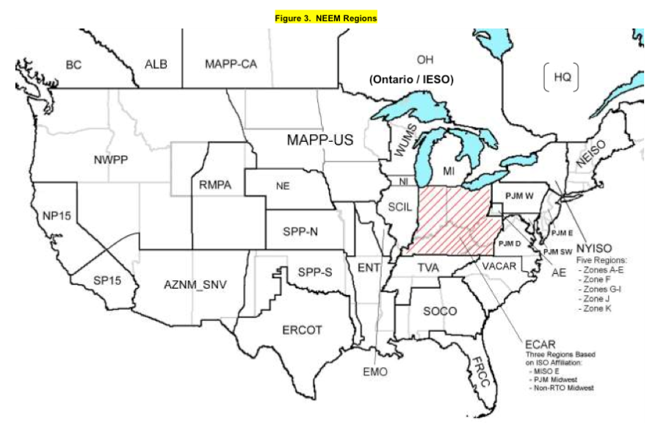
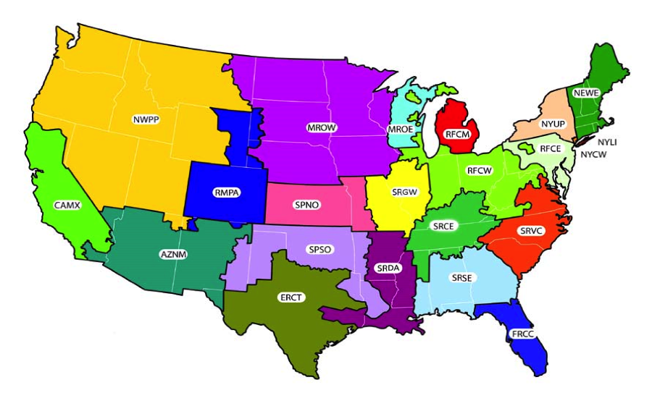
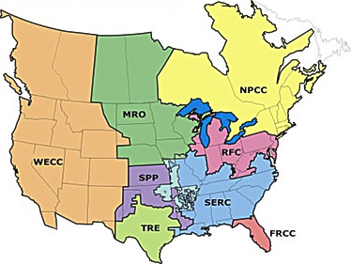
Method: Cartographic Conversions
Used NEMS regions as intermediary
  Can thus produce DR costs by NEMS region, in addition to NERC/NEEM
NEEM Regions
NEMS Regions
NERC Regions

Slide 22
Method: DR “Portfolios”
THREE EXAMPLE DR PORTFOLIO MIXTURES FROM FERC
FRCC |  | MRO |  | SERC
RES,DLC | 60% | RES,DLC | 29% | RES,DLC | 10%
CNI,DLC | 26% | CNI,DLC | 9% | CNI,ILD | 67%
CNI,ILD | 13% | CNI,ILD | 35% | CNI,DYN | 15%
OTH,ETC | 1% | CNI,DYN | 14% | CNI,ETC | 3%
 |  | CNI,ETC | 6% | OTH,DLC | 2%
 |  | OTH,DLC | 5%
FERC, NADR report by NERC region
Filtered Data by NERC region to identify portions of DR MW-avoided held by each program type
Developed “DR Portfolio” for each region = granularity in program costs
NADR Advantage: Shows changes to DR Portfolios over the 30-year period
  e.g. RES,DLC will grow while CNI,DYN remains constant
FERC (2011) doesn’t show changes to DR portfolios

Slide 23
Method: Costs-per-MW
COST PER CUSTOMER SOURCES:
EPRI (2011) |  | Customer Type:
Low: | High:
$70 | $140 | RES
$100 | $500 | CNI/OTH
KEMA (2009)
Low: | High:
$100 | $450 | RES
$1,300 | $2,500 | CNI/OTH
SGIG (2010)
Low: | High:
$200 | $400 | ALL
POTENTIAL PEAK LOAD REDUCTIONS PER CUSTOMER (MW) from NADR
 | C&I | RES | OTH
DLC | 0.003 | 0.001 | 0.007
ILD | 0.116 | 0.000 | 0.046
DYN | 0.003 | 0.001 | 0.009
ETC | 0.105 | 0.000 | 0.030
÷
THE UPPER BOUND
  NADR MW/customer lower than FERC MW/customer, so $/MW higher

Slide 24
Method: Costs-per-MW
COST PER CUSTOMER SOURCES:
EPRI (2011) |  | Customer Type:
Low: | High:
$70 | $140 | RES
$100 | $500 | CNI/OTH
KEMA (2009)
Low: | High:
$100 | $450 | RES
$1,300 | $2,500 | CNI/OTH
SGIG (2010)
Low: | High:
$200 | $400 | ALL
POTENTIAL PEAK LOAD REDUCTIONS PER CUSTOMER (MW) from FERC
 | C&I | RES | OTH
DLC | 0.011 | 0.001 | 0.020
ILD | 1.029 | 0.001 | 0.066
DYN | 0.083 | 0.002 | 0.045
ETC | 0.507 | 0.001 | 0.063
÷
THE LOWER BOUND
  FERC MW/customer higher than NADR MW/customer, so $/MW lower

Slide 25
Method: Costs-per-MW
KEMA LOW has been recommended to the EIPC SSC/MWG
  Wide range captures most of the other estimates
KEMA HIGH brings DR $/MW closest to peak generation $/MW (~$400,000)
COST-PER-MW-AVOIDED: KEMA (2009)
Low Bound ($/MW) “KEMA LOW”
 | C&I | RES | OTH
DLC | $121,700 | $78,704 | $64,961
ILD | $1,263 | $78,704 | $19,606
DYN | $15,628 | $44,013 | $29,064
ETC | $2,564 | $77,093 | $20,506
High Bound ($/MW) “KEMA HIGH”
 | C&I | RES | OTH
DLC | $187,231 | $354,170 | $99,939
ILD | $1,944 | $354,170 | $30,163
DYN | $24,043 | $198,059 | $44,713
ETC | $3,944 | $346,917 | $31,548
COST PER MEGAWATT-AVOIDED : EIA (2009), FERC (2011) + EIA (2009)
EIA (2009)
Low: | High:
$2,800/MW | $23,000/MW | ALL
FERC (2011) + EIA (2009)
Low: | High:
$1,650/MW | $25,000/MW | DLC
$1,700/MW | $27,000/MW | Non-DLC

Slide 26
Method: Cartographic Conversions (Reversal)
Reverse conversions allocate DR costs to each regional set
NERC Regions
NEMS Regions
NEEM Regions

Slide 27

Results: NPV Calculations
Performed for year 2015-2030
  Interest rate = 5%
  Same period and interest rate for peak generation

Slide 28
BAU Results ($B): | NADR | FERC | Average
EPRI HIGH | 0.8 | 0.4 | 0.6
EPRI LOW | 0.3 | 0.2 | 0.3
KEMA HIGH | 2.9 | 1.5 | 2.2
KEMA LOW | 1.2 | 0.5 | 0.8
SGIG HIGH | 1.7 | 1.1 | 1.4
SGIG LOW | 0.9 | 0.5 | 0.7
EIA HIGH | 0.7 | 0.6 | 0.6
EIA LOW | 0.1 | 0.1 | 0.1
FERC+EIA HIGH | 0.8 | 0.7 | 0.7
FERC+EIA LOW | 0.0 | 0.0 | 0.0

Slide 29
Future 4,S3 Results ($B): | NADR | FERC | Average
EPRI HIGH | 3.6 | 1.5 | 2.6
EPRI LOW | 1.0 | 0.6 | 0.8
KEMA HIGH | 13.9 | 5.0 | 9.4
KEMA LOW | 7.8 | 1.6 | 4.7
SGIG HIGH | 4.7 | 3.5 | 4.1
SGIG LOW | 2.4 | 1.8 | 2.1
EIA HIGH | 1.7 | 2.1 | 1.9
EIA LOW | 0.2 | 0.3 | 0.2
FERC+EIA HIGH | 2.0 | 2.4 | 2.2
FERC+EIA LOW | 0.1 | 0.2 | 0.1

Slide 30
F4S3 Results ($B): | NADR | FERC | Average
EPRI HIGH | 4.6 | 1.8 | 3.2
EPRI LOW | 1.2 | 0.8 | 1.0
KEMA HIGH | 17.4 | 6.2 | 11.8
KEMA LOW | 9.9 | 2.0 | 6.0
SGIG HIGH | 5.8 | 4.4 | 5.1
SGIG LOW | 2.9 | 2.2 | 2.6
EIA HIGH | 2.1 | 2.6 | 2.3
EIA LOW | 0.3 | 0.3 | 0.3
FERC+EIA HIGH | 2.5 | 3.0 | 2.7
FERC+EIA LOW | 0.2 | 0.2 | 0.2

Slide 31
Feedback: What are your thoughts?
Alternate sources for AMI costs?
  Other DR-relevant costs?
Any sources seem unrealistic? Credentials?
Is a utility-costs approach acceptable?
  Why/Why-not?
Refinements to methods?
Policy-relevant applications of this model?
Cross-referencing? Double-counting issues?
  (just because this came up at previous WOPRs…)

Slide 32
Thanks for your time

