Slide 1
Analytic Approaches for Assessing RD3 Needs across the Energy Sector
Dr. Marilyn A. Brown
Brook Byers Professor of Sustainable Systems
School of Public Policy
Georgia Institute of Technology
Quadrennial Technology Review
Cornerstone Workshop
Washington, DC December 5, 2014

Slide 2
Some Types of Analytic Approaches
Types and questions:
Scenario analysis: How do technology breakthroughs impact systems? Are systems resilient to disturbances? How do path dependencies & lock-in constrain options? Do policy impacts have synergies?
Expert elicitation: Which technologies & policies?
Games and prediction markets: Any new market trends?
Technology roadmapping: What gaps need to be filled?
Technology learning: When will technologies be ready?
LCA and holistic ROI approaches: Any impacts overlooked?
Chaos-based methods: How will actors respond?
All of these methods can add value.

Slide 3
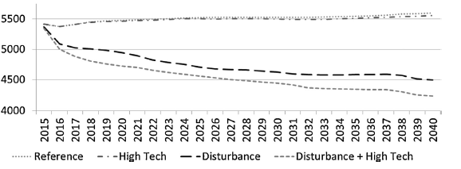
Scenario Analysis
Typically uses equilibrium forecasts that reflect BAU vs. alternative economic, technology or policy forecasts.
By modeling disturbances, we can see how resilient energy systems are, when the assumptions that underlie their planning suddenly no longer hold.
CO₂ Emissions
in million tonnes
GDP in 2020: $16,753 $16,758 $16,681 $16,662
(in $2005 B)
(Brown, et al., 2001; Smith and Brown, 2014)
Notes:
To model a disturbance to GT_NEMS’ capacity planning, we manually alter the demand expectations of the Electricity Capacity Planning module. We first deactivate the perfect foresight in the ECP by switching to ‘‘myopic foresight,’’ a mode in which the ECP uses the prior two years’ average demand growth rate to predict demand for all following years. We then begin overwriting these expectations starting in the year 2020; rather than allowing the ECP to develop its own projections of demand, we use the demand projections from the EIA’s Low Macroeconomic Growth AEO2014 side case. The LowMacro rates for post-2020 annual power demand growth are on average 0.5 percent lower than the same rates for the EIA AEO2014 reference case. In this disturbance scenario, therefore, less electricity capacity is built than would be appropriate for the rate of demand growth encountered by utility planners. This scenario would be consistent with unexpected temperature changes driving space cooling, space heating, and water heating demands to levels higher than anticipated by utility planners. improvement to U.S. energy efficiency, represented by the assumptions for EIA’s Integrated High Demand Technology side case in the AEO2014. In this case, we use assumptions that reflect a greater push for energy efficiency in all sectors and through multiple means.

Slide 4
Expert Elicitation: Delphi Method & Analytic Network Process
Relies on principles of collective intelligence:
Solicit opinions of experts on a given topic
Ask experts for arguments supporting opinion
Summarize and distribute results to experts solicited
Offer opportunity for experts to change opinion based on other experts’ input
Iterate until results stabilize or consensus is reached
Scanning Analysis Expert Survey Results
Sources: http://www.techcastglobal.com/methodology
Davoudpour et al. 2012

Slide 5
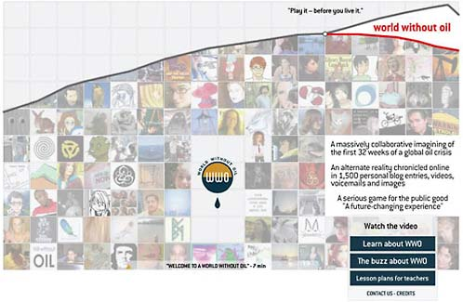
Games and Prediction Markets
Screenshot from World Without Oil, an Alternate Reality Game based around alternative fuel choices
“Crowdsourcing” assessment
Alternate reality games ask volunteers to make technology choices in games representing future scenarios
Prediction markets ask volunteers to place a monetary bet on specific future technology outcomes
Source: National Academies of Science (2009)

Slide 6
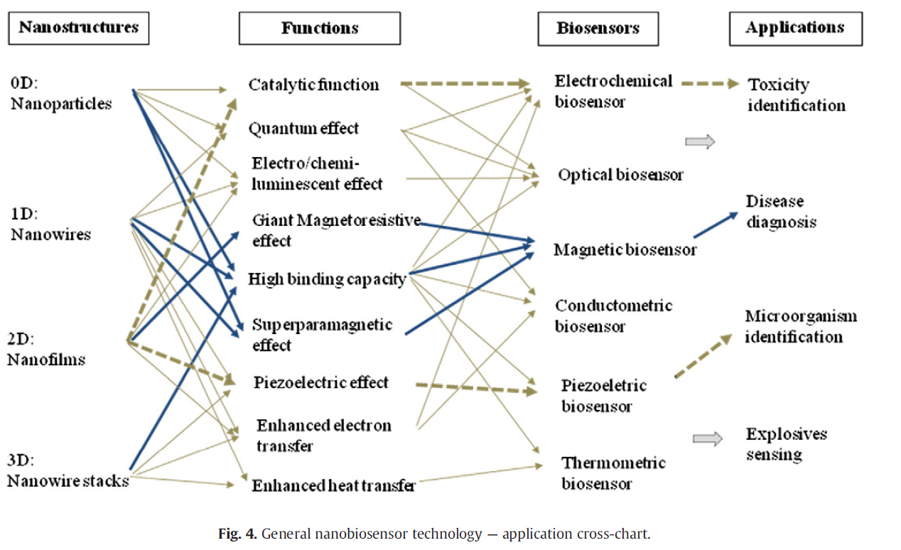
Technology Roadmapping
Multi-step, multi-method process to understand innovation pathways
Develop data on
Current state of technology
R&D activities and key actors
Commercialization activities
SWOT analysis
Gaps
Select promising innovation pathways
Example: Nanobiosensor Technologies
Nanostructures Functions Biosensors Applications
Source: Robinson et al. (2013)

Slide 7
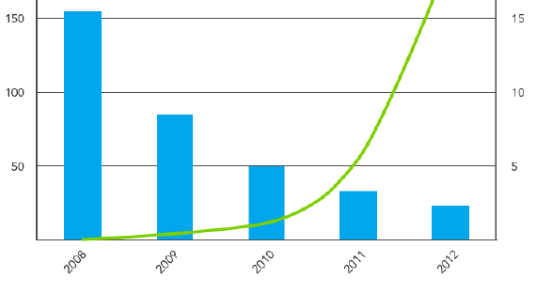
Technology Learning and Maturity
Cost and Penetration of A-Type LED Lights
Analyzing rates of change in technology
Diffusion (Bass/Gomperz curves)
Cost declines (learning curves)
Performance (Moore’s law)
Extrapolates these trends into the future
Can signal when technologies might switch
LED Lighting Cost ($/Kilolumen)
Cumulative LED Lights
Installed (Millions)
Source: DOE, 2013
Notes:
E.g. swapping mature technology for emerging technology

Slide 8
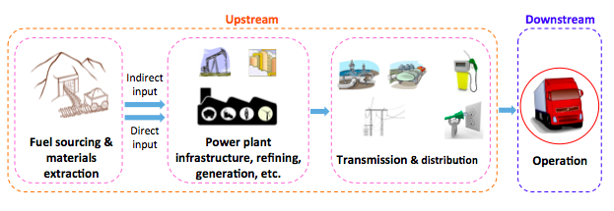
Life Cycle Analysis and “Holistic” Return on Investment
Can incorporate externalities and nonrevenue returns:
Environmental damages & job creation
Exposure to price risk & regulation
Can incorporate scenario analysis to understand risks to investment
Can also compare to investments in other assets
System boundaries can be expansive:
+Battery End-of-Life
Sources: Balachandra 2001; Lee, Thomas and Brown (2013)

Slide 9
Chaos-based Methods
Agent Based Modeling
Multiple autonomous ‘agents’ interact based on internal rules
Complex behaviors from simple individual rules
Uses
Technology adoption and penetration (Source: Epstein, et al., 2011)
Market behaviors (Source: Sichao, et al. 2010)
Artificial Neural Networks
Machine learning method to discern patterns from data
System of interconnected, adaptive ‘neurons’ that approach the non-linearity of inputs
Uses
Short-term load forecasting (Source: Drezga and Rahman, 1998)
Renewable generation forecasting (Source: Siminov, et al. 2012)
Chaos-based methods (and other approaches) need stronger behavioral energy research.

Slide 10
Bibliography
Balachandra, P.; Shekar, G.L. (2001) Energy technology portfolio analysis: An example of lighting for residential sector. Energy Conversion and Management, 42, 813-832
Brown, Marilyn A.; Mark D. Levine; Walter Short; Jonathan G. Koomey, 2001. “Scenarios for a Clean Energy Future,” Energy Policy, 2001, 29 (14): 1179-1196.
Davoudpour, H.; Rezaee, S.; Ashrafi, M. (2012) Developing a framework for renewable technology portfolio selection. Renewable and Sustainable Energy Reviews, 16, 4291-4297
DOE. 2013. Revolution Now: The Future Arrives for Four Clean Energy Technologies
Drezga, I; Rahman, S (1998) Input variable selection for ANN-based short-term load forecasting. IEEE Transactions on Power System^{s}
Eppstein, M; et. al. (2011) An agent-based model to study market penetration of plug-in hybrid electric vehicles. Energy Policy.

Slide 11
Bibliography
Lee, Dong-Yeon, Valerie M. Thomas, and Marilyn A. Brown. 2013. “Electric Urban Delivery Trucks: Energy Use, Greenhouse Gas Emissions, and Cost-Effectiveness,” Environmental Science and Technology, 47(14) 8022-2030.
National Academies of Science, USA. (2009) Persistent Forecasting of Disruptive Technologies.
Robinson, D.K.R.; Huang, L.; Guo, Y.; Porter, A.L. (2013) Forecasting Innovation Pathways (FIP) for new and emerging science and technologies. Technological Forecasting and Social Change, 80, 267-285
Sichao, K; Yamamoto, H; Yamaji, K (2010) Evaluation of CO2 free electricity trading market in Japan by multi-agent simulations. Energy Policy
Simonov, M; et. al. (2012) Artificial Intelligence Forecast of PV Plant Production for Integration in Smart Energy Systems. IREE
Smith, Alexander and Marilyn A. Brown. 2014. "Policy Considerations for Adapting Power Systems to Climate Change" The Electricity Journal, November, http://dx.doi.org/10.1016/j.tej.2014.10.00
TechCast Methodology. Accessed 11/25/2014 from http://www.techcastglobal.com/methodology

Slide 12
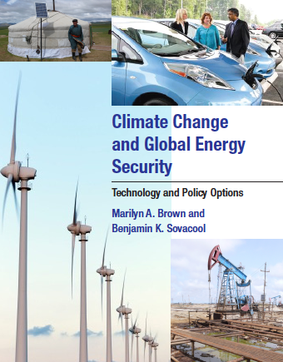
For More Information
Dr. Marilyn A. Brown
Brook Byers Professor of Sustainable Systems
School of Public Policy
Georgia Institute of Technology
Marilyn.Brown@pubpolicy.gatech.edu
Climate and Energy Policy Lab:
http://www.cepl.gatech.edu
404-385-0303
Thanks to Alex Smith and Ben Staver, Graduate Research Assistants at Georgia Tech, for assistance with these slides:
asmith313@gatech.edu
bstaver@gatech.edu

