Slide 1
The Energy Burden in the Southeast:
Solutions through Community & Business Engagement
Presented by:
Michael Oxman, Co-PI
Dr. Marilyn Brown, Co-PI
Dr. Beril Toktay, Co-PI
April 18, 2018
INTERSECT 2018
Atlanta, GA

Slide 2
Outline
Research Team and Key Collaborators
Study Overview, Definitions, and Objectives
Key Findings
Next Steps

Slide 3
Research Team & Collaborators
Team Member | Organization
Dr. Marilyn Brown (CO-PI) | School of Public Policy Ivan Allen College of Liberal Arts Brook Byers Institute for Sustainable Systems Georgia Institute of Technology
Michael Oxman (CO-PI) | Ray C. Anderson Center for Sustainable Business at Scheller College of Business Georgia Institute of Technology
Dr. Beril Toktay (CO-PI) | Ray C. Anderson Center for Sustainable Business at Scheller College of Business Georgia Institute of Technology
Majid Ahmadi | School of Public Policy (Climate & Energy Policy Laboratory) Georgia Institute of Technology
Naveed Ahmad | Scheller College of Business Georgia Institute of Technology
Yasaman Mohammad Shahi | H. Milton Stewart School of Industrial & Systems Engineering Georgia Institute of Technology
Suzanne Burnes Naajia Ahmed | Collective Wisdom Group
Sabrina Cowden Luke Gebhard Erik Froyd | Milepost Consulting
Collaboration Highlights:
Business, Public Policy, Engineering Expertise
Faculty & Student Collaboration
Enhanced stakeholder engagement via knowledgeable contractors

Slide 4
Study Overview and Definitions
What is an Energy Burden?
Numerator is the primary focus of this study
There is no widely accepted value or threshold that establishes whether a household faces a high or unaffordable energy burden. (ACEEE, 2017)
However, the U.S. Department of Health and Human Services classifies an energy burden of above 6% as “unaffordable” (Colton, What is the Home Affordability Gap, 2017)
Mean Household
Energy Bill*
*Electric & Gas
Energy Burden
Mean Household Income

Slide 5
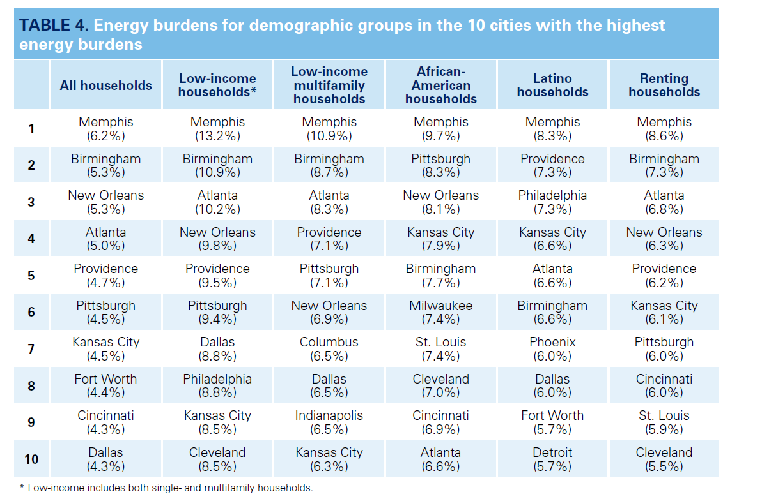
Impetus for Study
Source: ACEEE, Lifting the High Energy Cost Burden in America’s Largest Cities: How Energy Efficiency Can Improve Low Income and Underserved Communities
Notes:
SE Cities rank porrly

Slide 6
Study Overview and Objectives
1. What are the primary drivers & baseline attributes of the high energy burden in Atlanta?
2. What are the most potentially promising program attributes for alleviating energy burden circumstances in the Atlanta area?
3. What are the business case & policy drivers that may offer greater scale for identified approaches & solutions?

Slide 7
Key Phase 1 Findings
While Georgia has relatively low electricity rates, other energy burden factors are prevalent (large home size, high poverty rates, hot/cool climate, lower relative spending in US SE on EE)
Regression analysis found the following predictors Energy Burden:
Low vehicle ownership
High food stamp receipts
Low housing values
High %s of single-family housing
More transiency
Older homes (particularly built before 2000)
High levels of heating and cooling degree days

Slide 8
Atlanta’s highest energy burdens are concentrated in six zip codes
Zip Code | Mean HH Income | Mean Energy Bill | % Energy Burden
30303 | $36,600 | $2,760 | 7.5%
30310 | $35,103 | $2,161 | 6.2%
30314 | $33,671 | $1,929 | 5.7%
30311 | $41,723 | $2,153 | 5.2%
30315 | $39,115 | $1,850 | 4.7%
30354 | $39,634 | $1,855 | 4.7%
30316 | $65,507 | $2,212 | 3.4%
30331 | $57,360 | $1,890 | 3.3%
30312 | $53,185 | $1,650 | 3.1%
30317 | $75,241 | $2,332 | 3.1%
30318 | $63,356 | $1,930 | 3.0%
30313 | $59,983 | $1,818 | 3.0%
30308 | $73,003 | $1,482 | 2.0%
30305 | $146,565 | $2,951 | 2.0%
30342 | $128,856 | $2,594 | 2.0%
30327 | $239,582 | $4,684 | 2.0%
30324 | $92,423 | $1,735 | 1.9%
30307 | $124,801 | $2,255 | 1.8%
30309 | $106,803 | $1,917 | 1.8%
30306 | $132,706 | $2,276 | 1.7%
30319 | $133,289 | $2,273 | 1.7%
30344 | $47,469 | $738 | 1.6%
30326 | $114,839 | $1,648 | 1.4%
30363 | $86,429 | $807 | 0.9%
30336 | $42,751 | $270 | 0.6%
City | $82,800 | $2,007 | 2.9%

Slide 9
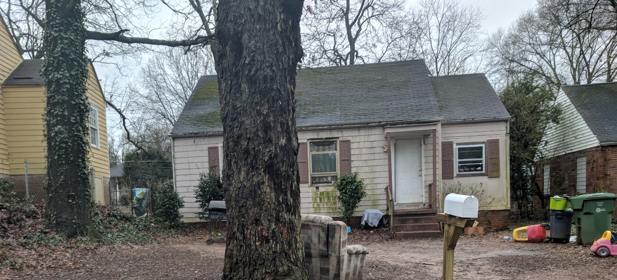
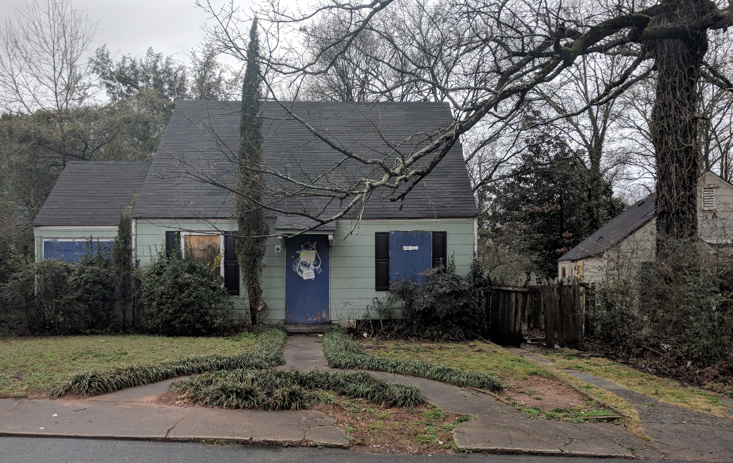
Households with High Energy Burden

Slide 10
Key Phase 1 Findings
Given complexity of energy burden root causes, success factors demonstrate importance of partnerships, customer engagement, and education/awareness
Low Income Customers
Partnerships needed for EE “lifecycle” (structural, weatherization, safety)
Innovative financing & contractor networks to alleviate upfront costs
Bill payment assistance (pre-pay, level billing, etc.) programs underway
Core Principle: Awareness needed to link energy use & behavior

Slide 11
Key Phase 1 Findings
Affordable energy recognized as a material issue for utilities with rate structures, bill assistance, and energy efficiency key components of solutions.
Utilities
Low income proportion of utility customer base is large & likely growing
Arrearages, bad debt, disconnects help to justify low income program investments (bill payment assistance, low income EE upgrades)
Energy affordability identified as a material issue across all customer segments (EPRI*, GRI/SASB**, individual utilities)
Core Principle: Business case for scaling low income programs likely to grow with funding/execution requiring coordinated partnerships.
*Electric Power Research Institute
**Global Reporting Initiative/Sustainability Accounting Standards Board

Slide 12
Key Phase 1 Findings
Policy can offer leverage to develop multi-partner solutions and incentives to reward energy efficiency / low income programming
Policy Makers
Regulatory frameworks increasingly used to incentivize EE (& low income) programs via new/modified cost tests & non-energy benefits (NEBs)
Existing/proposed federal, state, city, private sector programs may offer optimization opportunities (i.e. proportion of $$/efforts focused on
Core Principle: Energy burden is complex with solutions to root causes necessitating public policy incentives.

Slide 13
Next Steps (Phase 2)
Discovery (January-May 2018)
Utility
Engagement
Low Income Customers
Stakeholder Meetings
Low Income Customer Focus Group
Interviews with Health Professionals
Assessment (May – August 2018)
Public Health Experts
Community Action Agencies
Review of business case/policy drivers
Development (May – December 2018)
Establish principles for future research and/or pilot

Slide 14
Thank you
For more info, please contact:
Dr. Marilyn Brown: marilyn.brown@pubpolicy.gatech.edu
Michael Oxman: michael.oxman@scheller.gatech.edu
Dr. Beril Toktay: Beril.Toktay@scheller.gatech.edu
Websites:
Climate & Energy Policy Laboratory:
https://cepl.gatech.edu/
Ray C. Anderson Center for Sustainable Business: https://www.scheller.gatech.edu/centers-initiatives/ray-c-anderson-center-for-sustainable-business/index.html

