Slide 1
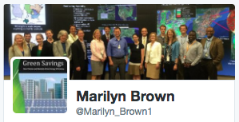
EVs + Renewables: A Merger of Complementary Adaptation Strategies Dr. Marilyn A. Brown Regents’ & Brook Byers Professor of Sustainable Systems Georgia Institute of Technology Geography 2050: American Geographical Society Fall Symposium on Energy Adaptation Strategies Columbia University, November 16, 2018
Notes:
Energy transformations: Electricity is decarbonizing and transportation is electrifying.
This enables a new climate resilient development pathway: greed-integrated vehicles.

Slide 2
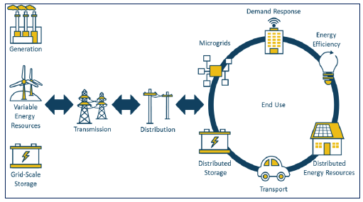
The Energy Ecosystem is Transforming
Source: DOE. 2017. Quadrennial Energy Review: Transforming the Nation’s Electricity System, Figure S-3
Notes:
for a “smart grid”- an electricity network that uses “digital and other advanced technologies to monitor and manage the transport of electricity from all generation sources to meet the varying electricity demands of end-users” (International Energy Agency, 2011).
Smart grid architectures can integrate a diverse set of electricity resources, including large power plants as well as distributed renewable resources, electric energy storage, demand response, and electric vehicles. Figure 1 portrays a complex smart grid system with both central and regional controllers managing the two-way flow of electricity and information between utilities and consumers. The actual mix of controls and technologies will depend upon a region’s transmission and distribution system, its electricity governance and business model, the nature of customers being served and other demand-side issues. By implementing a smart grid, electric systems can operate at higher levels of power quality and system security DER = distributed energy resources
With fully integrated network management
Combination of large-scale and small scale in a mesh like (two way direction)
Generation and load matching = energy management
Local islanding (microgrids)

Slide 3
The Shift to Distributed Resources is Happening
Expanding phenomena:
Distributed solar capacity is now nearly 1% of total U.S. generating capacity (14 GW).
>14 million electric customers are supplying power back into the grid.
>16 million customers participate in wholesale or utility demand response or time-varying rate programs.
>80 GW of combined heat and power now accounts for ~8% of total U.S. generating capacity.
Emerging phenomenon:
The charging cycles of 535,000 EVs are now being managed.
Source: DOE Electricity Advisory Committee, Smart Grid Subcommittee
Notes:
The way in which electricity is generated, delivered, and used is in the midst of significant transformation
Distributed Energy Resources (DERs) are growing rapidly and are now a significant part of the power system.
What is the outlook for our power system as technological advances and consumer demands converge?

Slide 4
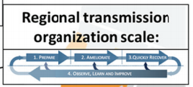
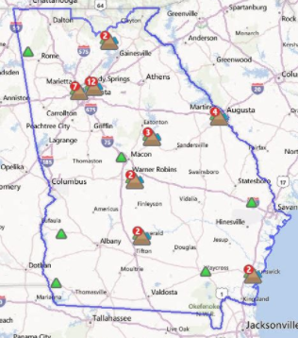
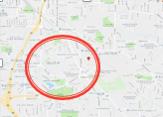
Grid Resilience is a New Focus, & Electric Vehicles can Contribute
Adapted from: National Academy of Sciences, 2017
Notes:
FERC Order 1000: Invest in demand-side measures before expanding transmission lines.
Time coordination – ensuring that charging is balanced with the time of use
Power coordination (theoretically possible ) – coordinate the power supply based on the ability of the user to pay (PG)

Slide 5
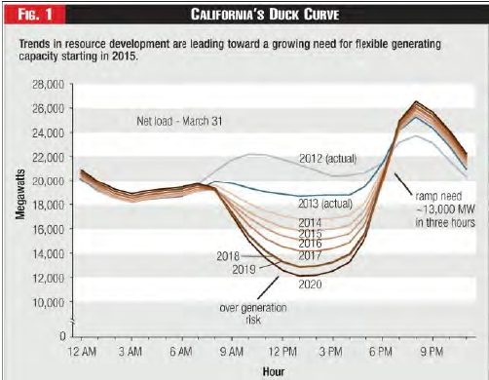
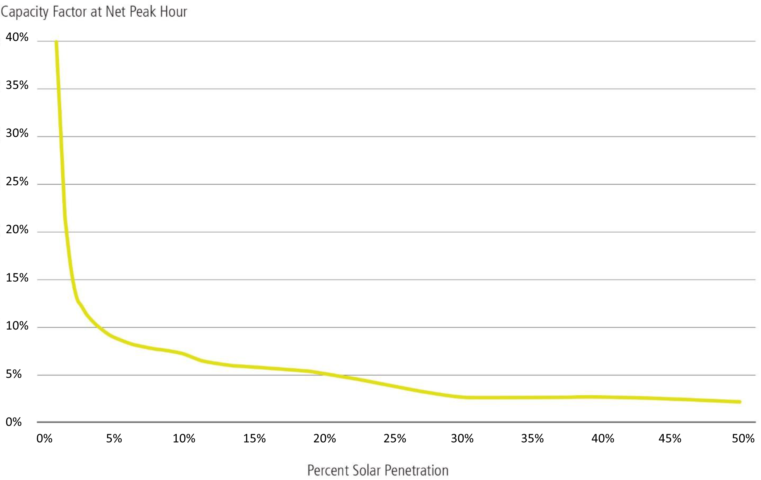
Managing Electric Resources in Real Time is Complicated
Peak day loads by network are shifting (California duck curve)
Capacity Factor of Solar
at Net Peak Hour
At 25% solar in Texas, the on-peak capacity of solar could drop to 5%.*
Resources need to be managed in real time
Percent Solar Penetration
*Source: DOE. 2017. Staff Report to the Secretary on Electricity Markets and Reliability
Notes:
There are time and space dimensions to this grid-integrated vehicle approach.
In the duck curve: grid requirements drop dramatically when solar is operating—creating the duck’s belly.
Then when the sun sets, California has to ramp up 13 GW in 13 hours.

Slide 6
Geospatially Managing Demand Adds More Complexity & Opportunity
EVs and other distributed resources need to be deployed into specific zones, and those zones are shifting as solar expands—the duck walks
Dispatched to address local constraints
ConEd’s Brooklyn Queens Demand Management Program
Notes:
Peak Day Loads by Network are Shifting – What will Amazon’s HQ2 in Queens do to this geography?
Distributed generation and storage can avoid more costly grid investments Still, the nation’s electricity grid remains the backbone of our ability to deliver electricity.
Households, businesses, and other organizations rely on this essential public service to live, study, produce goods/services and, ultimately, to thrive.
Safety, reliability and affordability are still the core principles that guide decisions on electricity generation, transmission, and delivery.
In this era of transformation, these core principles remain guideposts for decision-making, even as the ability to satisfy them becomes more complex.

Slide 7
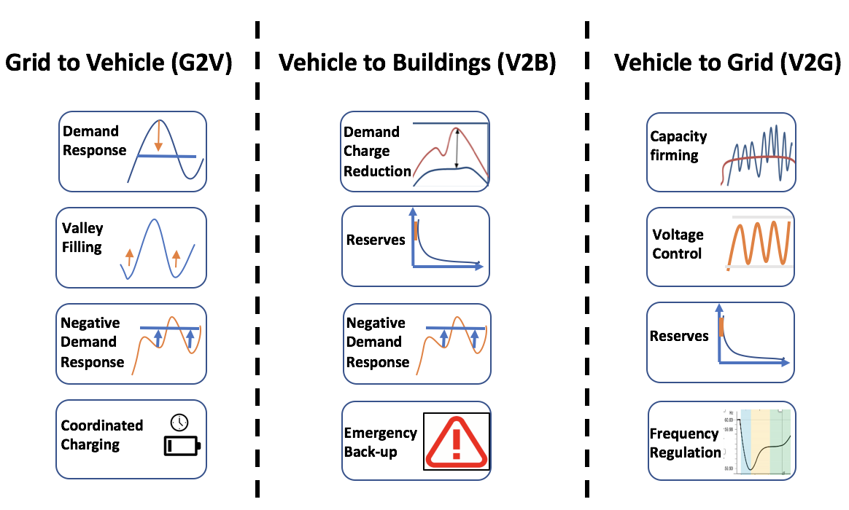
What Roles Could EVs Play?
First, they can reduce GHG emissions compared to ICEs.
But also, they can support the grid.
How much are these grid services worth?
What business models can be used to create value?
Brown, M.A., et al. 2018. Enhancing Grid Resilience with Integrated Storage from Electricity Vehicles U.S. Department of Energy, Electricity Advisory Committee (EAC).
Notes:
G2V: ERCOT: negative demand response to accommodate for over production with wind.
V2B: back-up generation (e.g., in Puerto Rico and Fukushima….)
V2G: $600-$1200 for frequency regulation.

Slide 8
The Creation of “Prosumers” and the “Sharing Economy”
Consumers are becoming producers as well as consumers – “Prosumers”
Facilitated by the falling cost of solar panels
Home battery systems are on the move
Many more EV models available and a growing charging infrastructure
Grid-integrated vehicles could become another form of “prosumerism”
Open for smart business in your garage?
Notes:
The technology is known, but the business model needed to scale up is unclear.
Source: Judy Chang – Brattle Group presentation
For definitions of prosumers: European Parliament Think Tank: http://www.europarl.europa.eu/thinktank/en/document.html?reference=EPRS_BRI(2016)593518
Image Source: DoE, 2017. Consumer vs Prosumer: What's the Difference?. Office of Energy Efficiency & Renewable Energy, Department of Energy. https://www.google.com/url?sa=i&rct=j&q=&esrc=s&source=imgres&cd=&cad=rja&uact=8&ved=0ahUKEwjMyJGy157YAhVKTSYKHZPQBmIQjRwIBw&url=https%3A%2F%2Fenergy.gov%2Feere%2Farticles%2Fconsumer-vs-prosumer-whats-difference&psig=AOvVaw0jhEvhnxTdYxNtdbakFQIw&ust=1514068649543563

Slide 9
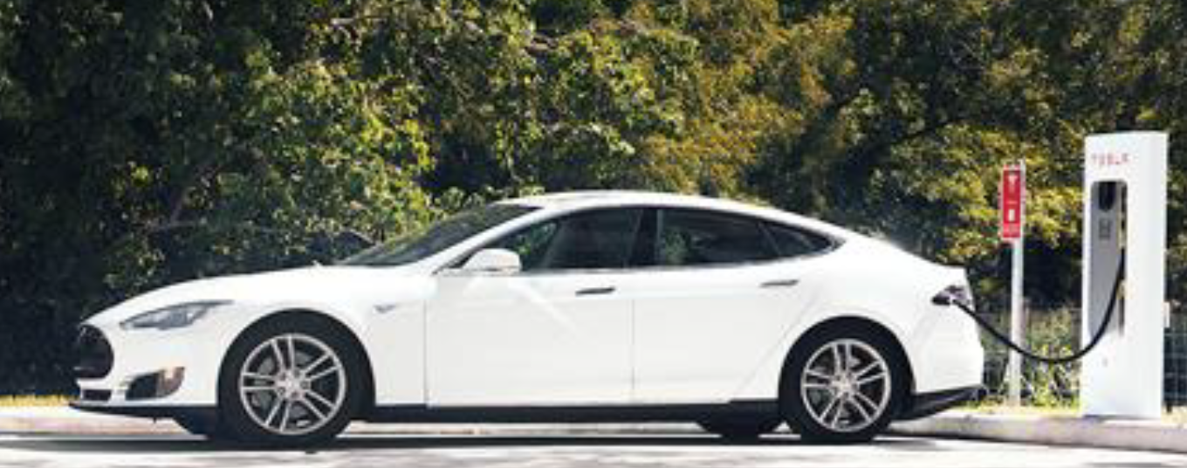
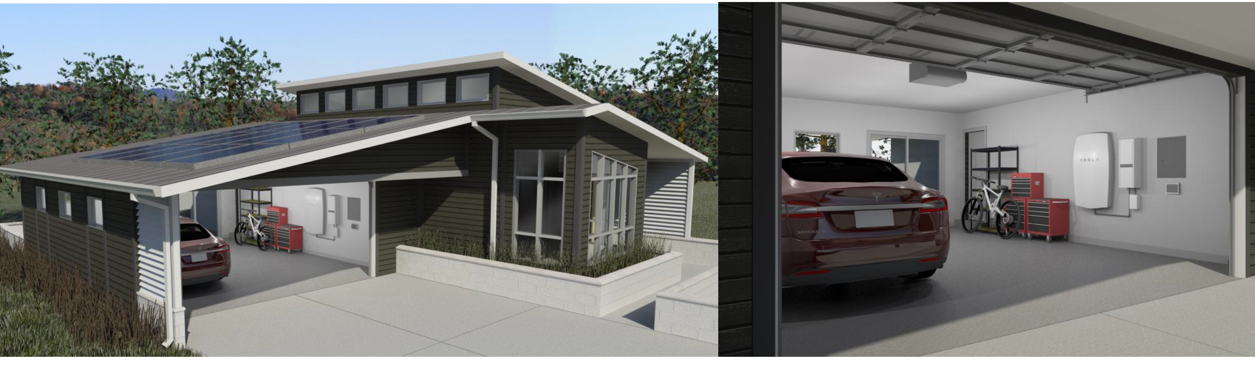
Visions of the Future
Pairing storage with rooftop solar could boom if interest translates into action.
The technology is known, but the business model needed to scale up is unclear.
Source: Mateo Jaramillo, Tesla, June 19, 2017
Notes:
Sunova in March launched SunSafe, its new solar-plus-storage service, making it the latest company to add storage to its offerings. Vivint Solar last year teamed up with Mercedes Benz to offer the automakers' batteries for solar customers. And Tesla offers its Powerwall battery in conjunction with solar panels installed by its SolarCity subsidiary.
In December, Sunrun began its BrightBox solar-plus-storage service in California and in March said that, so far this year, 20% of its solar customers in California have chosen to add storage to their solar installations. Sunrun also offers BrightBox in Arizona, Hawaii, Massachusetts, Nevada and New York.

Slide 10
Emerging Business Models
Business Models
Customers/Vehicle Owners
Non-utility participants
Original Equipment Manufacturers (OEMs)
Utilities
Individual EV owners
Managing charging remotely
Owning charging infrastructure
Providing gasoline cars as back-up for long distance travel
Ownership of charging infrastructure
Open market trading
Participating in the market as aggregators
Ownership of vehicles & charging infrastructure
Leasing infrastructure and vehicles
Participating as aggregators, providing subscriptions
Ride-sharing: contracts among ride share companies & aggregators
Role of vehicle renting companies
Managed charging by third-parties
Contracts for services of grid-integrated vehicles
Leasing vehicles
Ownership of vehicles
Ownership of charging infrastructure
Role of fleet owners

Slide 11
Storage, too—Could it be Mobile?
Utility-scale wind, solar, and storage operating capacity (gigawatts)
(Source: Energy Information Administration. 2018. Annual Energy Outlook 2018)
Notes:
5 KW/car for 100 million cars = 500 GW.

Slide 12
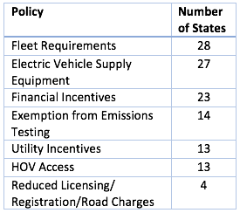
The Policy Ecosystem is Challenging
Federal
State
Local
Tax credit for EVs
Energy storage policies (FERC order 841)
EVSE provision in new construction
Public Charging Infrastructure
EV Policies
Energy Storage Policies are
Progressing:
California has directed its utilities to acquire 500 MW of energy storage by 2020
Massachusetts has ordered its utilities to procure 200 MWh of energy storage by the end of 2019
New York has proposed Energy Storage Deployment Program with a 2030 procurement target
Maryland has adopted a 30% ITC for storage facilities
Nevada has passed storage incentives
Rates, Metering & ICT Policies
Time-of-Use Pricing
Critical Peak Pricing
Real-Time Pricing
Selling connectivity + electricity
Demand charges
Net metering policies
Notes:
Time coordination – ensuring that charging is balanced with the time of use
Power coordination (theoretically possible ) – coordinate the power supply based on the ability of the user to pay

Slide 13
In Sum
Grid-integrated vehicles appear to offer a climate-resilient development pathway.
Two complementary trends:
With renewables, EVs are cleaner
With EVs, the grid could be more resilient
But business models + policy solutions are still needed.
Brown, MA et al. 2018. "Governance of the Smart Grid," Wiley Interdisciplinary Reviews (WIREs): Energy and Environment, DOI: 10.1002/wene.290.
Notes:
Rising share of renewables
Rising share of electricity in transport
Using EV batteries to support the grid

Slide 14
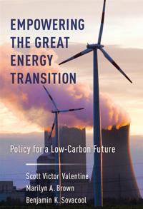
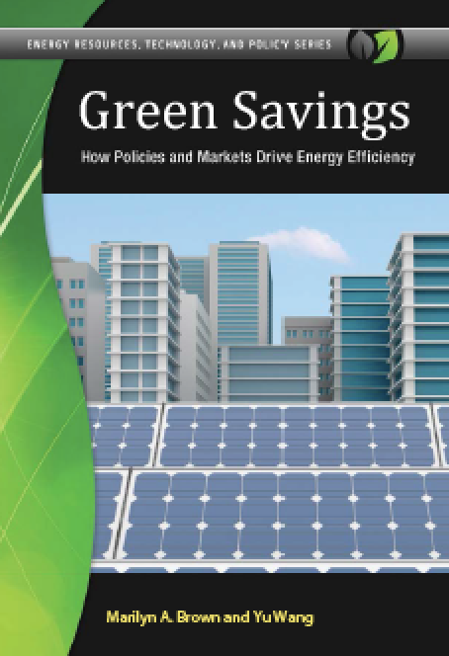
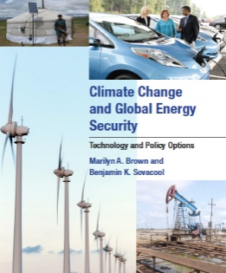
For More Information — and some late night reading??
Dr. Marilyn A. Brown, Regents’ and
Brook Byers Professor of Sustainable Systems
School of Public Policy
Georgia Institute of Technology
Atlanta, GA 30332-0345
Marilyn.Brown@pubpolicy.gatech.edu
Climate and Energy Policy Lab:
www.cepl.gatech.edu
2019 2016
2015 2013

