Slide 1
Integrating Energy Efficiency into the Distributed Energy Resource Mix
Marilyn Brown
Brook Byers Professor of Sustainability
School of Public Policy
Georgia Institute of Technology
Collaborators:
Ben Staver & Alex Smith (Georgia Tech)
John Sibley (Southface Energy Institute)
The Agile Utility: Aligning Distributed Generation with Consumer Demand
November 12, 2014

Slide 2
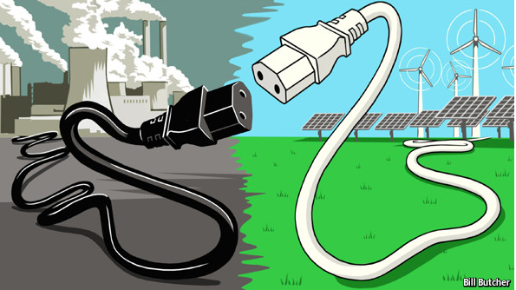
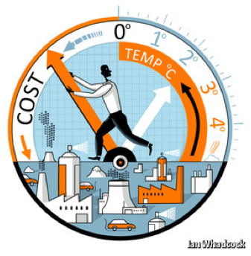
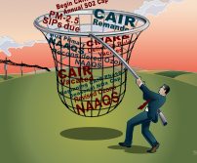
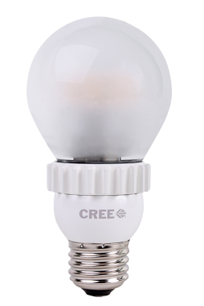
Background: Challenges to the Traditional Utility Business Model
Recent trends are challenging the traditional cost-of-service utility business model:
Technologies
Economics
Policies
Notes:
The utility sector has seen significant transformation in the past decade, prompted in part by the development and deployment of advanced technologies and the evolution of industry policies and regulations. In recent years, such changes have resulted in notable shifts in the marketplace, including new offerings and market entrants, as well as the formation of disruptive business models. Evolving customer offerings around photovoltaic solar, energy efficiency and demand response at the wholesale and retail levels and recent engagements by Google, Comcast and GM in the power sector are but a few examples of how the industry is changing.

Slide 3
Vicious or Virtuous Cycle?
These trends (“disruptive threats”) are placing upward pressure on utility rates:
Are alternative business models needed?
Source: Peter Kind (2013). Disruptive Challenges: Financial Implications and Strategic Responses to a Changing Retail Electric Business. Edison Electric Institute.
Notes:
These trends are placing upward pressure on utility rates.
Consumers are reacting by using more energy-efficiency measures and distributed generation like solar.
The result = “demand destruction”.
The suite of factors on the left of the graphic above imposes an upward pressure on utility rates. Consumers react to higher rates by using more EE measures, distributed resources like solar, etc, which reduces their energy demand from utilities and hence, imposes an even larger pressure for utilities to increase their rate to compensate for the loss in sales.

Slide 4
Origins of our Research Project
Project goal: develop a tool to illuminate the impacts of ratepayer-funded EE programs and advance the debate on best utility business practices
What are the pros and cons of different approaches to allocating the costs and benefits of ratepayer-funded energy-efficiency (EE) programs.
For more information on the project, see: Marilyn A. Brown, Benjamin Staver, Alexander M. Smith, and John Sibley. 2014. "Business Models for Utilities of the Future: Emerging Trends in the Southeast," School of Public Policy, Georgia Institute of Technology, Working Paper #84, http://cepl.gatech.edu/drupal/node/69.
Thanks to the Energy Foundation for their support.
Notes:
The suite of factors on the left of the graphic above imposes an upward pressure on utility rates. Consumers react to higher rates by using more EE measures, distributed resources like solar, etc, which reduces their energy demand from utilities and hence, imposes an even larger pressure for utilities to increase their rate to compensate for the loss in sales.

Slide 5
Methodology
Review business models in the Southeast and define a “prototypical” approach that uses three features:
the recovery of program costs,
the treatment of lost contributions to fixed costs, and
the provision of utility incentives.
Compile public data on a “stereotypical” southeastern utility and EE program.
Use GT-DSM to examine the prototypical approach
GT-DSM and its manual can be downloaded at:
http://cepl.gatech.edu/drupal/node/69
Notes:
Perhaps discuss GPC’s recovery of “Net Lost Revenues” (NC) or “Lost Contribution to Fixed Cost” (MS). Is the RIM result the sum of program costs (incentive + administrative) and (lost revenues – avoided supply costs)?

Slide 6
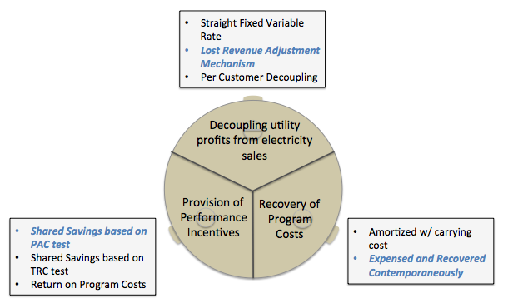
The Prototypical Approach Used in the Southeast
The prototypical approach is highlighted below for each “leg” of the three-legged stool:
Notes:
Bold options represent the “prototypical approach”

Slide 7
Examples in the Southeast
Notes:
For Arkansas, the PSC has provided uniform processes for decoupling. In many states, PSC provisions for energy efficiency business models have been driven by utilities.

Slide 8
The GT-DSM Model is Laid Out in Three Sectors
Customer Sector:
Impact of EE program on electricity rate and utility bill.
Two types of rate classes (Residential & C/I)
Bundled programs or individually
Utility Sector:
Impact of EE program on revenues and utility costs.
Performance incentive
Deferred capital investment
Rate case
Cost-Benefit Analysis Sector:
Estimate for four standard cost-effectiveness tests
Utility-operated EE programs
Alternate stakeholder perspectives for EE

Slide 9
The “Stereotypical” Southeast Utility
Based on public filings describing the Georgia Power Company in 2012 and the energy-efficiency programs proposed by the company in its 2013 IRP filing.
The Georgia Power Company is the largest utility in Georgia. We do not purport to replicate it in GT-DSM.
Serves 2.4 million customers, with annual sales of 81.1 TWh and a peak demand of 15.4 GW. The number of customers is expected to grow by 1.0% per year, and sales and demand are expected to grow 1.24% annually. Annual earnings are $1.2 billion based on an 11.25% return on equity from a rate base of $19.5 billion.
Fuel and purchased power costs are assumed to increase by 6.5% per year. Major capital investments are programmed over the next several years to build out new baseload capacity, make environmental retrofits, and improve transmission and distribution facilities.

Slide 10
The “Stereotypical” Southeast Utility (cont.)
Average rates are 12 ¢/kWh for residential customers and 8 ¢/kWh for commercial and industrial customers.
Residential rates are collected through volumetric charges.
The commercial and industrial rate includes a volumetric charge of 6 ¢/kWh, plus a demand charge, equal to $10/kW in the first year.
The utility has a peak cost period of 2-7pm on weekdays from June to September. This represents roughly 3.7% of the year. Rate cases are filed every three years.
The capital structure is 54% equity and 46% debt, with a cost of debt of 4.2%. The weighted average cost of capital is 8%.

Slide 11
The Portfolio of Residential EE Programs
A collection of programs:
The end-use specific programs include lighting, air conditioning, and other large home appliances.
The whole home programs cover both existing and new homes and generally include insulation and select large appliances.
Annual costs of $8.3 million for incentives and $9.8 million for administrative costs.
Set to save 57.8 GWh and 10.2 MW annually for each year of the measure and program lifetimes.
Average measure life is assumed to be 10 years.
8% of the residential energy-efficiency program savings occur during the utility’s peak period, much more than the roughly 3.7% of the year that occurs during the peak.
“

Slide 12
The Portfolio of Commercial EE Programs
Targets both small and large commercial buildings.
The small commercial program includes appliances, lighting, and insulation.
The other commercial programs are from either a long list of prescriptive facility improvements or from a custom built incentives program.
Annual costs of $13.7 million for incentives and $5.5 million for administrative costs.
Designed to save 241 GWh and 55.3 MW annually for each year of the measure and program lifetimes.
The average measure life is assumed to be 15 years. Since the programs are proposed to deploy measures for 10 years and the measures are assumed to operate for 15 years, our analysis of the impacts of these programs extends for 25 years.
10% of program savings are during the utilities peak period, which is more than for the residential program and also much more than the roughly 3.7% of the year that constitutes the peak.

Slide 13
Results

Slide 14
The Impact of Commercial EE Programs
 | Utility Economics |  | Customer Economics
 | Cumulative Earnings in $Billions | Return on Equity (%) (25-Year Average) | Average Commercial Energy Bill ($/year) | Participant Energy Bill ($/year) | Non-participant Energy Bill ($/year) | Average Commercial Energy Rate (¢/kWh)
Utility Without EE Programs | 47.02 | 11.46 | 28,107 | NA | NA | 12.37
+ Commercial EE Programs | 45.22 | 11.04 | 26,747 | 22,293 | 28,070 | 12.35
+ Program Cost Recovery & Shared Savings Incentives | 45.51 | 11.10 | 26,782 | 22,322 | 28,106 | 12.37
+ Prototypical Business Model | 46.79 | 11.41 | 27,015 | 22,516 | 28,351 | 12.50
Utility economics can be hurt by EE programs, but all customers can benefit.
The prototypical business model restores 99.7% of utility earnings, but rates rise by 1.0%. ROE exceeds authorized level of 11.25%.
Rates still lowered after recovery of program costs and incentives.
Notes:
On the customer side, average bills would drop by 1.9% for residential customers and by 4.8% for C/I customers. Program participants would benefit from much greater bill savings (7.5% for residential participants and 20.7% for commercial participants). Non-participating households and C/I businesses would both benefit from a small reduction in bills due to rate reductions.
Thus, without any elements of the business model being added, the energy-efficiency programs reduce rates by eliminating a greater proportion of more expensive on-peak than off-peak fuel expenditures.
The ratio of on- to off-peak savings creates this effect, which is analogous to the demand reduction-induced price effect (DRIPE) seen in ISO-administered electricity markets and in national studies of industrial energy-efficiency programs. With the DRIPE effect, both participants and non-participants can save on their electricity bills when energy-efficiency programs are introduced and utilities are not fully compensated or incentivized.

Slide 15
The Impact of Residential EE Programs
 | Utility Economics |  | Customer Economics
 | Cumulative Earnings in $Billions | Return on Equity (%) (25-Year Average) | Average Residential Energy Bill ($/year) | Participant Energy Bill ($/year) | Non-participant Energy Bill ($/year) | Average Residential Energy Rate (¢/kWh)
Utility Without EE Programs | 47.02 | 11.46 | 2,533 | NA | NA | 19.23
+ Residential EE Programs | 45.84 | 11.18 | 2,484 | 2,343 | 2,533 | 19.22
+ Program Cost Recovery & Shared Savings Incentives | 45.98 | 11.22 | 2,488 | 2,346 | 2,537 | 19.25
+ Prototypical Business Model | 46.88 | 11.43 | 2,511 | 2,367 | 2,560 | 19.42
Utility economics can be hurt by EE programs, but all customers can benefit.
The prototypical business model restores 99.7% of utility earnings, but rates rise by 1.0%. ROE exceeds authorized level of 11.25%.
Notes:
On the customer side, average bills would drop by 1.9% for residential customers and by 4.8% for C/I customers. Program participants would benefit from much greater bill savings (7.5% for residential participants and 20.7% for commercial participants). Non-participating households and C/I businesses would both benefit from a small reduction in bills due to rate reductions.
Thus, without any elements of the business model being added, the energy-efficiency programs reduce rates by eliminating a greater proportion of more expensive on-peak than off-peak fuel expenditures.
The ratio of on- to off-peak savings creates this effect, which is analogous to the demand reduction-induced price effect (DRIPE) seen in ISO-administered electricity markets and in national studies of industrial energy-efficiency programs. With the DRIPE effect, both participants and non-participants can save on their electricity bills when energy-efficiency programs are introduced and utilities are not fully compensated or incentivized.

Slide 16
The Prototypical Business Model’s Impact on Rates
Rates decline with EE Programs, but increase when lost utility revenues are recovered.
Note: Compared to operating an EE program without any business model features

Slide 17
Average Change in Energy Bills
Note: Compared to operating an EE program without any business model features.
SFVR = straight fixed variable rate for lost revenue recovery
Notes:
“Percent difference in energy bills” is (base case rates) minus (energy efficiency case rates). So the positive values mean that bills decrease with EE

Slide 18
Findings: Impact on Utility Earnings
Authorized Earnings
Earnings Without EE
Authorized
Earnings Without EE
Note: Compared to operating an EE program without any business model features.
SFVR = straight fixed variable rate for lost revenue recovery

Slide 19
The “DRIPE” Effect – Demand Reduction Induced Price Effect
EE programs reduce rates by eliminating a greater proportion of more expensive on-peak than off-peak fuel expenditures.
Deferring “new builds,” environmental retrofits, and T&D upgrades would be additional benefits, but these are not specified for the stereotypical utility.
Even if the utility recovers program costs and is paid incentives, there can be downward pressure on rates because of the “DRIPE” effect.
But with this combination, the utility is still left short of the earnings and ROE it would receive without the EE programs.

Slide 20
Conclusions
Utility earnings are reduced by EE programs, but they can be restored by alternative business models.
With these alternative models, EE programs:
cause modest increases in electricity rates,
reduce average bills for all customers,
significantly cut the electricity bills of participants.
Depending on the choice of business model, non-participant utility bills may also decline.
Selecting the right business model is important to the future of EE programs.
Tying reward to performance is an important principle for regulatory design.
Notes:
Increasing emphasis on tying reward to performance as a principle for regulatory design. Performance-based incentive mechanisms are becoming increasingly important as utilities and regulators will be motivated to sharpen their pencils and identify more granular, and more accurate, avoided costs.
Because of the relatively large impact, lost revenues deserve particular consideration in designing the business model of the future

Slide 21
Conclusions
The “utility of the future” discussion has largely focused on the rush to DG
Yet EE exerts similar stresses to utility economics and is likely to “scale up” significantly
With DER expanding and climate policy likely, we need to define strategies so that the utility industry and consumers can continue to prosper as the grid evolves

Slide 22
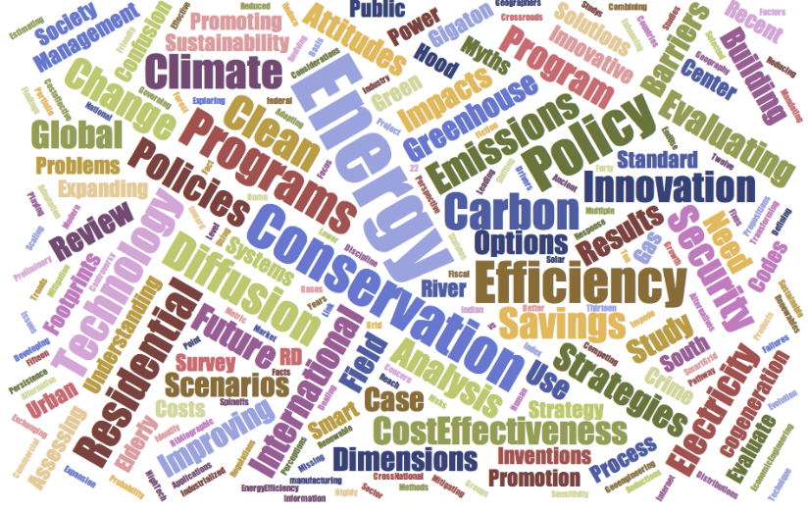
For More Information
Dr. Marilyn A. Brown
Brook Byers Professor
Georgia Institute of Technology
School of Public Policy
Atlanta, GA 30332-0345
Marilyn.Brown@pubpolicy.gatech.edu
Climate and Energy Policy Lab:
http://www.cepl.gatech.edu
My Word
Cloud

Slide 23
GT Understanding of CBA Tests
Ratepayer Impact Measure (RIM)
Benefits: Avoided Supply Costs (Production and T&D)
Costs: Lost Revenues Caused by Reduced Sales, Program Administration Costs, Program Incentives to Participants
Total Resource Cost Test (TRC)
Benefits: Avoided Supply Costs (Production and T&D)
Costs: Program Administration Costs, Participant Measure Costs
Program Administrator Cost Test (PAC)
Benefits: Avoided Supply Costs (Production and T&D)
Costs: Program Administration Costs, Program Incentives to Participants
Participant Cost Test (PCT)
Benefits: Bill Savings, Program Incentives to Participants
Costs: Participant Measure Costs
Notes:
Sources: National Action Plan for Energy Efficiency. 2007. Model Energy Efficiency Program Impact Evaluation Guide, November, http://www.cee1.org/eval/evaluation_guide.pdf

