Slide 1
Georgia Tech Initiative: Grid Integrated Vehicles (GIVs) in the Southeast
Presentation to Stakeholders
Chattanooga Electric Power Board
March 1, 2018

Slide 2
Outline
Introduction to CEPL, CDE, and the GIV Project
GIV Modes and Services
Technological Considerations
Business Models
Utility Models
Cost Benefit Analysis
NEMS
Input Output (IMPLAN)

Slide 3
Introduction
Grid-Integrated Vehicles in the Southeast

Slide 4
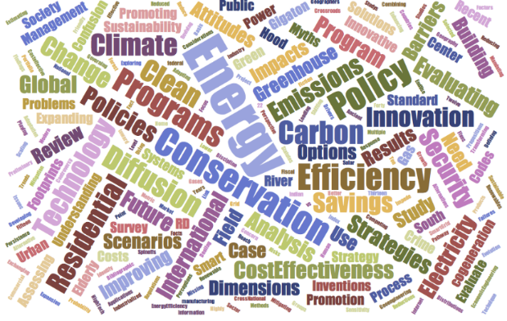
GT Climate and Energy Policy Lab
The Low-Income Energy Burden of Atlanta Households
U.S. SO₂ Emissions: Shifting Factors and a CO₂ Penalty
Electric Urban Delivery Trucks: Energy Use, Greenhouse Gas Emissions, and Cost-Effectiveness
Point Distribution for New LEED Construction
The Emergence of Smart-Grid Policies
www.cepl.gatech.edu

Slide 5
GT Center for Distributed Energy – Overview
Vision: Transforming Electricity Delivery and Utilization

Slide 6
Grid-Integrated Vehicles Business Models for the Southeast
Research Questions
What is the status of the technical components needed to support GIVs?
What business models can increase the adoption of GIVs in the Southeast?
How can GIVs be adapted to the vertically integrated utilities in the Southeast?
What impacts might GIV have on the economy as well as the energy sector in the Southeast?
What are the benefits and costs and are there winners and losers?

Slide 7
giV Modes and services

Slide 8
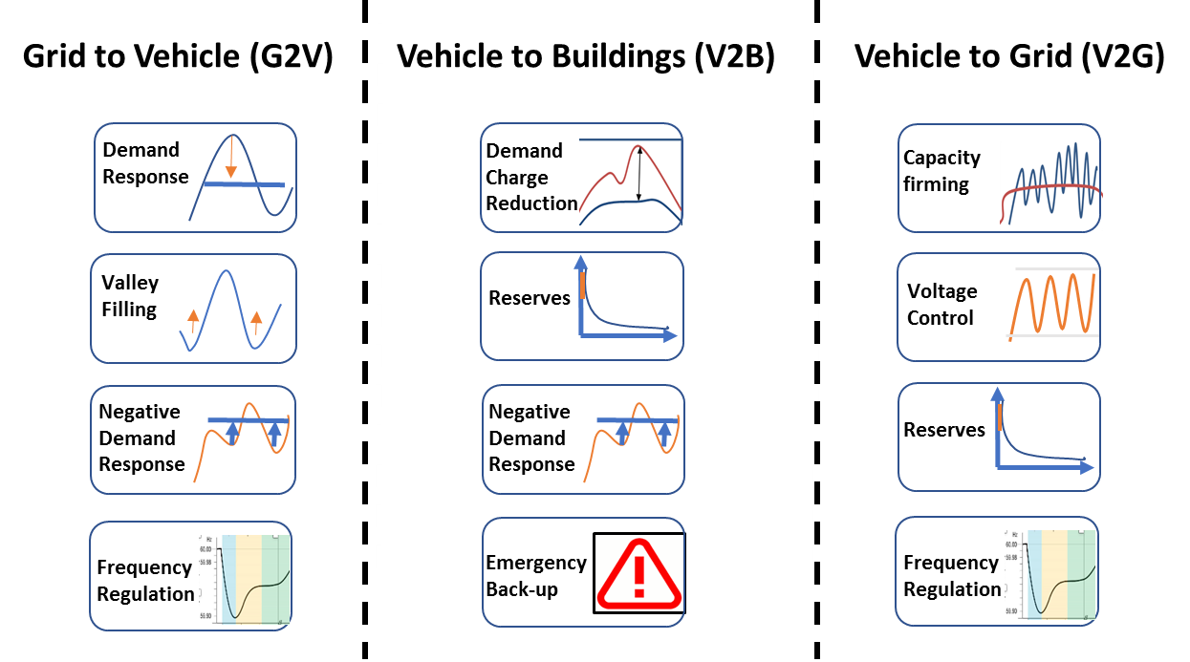
Modes of Grid Integrated Vehicles
How much are these services worth?
What is their marketplace value: today and in the future?
Notes:
Time coordination – ensuring that charging is balanced with the time of use
Power coordination (theoretically possible ) – coordinate the power supply based on the ability of the user to pay (PG)

Slide 9
Possible GIV Grid Services
Service | Definition
Demand Response | Responding to the changes in prices or high demand by charging vehicles when the demand is lower
Valley Filling | Building loads during off-peak hours to help load shifting
Negative Demand Response | Dynamic charging can be used to support demand during low demand periods to support base load power
Coordinated Charging | Synchronizing the charging process in order to avoid demand surges
Demand Charge Reduction | Switching to car batteries during high demand periods can help reduce the demand charges for users
Reserves | The low ramp-up speeds allow vehicle batteries to provide spinning, non-spinning and supplementary reserves
Emergency Back-up | The battery of the vehicle can be used as a storage device that feeds back into the grid in the event of outages
Capacity Firming | Using storage facilities to manage the variable generation, especially with the integration of renewables in the power generation mix
Voltage Control | Using the battery storage and two-way flow help maintain the voltage at the users’ end
Frequency Regulation | Ramping up or down based on the changes in frequency and difference in power demand and supply
Notes:
Time coordination – ensuring that charging is balanced with the time of use
Power coordination (theoretically possible ) – coordinate the power supply based on the ability of the user to pay (PG)

Slide 10
Technological considerations

Slide 11
EV Adoption: Need for GIV
Barriers
Range
Charging
Performance
Cost
Choice
Technical Solutions
Increasing the access to charging infrastructure
Fast charging.. Reduces dwell time
EVs in grid functions.. Generate revenue stream
Increasing the battery life and performance
Other Barriers
Competing charging networks. CHAdeMO, CCS, Tesla… Co-operation and Standard Interfaces needed.
EV adoption requires expensive charging infrastructure – finding new value streams for grid integrated vehicles
Range anxiety must be addressed for broad EV adoption – DCFC infrastructure needed in low density rural areas
By providing an efficient infrastructure, two major barriers - range anxiety and charging time can be addressed.
The role of utility becomes crucial and it can benefit if EVs are smart and grid integrated.

Slide 12
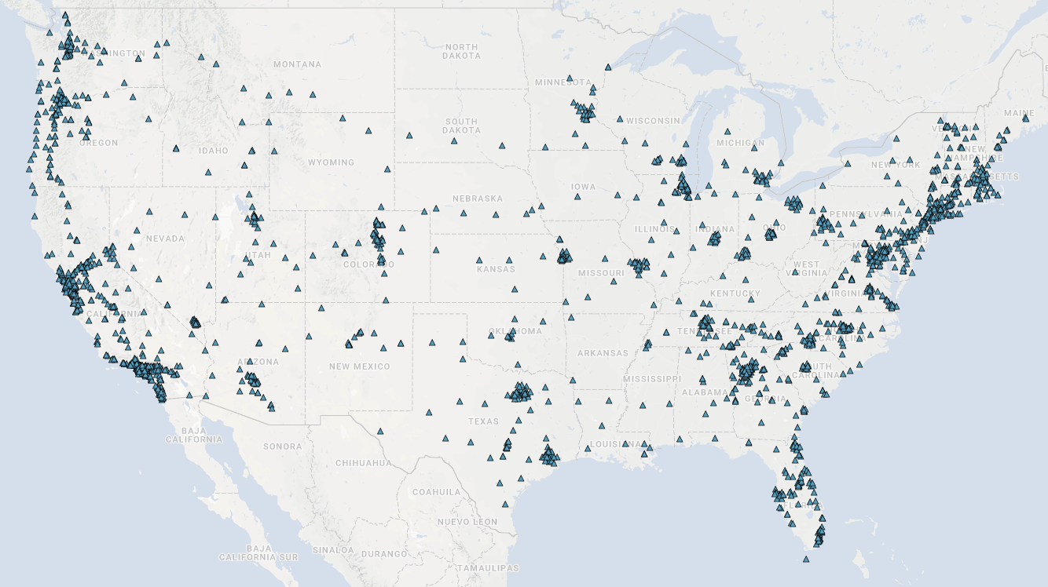
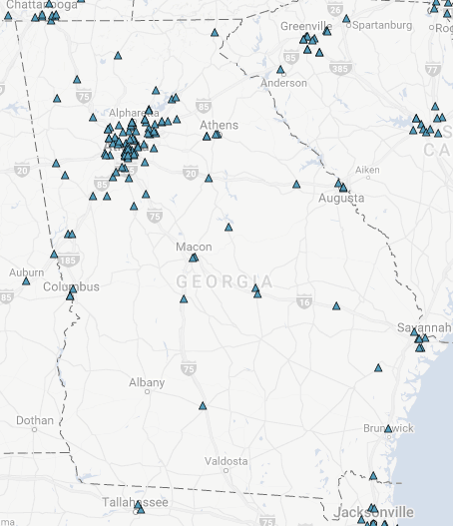
DCFC Infrastructure & Challenge
Constraints
Typical driving range of most available cars: 80 to 200 miles
Time to recharge the EV is significantly more than refueling a gasoline car
Range anxiety
Need for fast charging stations, at least every 20 miles in interstates (and more in urbans/ dense populated areas)
Level 1 and Level 2 charging are not sufficient to address range anxiety
DCFC locations
https://www.afdc.energy.gov/locator/stations
Georgia
Available infrastructure
USA: 2230 stations with ~6200 outlets
GA: 116 stations with 242 outlets
Mostly located in urban and one in more than 50 miles in interstates
Challenges
Business for EV charging station depends on number of EVs – one cannot grow without the other
Need for alternate business models for fast charging stations

Slide 13
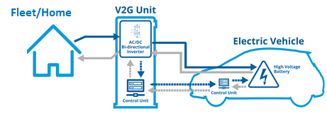
Challenges in Enabling V2G
How would V2G operate in vertically integrated economies?
Latency in terms of following the signal based on inputs to DSO/Aggregator is critical to revenue assessment.
Standardization of communication protocol (IEEE 2030 is on-going )
Need for real-time transactive market model
Fleet management and communication with market clearing centers
Available capacity in fleet.
Consumer Preferences.
Coordination with local utility.
Optimal methods of utilizing the battery without affecting the battery life and ways to address battery warranty issues and obtain qualification assurances from OEMs.
Co-ordination Market
Frequency Regulation/Ancillary Market
Market Clearing
ISO
Available Capacity
Local Utility signals
Aggregator/DSO/Utility
Communication Method?
Charger specifications
Battery Life/Warranty Issues
L2 Charger
Image Courtesy: Fleetkarma.com
Notes:
NOTE 1 – independent studies have shown that properly-managed V2G can actually extend battery life:
https://cleantechnica.com/2017/08/18/european-vehicle-grid-plan-pays-off-electric-car-owners-extends-battery-life/
https://newatlas.com/ev-battery-power-buildings-extend-longevity/50070/
NOTE 2 – Nuvve works with each OEM to qualify its services on vehicle batteries so that the battery warranty is not impacted.

Slide 14
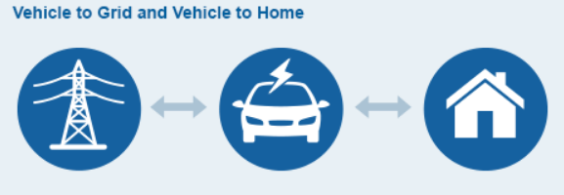
Key Considerations to GIV
Utility Perspective:
Benefits
Frequency regulation, peak shaving, load management, VAR support, ramp rate control (other ancillary services)
V2G may not be needed to realize many of these benefits
EV Charger technology requirement
Level 1, Level 2, Level 3 (DC Fast Charging)
Aggregation requirement
Home
Public charging
Charging at work
Charger manufacturer perspective:
Cost and volume of charger increases
Integration with charging aggregator
Home/EV owner:
Benefits and concerns
Incentives / discount on charging price
Revenue from allowing battery access – battery life/warranty
Emergency power supply (V2B)
Image Courtesy: Fleetkarma.com
Who leads the initiative of GIV ?
Private company / startup ?
EV manufacturer ?
Utility ?
The benefits are diffused
EV/ Battery manufacturer:
Benefits and concerns
Incentives?
Increases EV adoption?
Battery warranty?
*http://www.toyota-global.com

Slide 15
Business models for GIVs

Slide 16
Emerging GIV Business Models
Grid-to-Vehicle (G2V): Related to smart/coordinated charging to make the process of EV charging more efficient (PG&E: BMW)
Vehicle-to-Buildings (V2B): Allowing EV companies to control vehicle charging for dynamic balancing
Vehicle-to-Grid (V2G): Based on a bi-directional flow of power between the vehicle and the grid to enable the vehicle to provide advanced grid services (PJM: Nuvve/U of Delaware; SCE: Nuvve+Torrance School District)
Notes:
Subscription based services for mobility
OEMs with EVs partnering with recharging services
Separate use of vehicles by ownership eg. Fleet owners, car rental companies, OEMS…
Car-to-go: Daimler is operating EVs in cities- shared use mobility. Volvo has also declared goals for EVs
Role of car rental companies: Avis purchased Zipcar
Value to grid vs value to the building vs value to car owner vs value to home

Slide 17
Emerging Models for GIVs
Business Models
Customers/Vehicle Owners
Non-utility participants
OEMs
Utilities
Individual EV owners
Ownership of vehicles
Managing charging remotely
Owning charging infrastructure
Providing ICEs as back-up for long distance travel
Role of fleet owners
Leasing vehicles
Ownership of charging infrastructure
Contracts for GIV services
Open market trading
Participating in the market as aggregators
Ownership of vehicles and charging infrastructure
Leasing infrastructure and vehicles
Participating as aggregators & providing subscription
Ride-sharing
Role of vehicle renting companies
Special contracts among ride share companies & aggregators
Managed charging by third-parties

Slide 18
Emerging Trends
Changing definitions of electricity consumers
Consumers becoming producers as well as consumers – “Prosumers”
Residential prosumers – distributed energy generation
Commercial prosumers – do not rely on electricity generation as their main revenue source
Public Institutions – schools, public buildings etc.
V2G is another form of ‘prosumership’ where the vehicle owner is a consumer as well as a producer of the resource
Notes:
Source: Judy Chang – Brattle Group presentation
For definitions of prosumers: European Parliament Think Tank: http://www.europarl.europa.eu/thinktank/en/document.html?reference=EPRS_BRI(2016)593518
Image Source: DoE, 2017. Consumer vs Prosumer: What's the Difference?. Office of Energy Efficiency & Renewable Energy, Department of Energy. https://www.google.com/url?sa=i&rct=j&q=&esrc=s&source=imgres&cd=&cad=rja&uact=8&ved=0ahUKEwjMyJGy157YAhVKTSYKHZPQBmIQjRwIBw&url=https%3A%2F%2Fenergy.gov%2Feere%2Farticles%2Fconsumer-vs-prosumer-whats-difference&psig=AOvVaw0jhEvhnxTdYxNtdbakFQIw&ust=1514068649543563

Slide 19
Impact on the Grid
Changing the demand and supply dynamics
Additional infrastructure needed to account for two way supply to the grid
Grid Modernization Initiative (DoE, 2015):
Greater resilience
Improved reliability
Enhanced security
Additional affordability
Superior Flexibility
Increased sustainability
Notes:
Source: https://energy.gov/eere/articles/consumer-vs-prosumer-whats-difference
DoE, 2015. Grid Modernization Multi-Year Program Plan. US Department of Energy. Retrieved December 22, 2017 from https://energy.gov/sites/prod/files/2016/01/f28/Grid%20Modernization%20Multi-Year%20Program%20Plan.pdf

Slide 20
Car Ownership Models
Evolution to the mobility services model
The sharing economy has affected the ownership of vehicles
Ride sharing
Renting vehicles
Autonomous vehicles
This will affect the pattern of usage and availability of storage resources on demand for ancillary services

Slide 21
Ownership Models
Mode of ownership | Availability to offer ancillary services | Requirement for charging
Consumer-owned | High – syncing with the owners’ usage patterns is possible and day ahead decision making is also viable | Evenings to morning and during the day
Rented | Limited – vehicles are available to provide grid services when idle and sometimes when being used by renters | Mixed, based on renting pattern of consumers
Leased | High – similar to the consumer owned vehicles | Similar to consumer owned vehicles
Use for ride share | Varied – availability would fluctuate widely | Depending on the service offering by the driver

Slide 22
Next Steps: Cost Benefit Analysis

Slide 23
National Energy Modeling System
NEMS: regional energy-economy model of the United States
Annual projections to 2040/2050:
Consumption by sector, fuel type, region
Production by fuel
Energy imports/exports
Prices
Technology trends
CO₂ emissions
Macroeconomic measures and energy market drivers

Slide 24
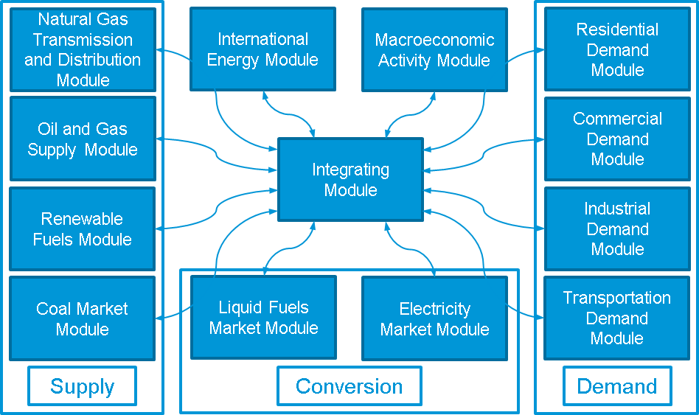
NEMS Uses a Modular Structure
A key aspect of the NEMS is its modular structure, which allows for individual modeling methodologies for each energy sector and facilitates model management
Where appropriate and significant information exists, each sector is represented by a detailed structural model of the market.

Slide 25
Modeling GIV in NEMS 2018
We are just beginning to scope this. Here’s our understanding thus far:
EVs with 100-, 200-, and 300-mile ranges are modeled
State ZEV mandates are modeled
$7500 tax rebate is modeled, but the 200,000 cap per car manufacturer is not
No scrappage value
The electric sector models a 4-hour lithium-ion battery (new this year)
864 types of hours or time slices (12x24x3) are modeled
EV charging is modeled as an electricity load

Slide 26
Input-Output for Modeling Jobs
Purchasing Sector
z₁₁
……………………..
z_{1n}
C₁ I₁ E₁ G₁ X₁
Selling Sector
……………….
……………….
……………….
z_{ij}
z_{n1}
……………………..
z_{nn}
X_{n}
L₁
N₁
T₁
M₁
X₁
L_{c} L_{i} L_{e} L_{g} L
N_{c} N_{i} N_{e} N_{g} N
T_{c} T_{i} T_{e} T_{g} T
M_{c} M_{i} M_{e} M_{g} M
C I E G X
Imports
……………………..
X_{n}
Where Z_{ij} is $ values of the transactions between sector i and sector j,
C_{i} is the consumer purchases,
I_{i} is the purchases for investment purposes,
E_{i} is the sales abroad (exports),
G_{i} is the government (federal, state, and local) purchases,
X_{i} is the total output, and X is total gross output throughout the economy.
(Source: Miller and Blair, 2009 p.3)
Notes:
Monetary values of the transactions b/w pairs of sectors (from each sector I to each sector j)
Interindustry structure/Consumption patterns/Incomes/Nonmarket Transfers
Lg represents payment to government workers.
Lc includes household payments for domestic help.
Tc includes tax payments by households.
Mg represents government purchases of imported items
Me represents imported items that are re-exported.
X=X1+….+Xn+L+N+T+M = X1+….+Xn+C+I+E+G
L+N+T+M=C+I+E+G
L+N+T=C+I+G+(E-M)

Slide 27
Employment in I-O Models
Computing economy wide effects of investments on Output & Employment
Three types of employment results
Direct: Directly affected by business activity (production and sales of EVs in the transportation sector)
Indirect: Impacts caused by inter-industry exchanges (purchase of production inputs)
Induced: Impacts created by household spending of those directly and indirectly employed by the industry (Spending by those employed in the Industry)

Slide 28
Process of Calculating the Effects
Bill of Goods
Share o different components
IMPLAN Industry codes and multipliers
Investment Levels
Total investments made in the transportation sector
Employment Numbers
By sector
By type

Slide 29
Appendices

Slide 30
Governance Models for Utilities

Slide 31
Types of Utility Models
Investor owned utilities – For profit companies owned by shareholders
Public Power Utilities – Not-for-profit utilities owned by local government agencies
Cooperatives – Not-for-profit entities owned by members
Federal Power Programs – wholesale only entities that own different segments of the power sector business
Independent Power Producers – Privately owned businesses that own their generation assets
Notes:
Source: US Electricity Industry Primer, DOE; https://www.energy.gov/sites/prod/files/2015/12/f28/united-states-electricity-industry-primer.pdf

Slide 32
Implications of Governance Structures
Impact on the ability to set rates
Ability to provide different services and market them
Ability to stack different ancillary services

Slide 33
Vertically Integrated Utilities
Electricity rates are set on the basis of cost to serve
Monitoring by the regulatory commission
Ancillary services are provided in-house making it difficult to put a value on them

Slide 34
Competitive Markets
RTOs
PJM – PJM Interconnection
MISO - Midcontinent Independent System Operator
SPP – Southwest Power Pool (also a regional reliability council)
ISONE – ISO New England
ISOs
CAISO – California ISO
NYISO – New York ISO
ERCOT – Electric Reliability Council of Texas (also a regional reliability council)
MISO – Midcontinent ISO
ISO NE – ISO New England
AESO – Alberta Electric System Operator
IESO – Independent Electric System Operator

