Slide 1
IGERT
Energy Materials
& Policy
ENERGY EFFICIENCY AND SOLID STATE LIGHTING
Setting the stage by Georgia Tech NSF IGERT Faculty: --Professor Bernard Kippelen, Electrical and Computer Engineering --Professor Valerie Thomas, Industrial and Systems Engineering Research results presented by Georgia Tech NSF Fellows: Materials and Systems --Ryan Murphy, Materials Science and Engineering, Policy and Economics --Mallory Flowers, School of Public Policy
Forum and Celebration of Energy Transitions

Slide 2
IGERT
Energy Materials
& Policy
Energy Efficiency and Solid-State Lighting:
An introduction
Bernard Kippelen
Joseph M. Pettit Professor in Electrical and Computer Engineering
Director, Center for Organic Photonics and Electronics
kippelen@gatech.edu
404 385-5163
Forum and Celebration of Energy Transitions

Slide 3
Legacy technology
60 Watts
900 lumens
15 lm/W
1,500 h
…see you in the museum.

Slide 4
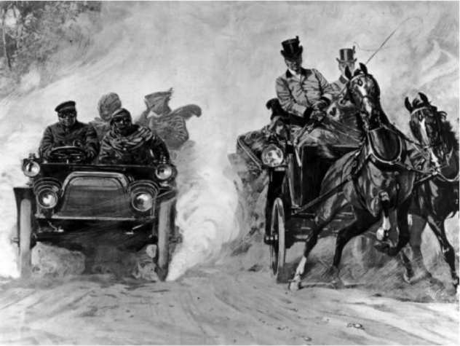
Innovation

Slide 5
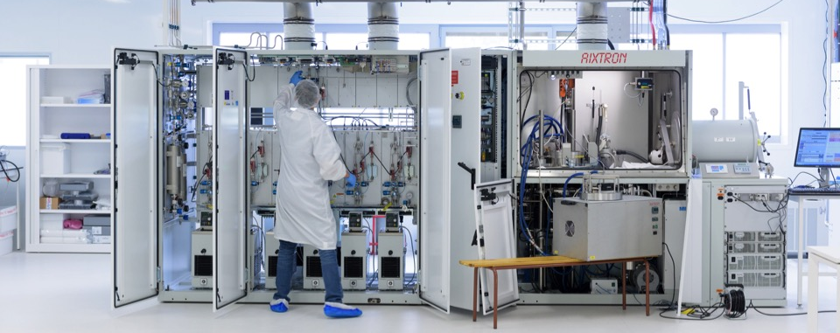
Innovation drivers
INORGANIC SEMICONDUCTORS
Novel compound semiconductors grown by MOVCD or MBE (e.g. GaN)

Slide 6
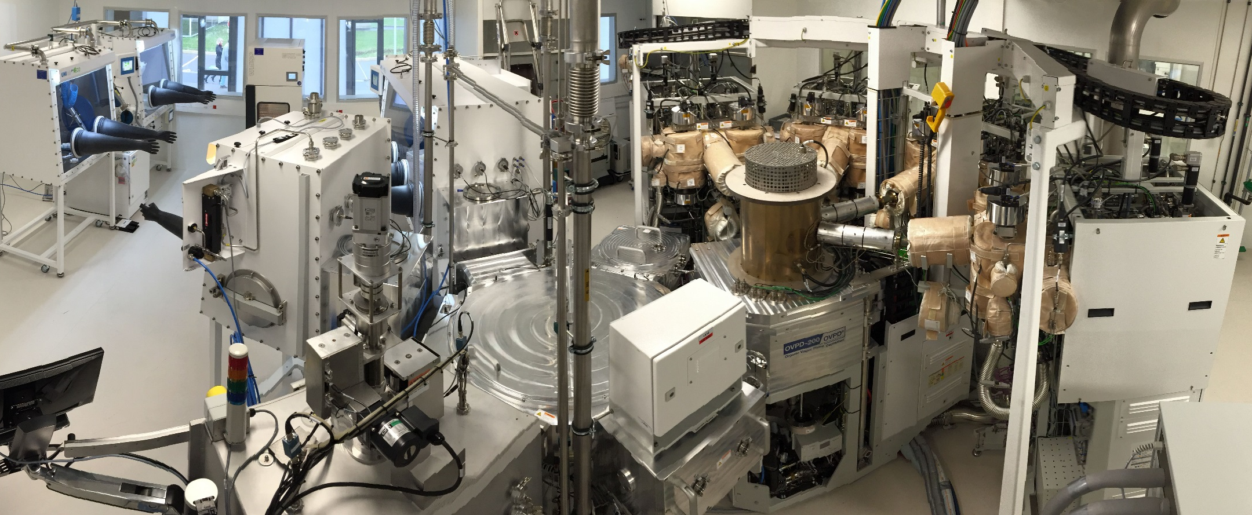
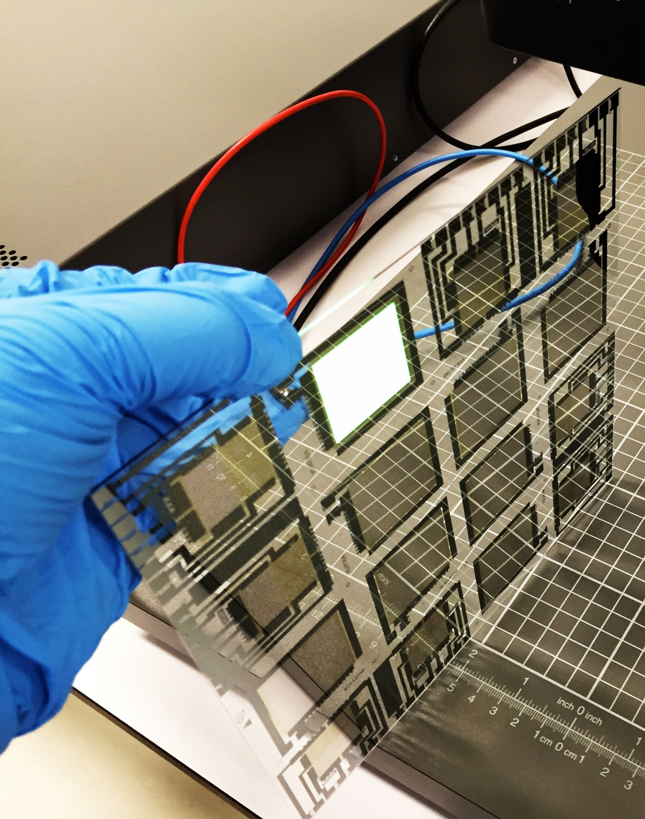
OLEDs
ORGANIC SEMICONDUCTORS
Processed over large area at room temperature. The future is flexible.

Slide 7
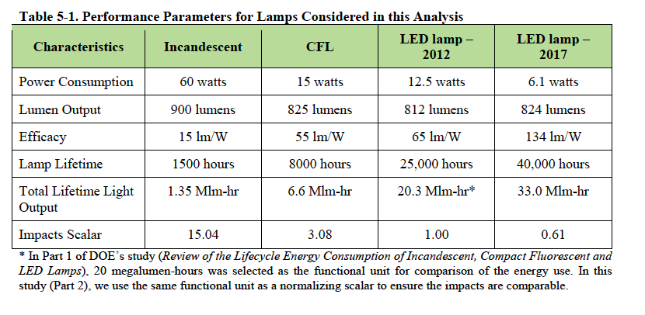
Performance comparison

Slide 8
Solid State Lighting (SSL)
“Solid-state lighting has contributed to more than $2.8 billion in U.S. energy cost savings over the past 15 years, and further SSL technology advances will increase those savings even more in the years to come. By 2035, SSL could reduce national lighting electricity use by 75% -- which would equate to the total energy consumed by 45 million American homes today and could save American families and businesses $50 billion annually, not to mention add jobs and boost the economy.”

Slide 9
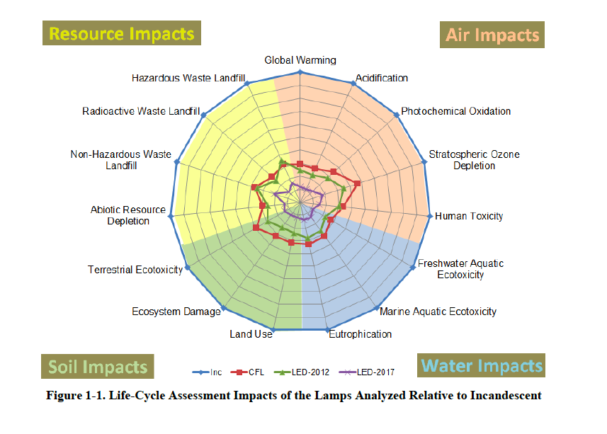
Beyond energy savings

Slide 10
IGERT
Energy Materials
& Policy
Energy Efficiency and Solid-State Lighting:
An introduction
Valerie Thomas
Anderson Interface Professor
in Industrial and Systems Engineering and Public Policy
vt34@gatech.edu
404 385-7254
Forum and Celebration of Energy Transitions

Slide 11
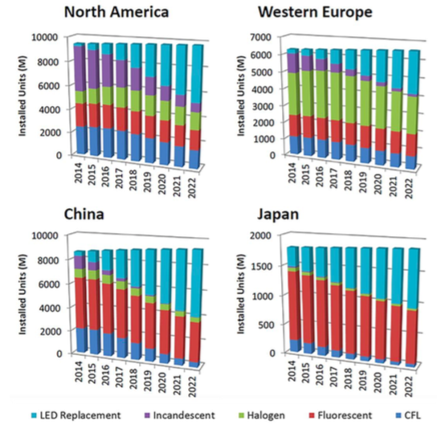
Japan Led Early Adoption Due to Prioritizing Energy Savings after Fukushima
Notes:
Evolution of Regional Installed Lamp Base by Lighting Technology
Source: Stephanie Pruitt, Strategies Unlimited, November 2015 [34]:S. Pruitt, "Testimony to National Academy of Science Committee on Solid State Lighting," Washington, DC, November 2015.
As cited in EERE, Solid State Lighting R&D plan, June 2016.

Slide 12
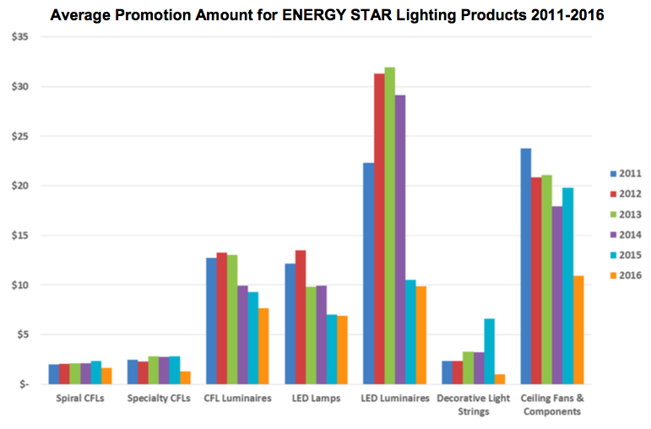
EIA, 2016, Energy Star Summary of Lighting Programs

Slide 15
IGERT
Energy Materials
& Policy
“Challenges of Solid State Lighting Adoption”
Ryan Murphy
School of Materials Science and Engineering
rjmurphy@gatech.edu
Forum and Celebration of Energy Transitions

Slide 16
IGERT
Energy Materials
& Policy
Outline
Advantages of LEDs
Challenges of LEDs and LED Adoption
New Technologies and Policies to Improve LED Adoption
Forum and Celebration of Energy Transitions

Slide 17
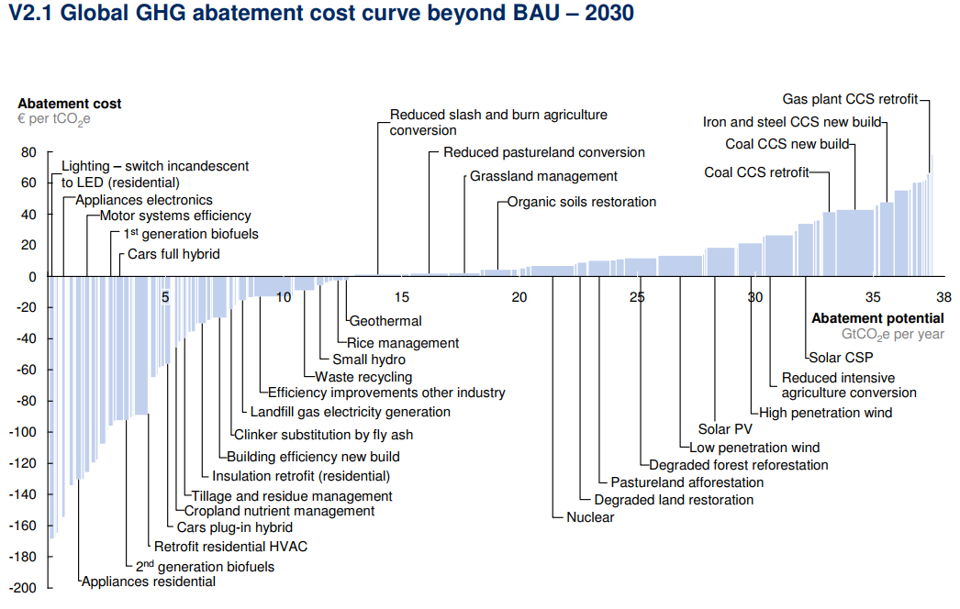
IGERT
Energy Materials
& Policy
A Reduction in Energy Consumption Does not Have to Cost the Economy!
McKinsey & Company, Version 2.1 of the Global Greenhouse Gas Abatement Cost Curve, 2010
Forum and Celebration of Energy Transitions

Slide 18
IGERT
Energy Materials
& Policy
Simple Estimations Show Huge Savings Over Traditional Incandescent Bulbs
 | LED | Incandescent
Upfront cost | $8 | $1
Energy | 11 watts | 60 watts
Lifetime | 50,000 | 1,200
Power @ 6 hours per day | 66 Wh/day | 360 Wh/day
Cost per day @ 7 ₵ per kWh | 0.46 ₵ | 2.52 ₵
Cost per year @ 7 ₵ per kWh | $1.69 | $9.20
Assuming you have to replace the incandescent bulb at least once in the first year (avg lifetime 200 days), you break even after 291 days
Over the lifetime of a LED (~23 years) you save $205
Forum and Celebration of Energy Transitions

Slide 19
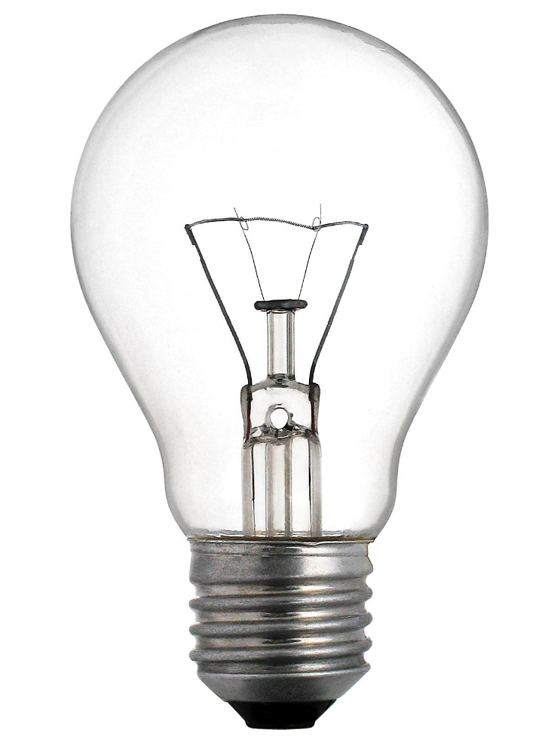
IGERT
Energy Materials
& Policy
Lighting has Become More Efficient but Also More Complicated
Forum and Celebration of Energy Transitions
Notes:
Traditional vs Florescent, vs LED

Slide 20
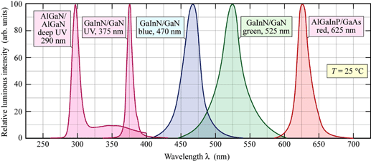
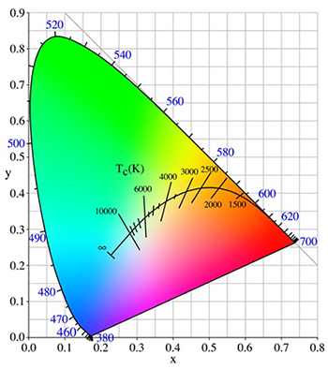
IGERT
Energy Materials
& Policy
…And to Create Natural Looking Light is Even More Difficult
Sunlight
LEDs
Intensity
400
500
600
700
Wavelength (nm)
Kirk-Othmer Encyclopedia of Chemical Technology (John Wiley & Sons, Inc., Hoboken, NJ, USA, 2000).
S. Keeping, How the CIE Color Space is Used to Design Better LEDs. Digi-Key Artic. Libr.
Forum and Celebration of Energy Transitions
Notes:
Traditional vs Florescent, vs LED

Slide 21
IGERT
Energy Materials
& Policy
Despite Their Low Overall Cost, LEDs have not Been as Widely Adopted as Expected
High Up-Front Costs
Lack of Clear Information
Lumens
Equivalent Watts vs. Watts Consumed
Color Temperature
Color Stigmatization
Forum and Celebration of Energy Transitions

Slide 22
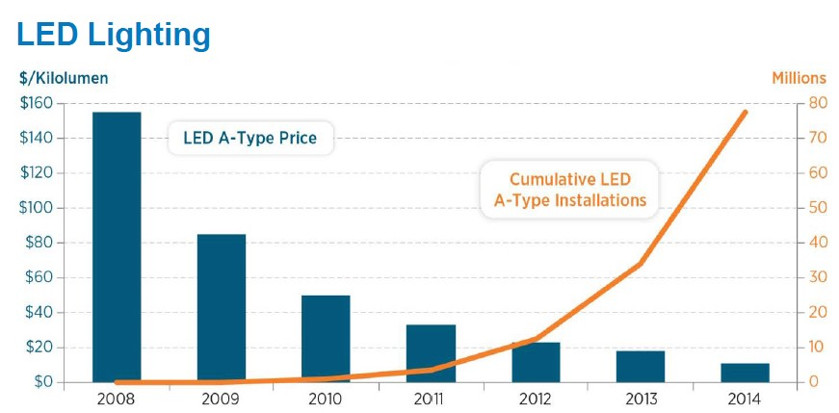
IGERT
Energy Materials
& Policy
As With Most Electronics, LED Cost will Decline as Demand and Production Increases
Source: DOE
Forum and Celebration of Energy Transitions

Slide 23
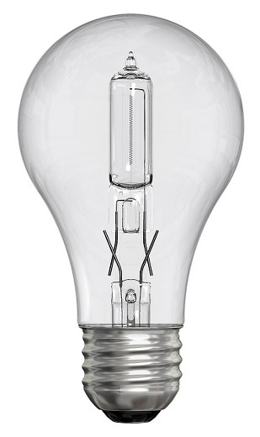
IGERT
Energy Materials
& Policy
Setting Standards for Lightbulb Efficiencies can Increase LED Demand
In 2012, the Energy Independence and Security Act of 2007 began to require all light bulbs be at least 25% more efficient than traditional incandescent bulbs
Source: DOE
Forum and Celebration of Energy Transitions

Slide 24
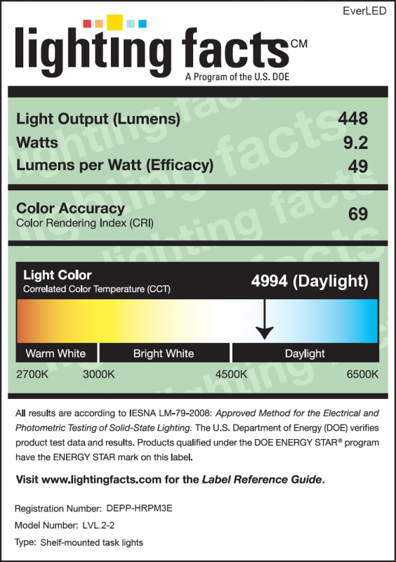
IGERT
Energy Materials
& Policy
Clear Information is Key to Removing Stigma
Forum and Celebration of Energy Transitions

Slide 25
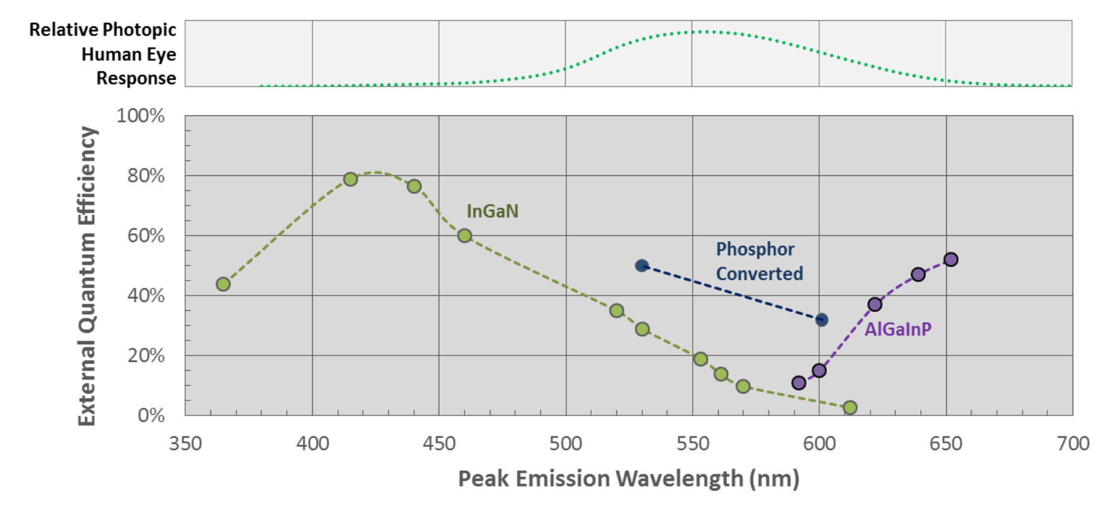
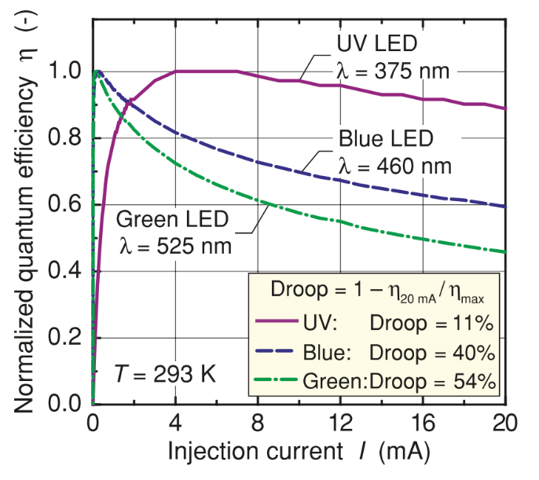
IGERT
Energy Materials
& Policy
The Difficulty of Improving the Color Accuracy of LEDs is Green Light
Forum and Celebration of Energy Transitions

Slide 26
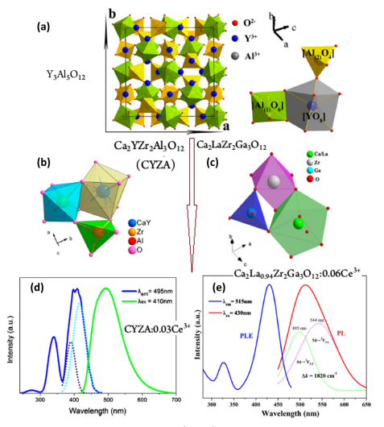
IGERT
Energy Materials
& Policy
Improving Phosphor Efficiency
Z. Xia, Q. Liu / Progress in Materials Science 84 (2016) 59–117
Forum and Celebration of Energy Transitions

Slide 27
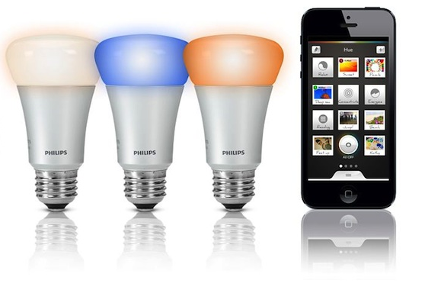
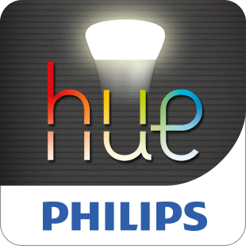
IGERT
Energy Materials
& Policy
Smart Bulbs Can Help Displace Stigma and Further Reduce Energy Usage
Forum and Celebration of Energy Transitions

Slide 28
IGERT
Energy Materials
& Policy
Policy, New Materials, and Smart Devices Togeather Can Address the Challenges of Solid State Lighting
Forum and Celebration of Energy Transitions

Slide 29
IGERT
Energy Materials
& Policy
Acknowledgements
Kera Allen, School of Public Policy
Usayd Casewit, School of Public Policy
Carolyn Buckley, School of Chemistry and Biochemistry
NSF IGERT Program
Forum and Celebration of Energy Transitions

Slide 30
IGERT
Energy Materials
& Policy
Energy Efficiency & SSL in the Built Environment
Traditional Policy Approaches
Market-based Approaches
Forum and Celebration of Energy Transitions
Notes:
Codes, Regulations: slow, but don’t hurt
Economics side: market failures must be addressed
Information programs like benchmarking & voluntary certification
Dissertation examines technology adoption toward certification for LEED; will focus on that program

Slide 31
IGERT
Energy Materials
& Policy
Theory: Why Volunteer for Certification?
Market premiums from signaling green
Improved employee/occupant experience
Reduced utility bills
Forum and Celebration of Energy Transitions
Notes:
Emphasize that this is a signal, that it’s made up of a lot of stuff / tech / impacts
Note comprehesive but flexible

Slide 32
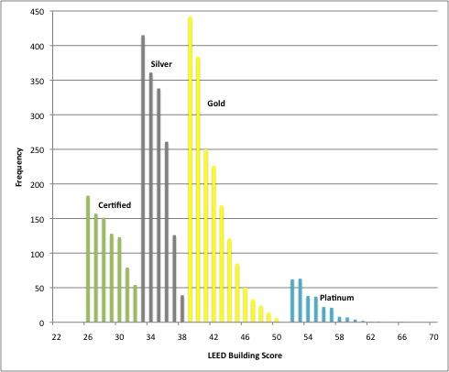
IGERT
Energy Materials
& Policy
Practice: What is the Market Signal Worth?
Forum and Celebration of Energy Transitions
Notes:
LEED: get points for specific technologies; need enough to certify into one of these tiers.
Typically don’t see what tech the signal is made of. Just this distribution that suggests they really want the label.
Studying the diffusion of tech let’s us know how we value signals
And tells us something about the effectiveness of certification programs
Skip over details of the approach

Slide 33
IGERT
Energy Materials
& Policy
Findings
Certification incentivizes:
Energy & Water Efficiency
But is more limited at promoting:
Indoor Environmental Quality
(Low-VOC materials, Improved Ventilation, etc)
Provision of Public Goods
(Habitat Protection, Stormwater Controls, Albedo Effects, etc)
Forum and Celebration of Energy Transitions
Notes:
Promising for the Energy Transition!
But we still have a ways to go,
Unique new challenges around promoting sustainability in other areas

