Slide 1
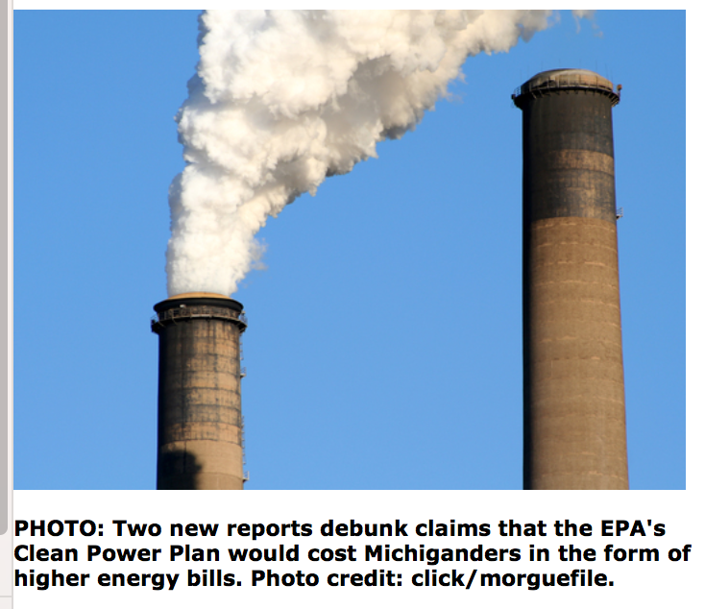
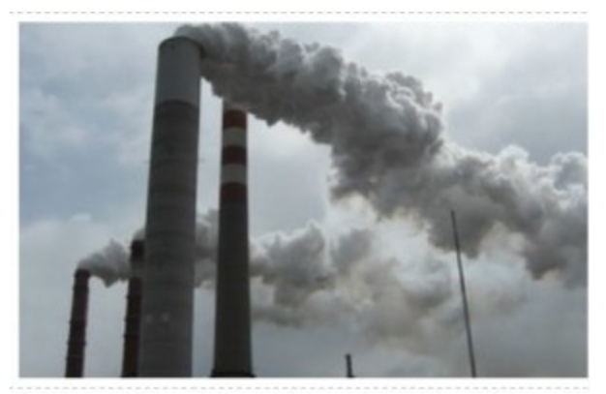
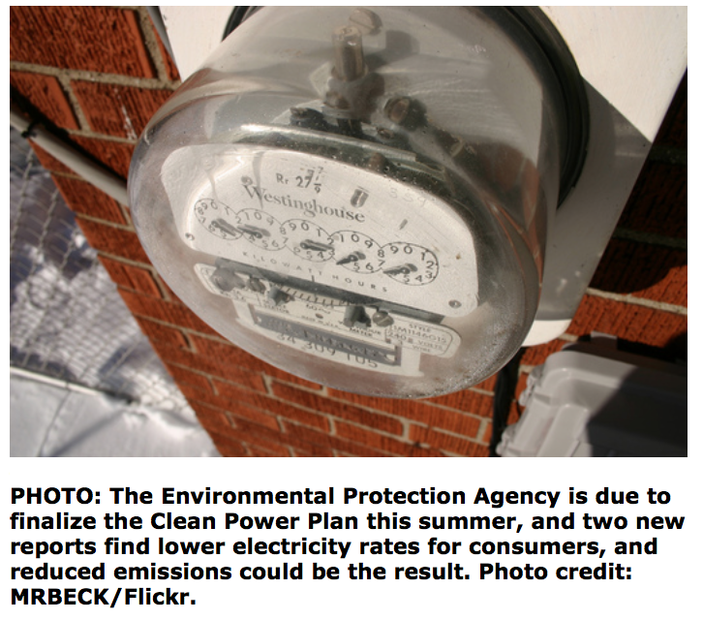
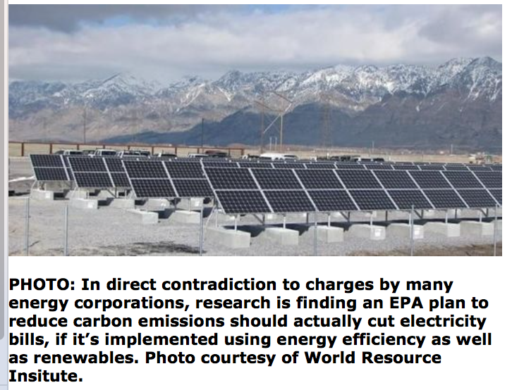
Georgia Tech and Synapse Reports Show How EE Reduces CO₂ and Electricity Bills
CEPL.gatech.edu/clean-power-pathways

