Slide 1
Choosing Our Energy Future II
A TOWN HALL DISCUSSION OF REGULATORY SCENARIOS
AND NO-REGRETS STRATEGIES FOR GEORGIA
October 14, 2016
#GAenergy

Slide 2
Café Conversations:
Central Questions:
How can Georgia thrive across a range of future scenarios?
What “no-regrets strategies” should we consider?
5-minute overview presentations from topic experts
Maximizing Innovation, Economic Development and Jobs
Supporting Economic Transition Opportunities in the Event of Power Plant Closings
Addressing Low-Income Energy Needs
Achieving Environmental Compliance
Adapting the Utility Business Model
Ongoing State Energy Planning
60-minute discussion at your tables:
Explore “key questions” from presenters
What no-regrets strategies should Georgia consider?
What processes/organizations can take these strategies forward?
3-minute readouts from each table, including top 2 “no-regrets strategy” proposals
Quick vote

Slide 3
Topic 1 Maximizing Innovation, Economic Development and Jobs
Expert Presenter:
Costas Simoglou
Georgia Department of Economic Development, Center for Innovation for Energy
Discussion Leaders:
Garry Harris
Center for Sustainable Communities
James Marlow
Radiance Solar
Recorders:
Charlotte Courtade
Emory University
Faris Mohammed
Emory University

Slide 4
Topic 1 Maximizing Innovation, Economic Development and Jobs
Overview
Discussion Questions
No-Regrets Strategies
How can we:
Focus on our “unfair” advantages?
build industry Ecosystems?
Localize the food & energy models?

Slide 5
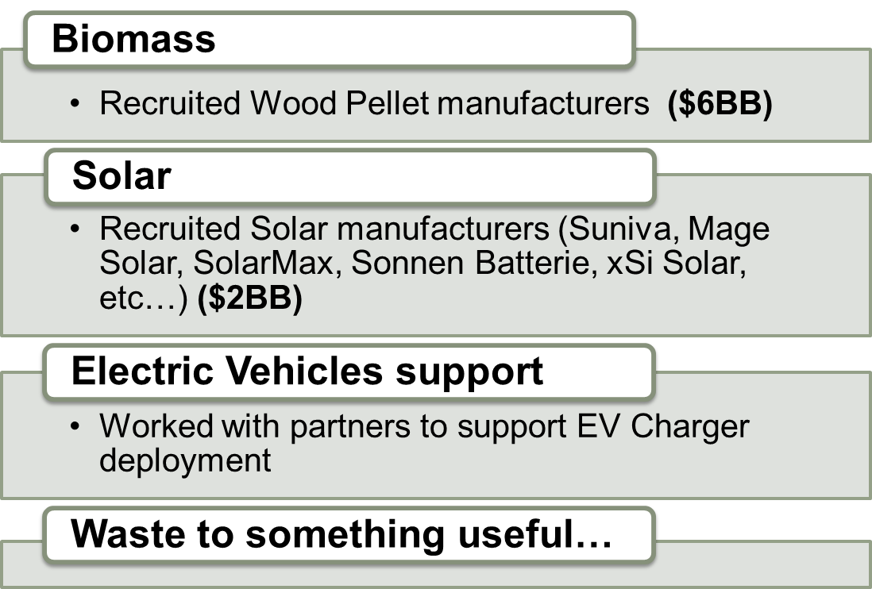
Topic 1 Maximizing Innovation, Economic Development and Jobs
Overview
Discussion Questions
No-Regrets Strategies

Slide 6
Topic 1 Maximizing Innovation, Economic Development and Jobs
Cleantech industry status - 2015
Overview
Discussion Questions
No-Regrets Strategies
Companies: 801
Jobs: 19,231
Gross Revenue: $3,333,211,625
Cleantech Industry Future????
Autonomous Electric Vehicles
Energy Storage
Robots (cheap) for everything!
Change in business models

Slide 7
Topic 2 Supporting Economic Transition Opportunities in the Event of Power Plant Closings
Expert Presenter and Discussion Leader:
Ian Karra
Sierra Club
Recorder:
Jenna McGrath
Georgia Tech

Slide 8
Topic 2 Supporting Economic Transition Opportunities in the Event of Power Plant Closings
Overview
Discussion Questions
No-Regrets Strategies
National transition from coal is underway
242 out of 523 coal-fired power plants have been retired, announced for retirement, or have a specific retirement date
Economic and environmental sustainability are increasingly connected
Georgia’s transition needs are unique from the rest of Appalachia
Jobs at generating facilities, contractors, and downstream economic activity
Tax revenue*
Energy planning processes present both a challenge and an opportunity for economic development in coal communities

Slide 9
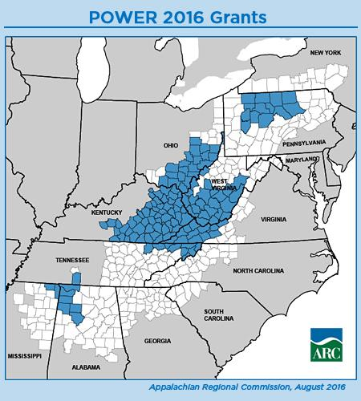
Topic 2 Supporting Economic Transition Opportunities in the Event of Power Plant Closings
Overview
Discussion Questions
No-Regrets Strategies
Opportunities
TVA Widows Creek Plant
1600 MW coal plant -> $600 million Google data center
Donation of Plant Kraft
POWER Initiative funding
State-driven transition resources
Massachusetts
Oregon
New York

Slide 10
Topic 2 Supporting Economic Transition Opportunities in the Event of Power Plant Closings
Overview
Discussion Questions
No-Regrets Strategies
What opportunities exist for supporting the communities affected by these changes?
Are there strategies that can replace some or all of the tax revenues and employment that these plants provide?
What are the opportunities for re-use and economic development? How might training and education programs for displaced workforce assist?
How can stakeholders in coal communities engage more fully in energy planning processes?
What resources or strategies already exist to assist in transition planning (federal funding, utility ED resources, academic, success stories from the field)?

Slide 11
Topic 2 Supporting Economic Transition Opportunities in the Event of Power Plant Closings
Overview
Discussion Questions
No-Regrets Strategies
Minimize the shock of plant closures
Maximize the planning timeline
Work with what we’ve got
Existing infrastructure
Planned new generating capacity
Learn from success stories, avoid repeating history
Recruit creative thinking
Leverage funding opportunities, brain trust
Smarter energy management

Slide 12
Topic 3 Addressing Low-Income Energy Needs
Expert Presenter and Discussion Leaders:
Seandra Pope
Rooted Consulting Group
Lisa Flick Wilson
Southeast Energy Efficiency Alliance
Recorders:
Lu Wang
Georgia Tech

Slide 13
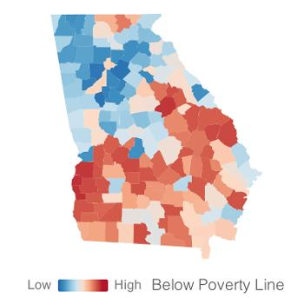
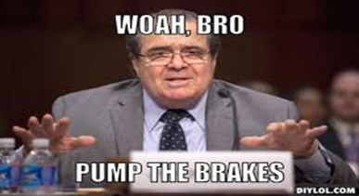
Topic 3 Addressing Low-Income Energy Needs
Overview
Discussion Questions
No-Regrets Strategies
From Game On to Freeze & Pivot
Atlanta ranked highest energy burden (18.2%) in the SE for low-income households*
*ACEEE Energy Burden Report, 2016
Notes:
Poverty in GA and Energy Burden in Atlanta
We all know the statistics about poverty in Georgia, as well as similar trends across the deep South. Georgia’s 2015 Poverty Report showed that Georgia overall has 18.3% of people living at or below the poverty line and ranks 44th.
This means that almost 1/5th of our state has families of four who have annual incomes below $23,834.
This translates to high energy burdens for these families and their homes. That is the percentage of household income spent on home energy bills.
ACEEE’s recent Energy Burden Report also validated that Atlanta ranked highest in the 18ht cities it studies for for energy burden in low-income households at 18.2%
The study also found that African-American, Latino, low-income multifamily, and renter households all spend a greater proportion of their income on utilities than the average family.
Additionally, we have the backdrop of the recent years as a backdrop to issues affecting lower income people
CPP (and don’t forget the Climate March and Paris Climate negotiations) all shined a light on energy planning processes
The CPP specifically called out the need for states to demonstrates how they were engaging vulnerable and overburdened populations in the planning process.
Key elements of the Clean Power Plan, like the Clean Energy Incentive Program, aimed at directing incentives to catalyze increased energy efficiency in low-income communities.
At the same time you have more and more utilities and regulators looking at the evolving utility business model and the design of programs aimed at improving the energy burden of low-income households.
There is this straddle between the utilities past and existing business model and pivoting to a future state of operations.

Slide 14
Topic 3 Addressing Low-Income Energy Needs
Overview
Discussion Questions
No-Regrets Strategies
How might anticipated changes to the energy industry impact low-income households, business and communities?
Where and how do we need to improve our understanding of lower-income issues that impact energy planning?
What can our own sectors and organizations do to better enable and increase engagement in our energy planning processes?
What strategies can be employed to better address energy equity needs and maximize economic opportunities in low-income communities.
Notes:
So all of this can make for a somewhat complex environment to operate in and improve the realities of the families in our state that need it most.
So in our small group we will be discussing the following...

Slide 15
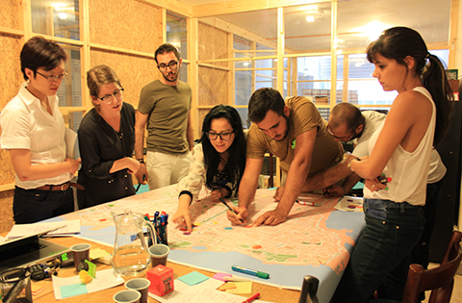
Topic 3 Addressing Low-Income Energy Needs
Overview
Discussion Questions
No-Regrets Strategies
Alignment Research Collaboration Engagement
Improved Program Design = Improved Results
Energy Efficiency Energy Burden
Notes:
However, in terms of our no regrets strategies there is a lot going on in this space
Specifically we see an increased number of collaborations between organizations, funders, utilities, and regulators. Efforts like the Just Energy Circle, the DSM working group, the Energy Efficiency for All collaborative and the Clean Power Plan coordinations efforts all have elements or core strategies aimed at addressing the impacts of energy burdens on low-income families.
Additionally, and one of the reasons why we are up here is that SEEA and Rooted are partnering on a process designed to elevate research and recommendations on how to authentically engage Georgians from a cross-section of key demographic types.
Alignment - Ongoing alignment Georgia based advocacy organizations working in energy and equity
Research to identify stakeholders knowledge, attitudes and the perceived impacts of energy planning and decision making. Conducting deeper Cultural assessments key Georgia demographic groups
Increased Collaboration between stakeholders in an ongoing manner with shared strategies, leadership and resources
Increased Engagement in GA to support improvements in energy planning processes and outcomes.
3. We see this research and engagement process aiding a variety of issues intersecting with energy and equity.
We hope our research and stakeholder engagement will also aid in the improvement of utility program design and implementation, specifically for programs targeted at improving low-income households.
This research will be available in early 2017 and for more information on the process find one of us and some of our champions of the process are here in the room today.
3) Finally, we know that many studies and programs continue to show that if you ramp Up energy efficiency this can directly reduce high energy burdens in low-income households by as much as 30%.

Slide 16
Topic 4 Achieving Environmental Compliance
Expert Presenter:
Katie Southworth
Natural Resources Defense Council
Discussion Leaders:
Charles Rossmann
Southern Company
Katie Southworth
Natural Resources Defense Council
Recorders:
Usayd Casewit
Georgia Tech
Alison Gleditsch
Emory University

Slide 17
Topic 4 Achieving Environmental Compliance
Overview
Discussion Questions
No-Regrets Strategies
Environmental Regulations and Programs Impacting Electric Sector
Federal Regulations and Programs
Clean Power Plan
Hazardous and Solid Waste Management Systems: Disposal of Coal Combustion Residuals from Electric Utilities
National Ambient Air Quality Standards (NAAQS) for Ozone
National Primary Ambient Air Quality Standards (NAAQS) for Sulfur Dioxide
Clean Water Act Effluent Limitations Guidelines and Standards for the Steam Electric Power Generating Point Source Category
Cross-State Air Pollution Rule
(Order 1000, ITC, PTC)

Slide 18
Topic 4 Achieving Environmental Compliance
Overview
Discussion Questions
No-Regrets Strategies
State Regulations and Programs
NC REPS (N.C. Gen. Stat. § 62-133.8)
REPS requires all investor-owned utilities in North Carolina to supply 12.5% of 2020 retail electricity sales (in North Carolina) from certain eligible energy resources by 2021. Municipal utilities and electric cooperatives must meet a target of 10% renewables by 2018.
NC Clean Smokestacks Act (2002)
Set caps on total annual emissions of nitrogen oxides (NO_{x}) and sulfur dioxide (SO₂) by each of North Carolina’s two investor-owned utilities, Duke Energy and Progress Energy,
State SIP Processes
Notes:
which required them in effect to permanently reduce their total year-round NO_{x} emissions 77% by 2009 and their SO₂ emissions 73% by 2013, and to maintain these caps notwithstanding any future growth in service.^{[3]} These caps were sufficiently stringent to force either modernization or retirement of all forty-five coal-fired electric generating units (EGUs) at their fourteen sites in North Carolina.

Slide 19
Topic 4 Achieving Environmental Compliance
Overview
Discussion Questions
No-Regrets Strategies
State Regulations and Programs
Georgia Air Quality Act 12-9-1
“It is declared to be the public policy of the State of Georgia to preserve, protect, and improve air quality and to control emissions to prevent the significant deterioration of air quality and to attain and maintain ambient air quality standards so as to safeguard the public health, safety, and welfare consistent with providing for maximum employment and full industrial development of the state.”
Notes:
which required them in effect to permanently reduce their total year-round NO_{x} emissions 77% by 2009 and their SO₂ emissions 73% by 2013, and to maintain these caps notwithstanding any future growth in service.^{[3]} These caps were sufficiently stringent to force either modernization or retirement of all forty-five coal-fired electric generating units (EGUs) at their fourteen sites in North Carolina.

Slide 20
Topic 4 Achieving Environmental Compliance
Overview
Discussion Questions
No-Regrets Strategies
Local Regulations and Programs
Local Government Air Programs
Economic Development Zones under Clean Air Act
Local Government Lead-by-Example Programs
City of Atlanta
Green Building Codes and Disclosure
City of Atlanta
Local Utility Programs and Incentives
LPCs, Weatherization, etc.
Notes:
which required them in effect to permanently reduce their total year-round NO_{x} emissions 77% by 2009 and their SO₂ emissions 73% by 2013, and to maintain these caps notwithstanding any future growth in service.^{[3]} These caps were sufficiently stringent to force either modernization or retirement of all forty-five coal-fired electric generating units (EGUs) at their fourteen sites in North Carolina.

Slide 21
Topic 4 Achieving Environmental Compliance
Overview
Discussion Questions
No-Regrets Strategies
DISCUSSION QUESTIONS
Should Georgia take a leadership approach to environmental compliance?
Risks/ benefits?
What planning efforts and processes are currently underway in Georgia?
Are these working? Who is involved? What level of coordination occurring across processes?
What does a no-regrets strategy(ies) look like?
What has been successful in the past under previous planning efforts in Georgia?
Useful examples from other jurisdictions?

Slide 22
Topic 4 Achieving Environmental Compliance
Overview
Discussion Questions
No-Regrets Strategies
STRATEGIES (suggestions for further discussion)
1- Promote Meaningful Engagement
Design processes to improve integration of stakeholder input and feedback into regulatory planning processes.
2- Think Outside of the Box/ No Silos.
Coordinate effective cross-jurisdictional planning (across state and local agencies- econ dev’t, SEO, PSC, EPD, local sustainability offices)
3- Take the Long View and Think Big
Actively engage in regional and interregional planning and coordination processes - (Nicholas Institute, Tech, SESARM, SERTP, PJM, MISO, SPP)

Slide 23
Topic 5 Adapting the Utility Business Model
Expert Presenter
Jennette Gayer
Environment Georgia
Discussion Leaders:
Anthony Coker
Hannah Solar
Jennette Gayer
Environment Georgia
Recorders:
Ashley Fournier
Southeast Energy Efficiency Alliance
Ross Beppler
Georgia Tech

Slide 24
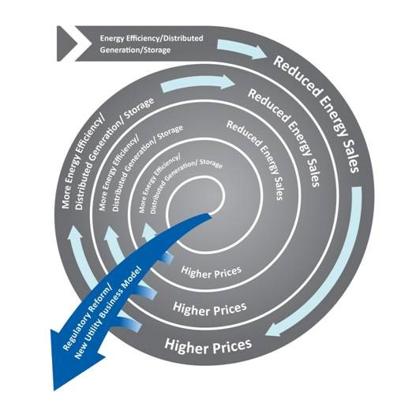
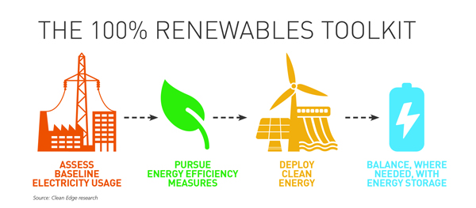
Topic 5 Adapting the Utility Business Model
Overview
Discussion Questions
No-Regrets Strategies
VS

Slide 25
Topic 5 Adapting the Utility Business Model
Overview
Discussion Questions
No-Regrets Strategies
How do you “rebuild an airplane in the air?”
How do you REALLY get a utility invested in EE ?
How do you implement the three legged stool?:
1. Decouple utility profits from electricity sales;
2. Recover costs of EE programs etc.;
3. Enforce and or Incentivize.
How do you make big risky investments actually risky?
How can we understand the cost/benefits of DG? And, harmonize regulatory frameworks, pricing structures, etc to take advantage of the benfits?
How do we speed this up????

Slide 26
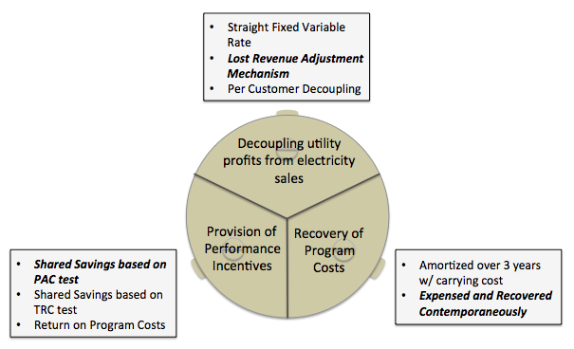
Topic 5 Adapting the Utility Business Model
Overview
Discussion Questions
No-Regrets Strategies
Nov. 17=100% RE Day of Action
Rethinking Nukes on the Chattahoochee
Value of Solar Conversations: Address transparency
The three legged stool from the National Action Plan for EE.

Slide 27
Topic 6 Ongoing State Energy Planning
Expert Presenter:
David Gipson
Georgia Environmental Finance Authority
Discussion Leaders:
Nick Cooper
Georgia Public Service Commission
David Gipson
Georgia Environmental Finance Authority
Recorders:
Eric Erzinger
Georgia Tech
Ben Staver
Georgia Tech

Slide 28
Topic 6 Ongoing State Energy Planning
Overview
Discussion Questions
No-Regrets Strategies
History of state energy planning and reporting
Existing planning processes
Integrated resource planning
Energy emergency planning
Energy codes planning
Clean Power Plan planning
Implementation of strategies

Slide 29
Topic 6 Ongoing State Energy Planning
Overview
Discussion Questions
No-Regrets Strategies
What is the effect of economics on energy planning outcomes?
How could we better connect existing energy planning processes and fill gaps?
How could existing forums for planning be improved?
How can we improve the implementation of plans?

Slide 30
Topic 6 Ongoing State Energy Planning
Overview
Discussion Questions
No-Regrets Strategies
Focus on job creation, workforce development, economic development
Utilize emergency management tabletop exercises
Model what works in other states
Prepare to go for funding to implement ideas
Build organizational partnerships

Slide 31
Choosing Our Energy Future II
A TOWN HALL DISCUSSION OF REGULATORY SCENARIOS
AND NO-REGRETS STRATEGIES FOR GEORGIA
October 14, 2016
#GAenergy

Slide 32
Topic 1:
Policy: expand PACE across Georgia
Financing and economic: improve energy performance contracting
Maximize efficiencies in buildings, power generation
Educational pipeline starting at middle and high school levels
Topic 2:
Address uncertainty by clarifying
Root transition planning in community; leverage local resources in all coal communities across Georgia
PSC study of coal plant closings to provide clear signals
Develop local leaders
Plant operators evaluating workforce to ease transition
Identify financial resources available/needed
Topic 3
Prioritize communications among key stakeholders
1) Raise awareness in all parties (low-income and non-low-income, policy makers, etc)
2) Engage utility investors to come up with a win-win solution
3) Work with local service providers (health, education, social service) to understand affected families’ needs
Disaggregate understanding of various types of low income consumers
1) Continue to build engagement base by identifying motivated groups
2) Transform programs serving these populations

Slide 33
Topic 4: Environmental Compliance
1) Create technology pollution control R&D program
2) Continue to engage in multi-state agency coalitions addressing environmental compliance
3) Encourage public-private partnerships to take advantage of federal and other monies
4) Aggressive follow-up on National Energy Efficiency Day (October 5, 2016!!!)
5) Create a technical reference manual for energy efficiency (GEFA to lead); to enable consistent crediting of energy efficiency measures under CPP, etc.
Topic 5: Adapting the Utility Business Model
1) Joint utility-transportation decarbonization approach
2) Regulatory framework that incents the deployment of clean/innovative technology via utilities (address rates, storage, etc.)
Topic 6: State Energy Planning
1) Prudent, ongoing state energy resiliency planning every 5 years
2) Create a central clearinghouse for communications, resources and planning about energy issues

Slide 34
It’s not November 8th yet, but you can vote here: http://bit.do/COEF2

