Slide 1


Choosing Our
Energy Future II
A TOWN HALL DISCUSSION OF REGULATORY SCENARIOS
AND NO-REGRETS STRATEGIES FOR GEORGIA
October 14, 2016
#GAenergy

Slide 2
Agenda:
9:00 Looking Into the
Future
10:00 Café Conversations:
No-Regrets Options for Georgia’s Energy Future
12:15 Break, grab lunch
12:25 Closing Session
Housekeeping:
Podium remarks, discussion readouts are public
Roundtable discussions are off the record
Social Media: #Gaenergy
Streaming video: @cyrushomi
“AllSaintsWiFi”
Restrooms

Slide 3
Potential Regulatory Futures Impacting the Utility Sector
David Moore
Smith, Gambrell, and Russell

Slide 4


Clean Power Plan
David M. Moore
October 14, 2016

Slide 5
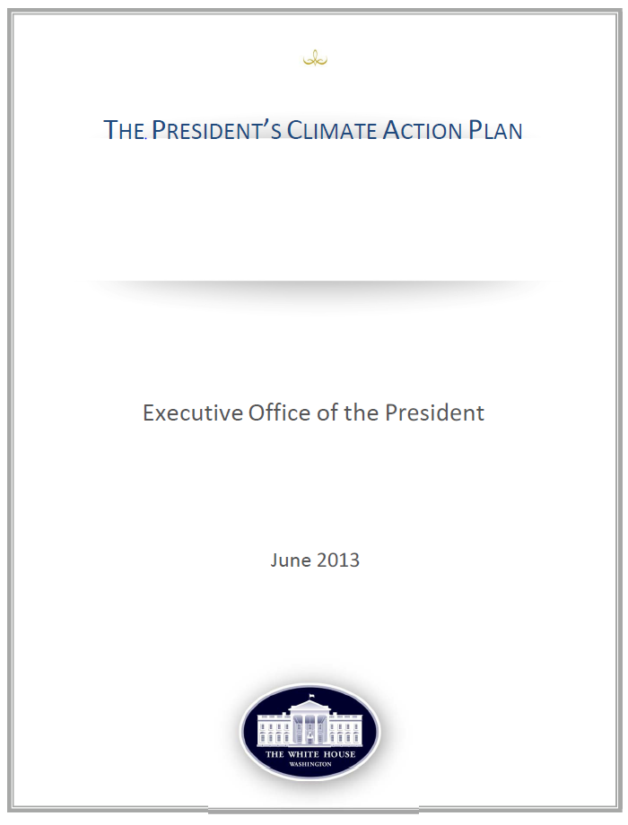
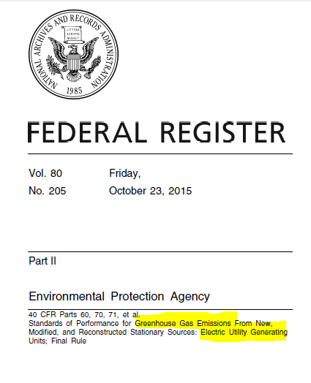

Slide 6
What Does the Clean Power Plan Do?
Directly
Indirectly
30% Reduction in CO2 Emissions Overall
LESS COAL: Infeasible in Many States/Areas
MORE GAS: Natural Gas Combined Cycle
MORE RENEWABLES
ENERGY EFFICIENCY
Transmission
Reliability
Power Prices
Economic Development

Slide 7
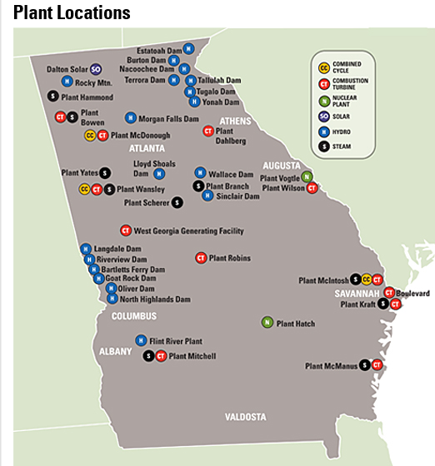
Georgia Power Coal Plant Retirements: Branch 1&2; Kraft 1, 2, 3; McManus 1; Yates 1, 2, 3, 4, 5: 1,000 MW coal

Slide 8
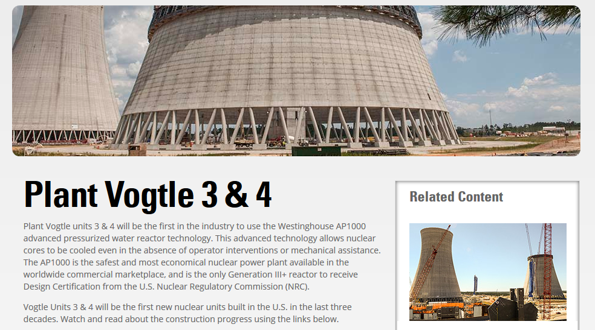

Slide 9
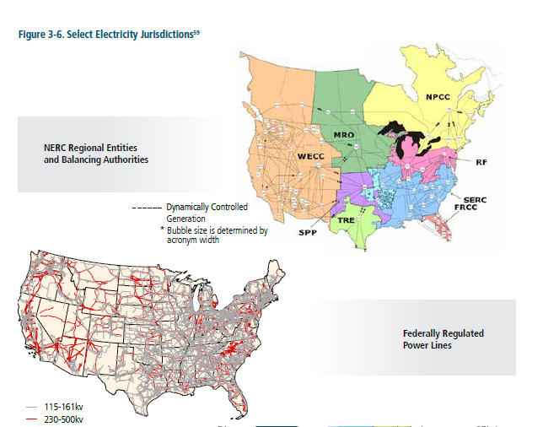

Slide 10

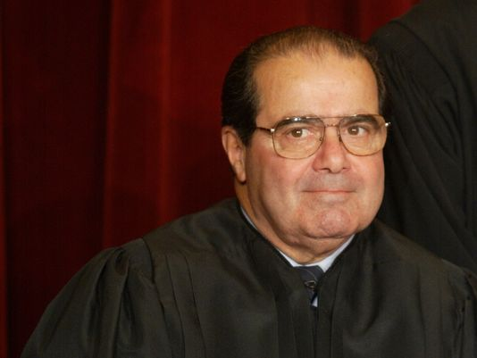
Legal
Rule Issued October 23, 2015
November 3, 2015 – States appeal D.C. Circuit
January 26, 2016 – 29 States, industry, file Supreme Court appeal
February 9, 2016 – Supreme Court stays rule (5-4 ruling)
February 13, 2016 – Scalia
D.C. Circuit ruling after election

Slide 11
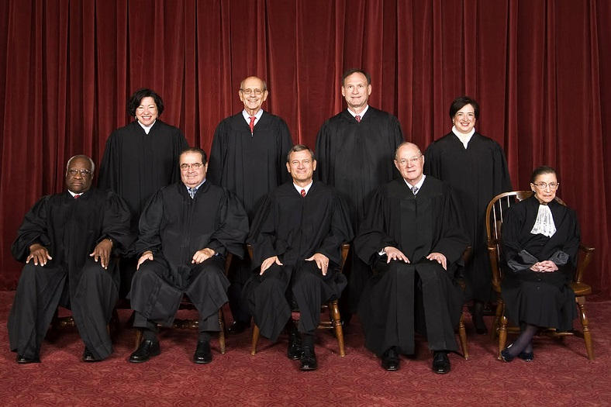

Supreme Court Stay
February 9, 2016
Stay
No Stay
Scalia
Roberts
Kennedy
Thomas
Alito
Ginsburg
Breyer
Sotomayor
Kagan

Slide 12





What authority/expertise does EPA have over
  Air Emissions
  Renewable energy
  Generation Mix
  Transmission
  Reliability

Slide 13
“Specifics” of Clean Power Plan Rule
Measure/”Block” | % C02 Reduction
Coal Plant Heat Rate Improvements – Reduce carbon by an average of 6% | 12%
NGCC: Redispatch from coal-fired power plants to natural gas combined cycle plants | 31%
Renewable and Zero-Emission Power Sources: Nuclear, Solar, Wind, Hydropower | 35-40%
Demand-side and Efficiency Improvements of 1.5% per year. | 18%
Goal: 30% C02 Emission Reduction

Slide 14
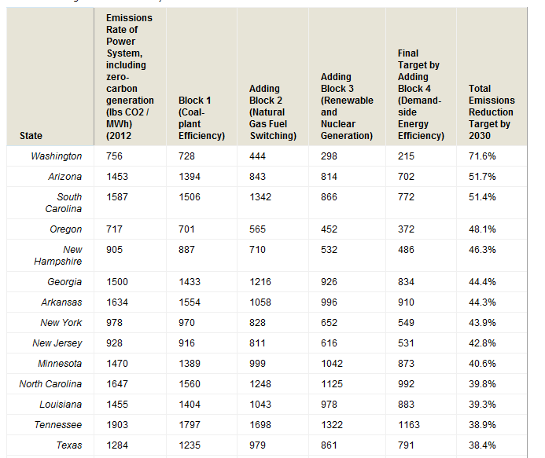
Coal and Gas By the Numbers
C02 Targets: 215-1163 lbs/MWh
Coal
EPA: 2,249 lbs/MWh of carbon dioxide national average
Natural Gas
EPA: 1135 lbs/MWh of carbon dioxide national average
MWh is “Megawatt hour” or one hour of generating one megawatt of power

Slide 15
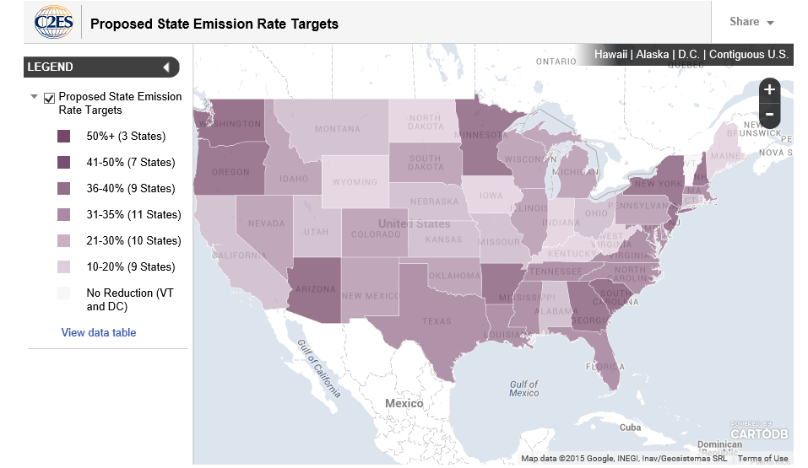
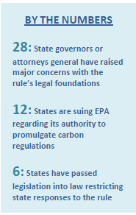

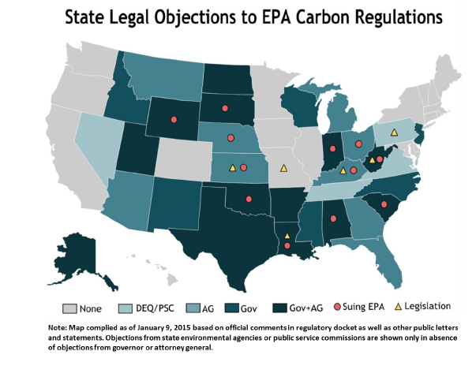

Slide 16
Deadlines in 111 Rule
September 2016 – State plan due, or request for extension to September 2018
2022- 1st Phase Implementation
2030 – 2d Phase Implementation
Example: West Virginia: reduce carbon dioxide emissions 26% by 2022, and 37% by 2030. West Virginia is 95% coal powered.

Slide 17
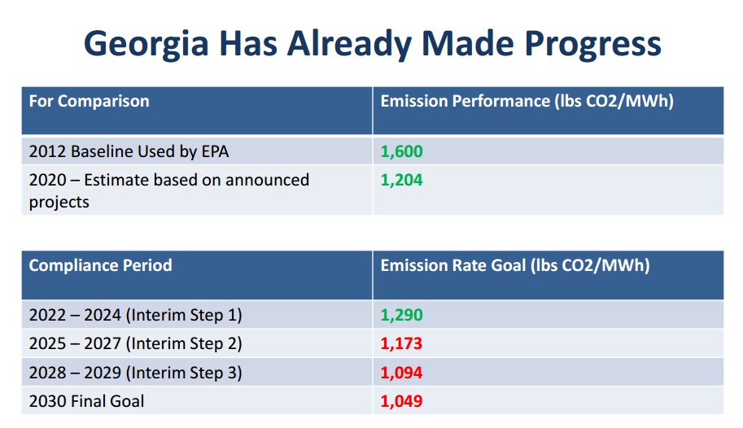
Georgia

Slide 18
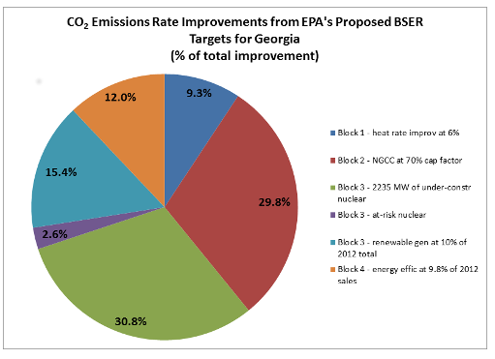

Slide 19
Challenges to EPA Rules - Generally
Two winning legal challenges:
  Substance:
    Did Congress grant EPA Authority
    Is EPA’s Decision Supported: “arbitrary and capricious” and “deference” rule
  Procedural: notice, comment, fair, open
The “Stay” signals challenge possibly supported “on the merits”
EPA has 40 Years Experience Defending Rules

Slide 20
Primary Challenges to Clean Power Rule
Authority: EPA can restrict emissions to what is ‘best’ technology, but cannot force private sector to build renewables, nuclear. Clean Air Act Section 111 (42 U.S.C. § 7411)
Interpretation: EPA has to regulate power plants under either CAA 111 or 112 – not both.
Limits/Goals – are they correct (and achievable)
Procedure – notice of new scientific findings late

Slide 21
Why is the Clean Power Plan Different?
EPA normally sets “how much” pollution, does not required building non-polluting technology.
EPA normally sets amount of pollution based upon the best possible reduction science can achieve; here the coal limits are below what can be done (except carbon sequestration)
EPA normally combines pollutant sources only to set national or regional standards; here a future non-existent technology is combined with an existing plant with limited pollution reduction capability.

Slide 22
Outcomes to Challenges to EPA Rules
(1) Affirm (uphold rule)
(2) Invalidate
(3) Remand
(4) Remand with instructions – most likely

Slide 23

January 20, 2017

Slide 24
Why should we care?
We all need power – safety, homes, schools/education, warmth
We all need stable climate
We all want more power with less emissions

Slide 25
We don’t want
Brown Outs/Power Losses
Large increases in power bills
Fewer/lower paying jobs
Secondary impacts from fossil fuel extraction

Slide 26
We do want
Lights to turn on when we flip the switch
Cheap and plentiful power
Economic growth/jobs
Safety and protection of homes and loved ones

Slide 27
Do we want?
More nuclear units – waste
More solar – metals, water use, large segments of habitat impacted, species impacts
More wind – bird migration impacts, species impacts
More hydropower – river/stream impacts, species changes
Geothermal, kinetics

Slide 28
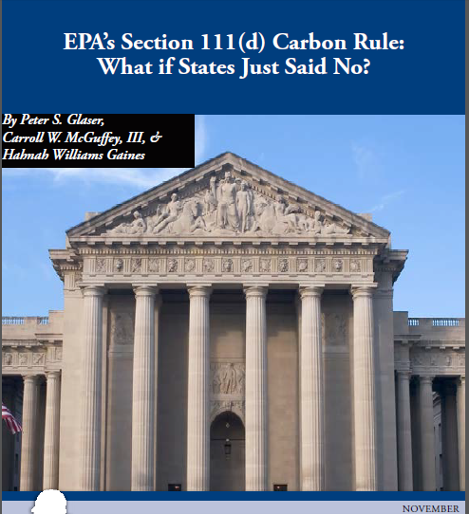
Just Say No?
EPA Authorizes States to Issue Clean Air Act Permits
EPA Funds State Air Programs

Slide 29
For and Against - sample
For the Clean Power Plan
Against
18 States + DC
60 cities (Clarkston, GA)
10 utility/power companies (heavy hydropower)
Public Health Organizations
29 States
Municipal Electric Association of Georgia
Utility industry associations Utility Air Resource Group,
Former Public Utility Commissioners
Chamber of Commerce, Black Chamber of Commerce
Coal Industry

Slide 30
Where do we go from here?
The next president will appoint the next Supreme Court justice
The next Supreme Court will likely decide the Clean Power Plan rule
Coal is already on the decline
Gas is on the rise, with nuclear behind
Renewables are on the increase but major questions regarding capacity factor and reliability to keep the grid powered and stable

Slide 31
Environmental Regulations
Brenda Brickhouse
Vice President, Environment & Energy Policy
October 14, 2016

Slide 32
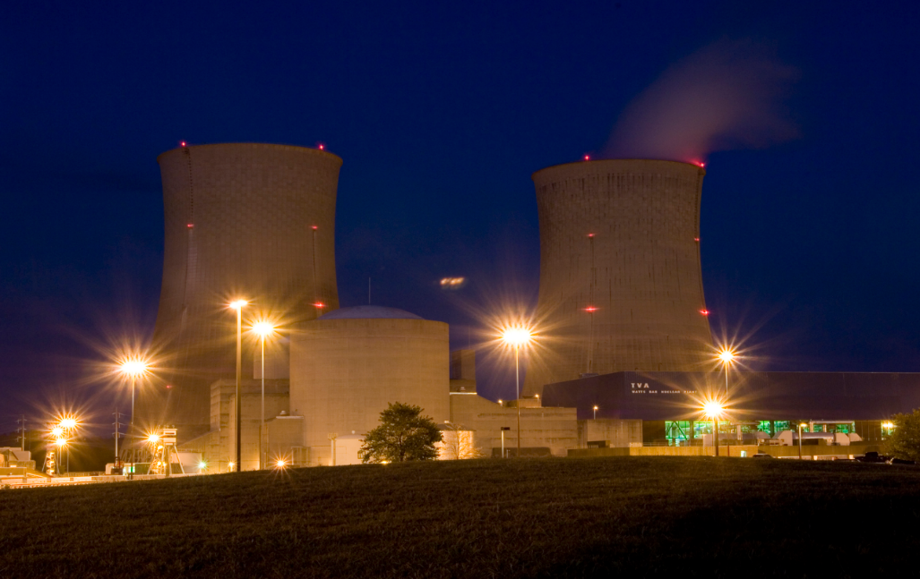

Air
Air Quality Standards
Cross-State Air Pollution Rules
Mercury & Air Toxics
Water & Waste
Intake & Discharge Constraints
Coal Combustion Residuals
Groundwater

Slide 33

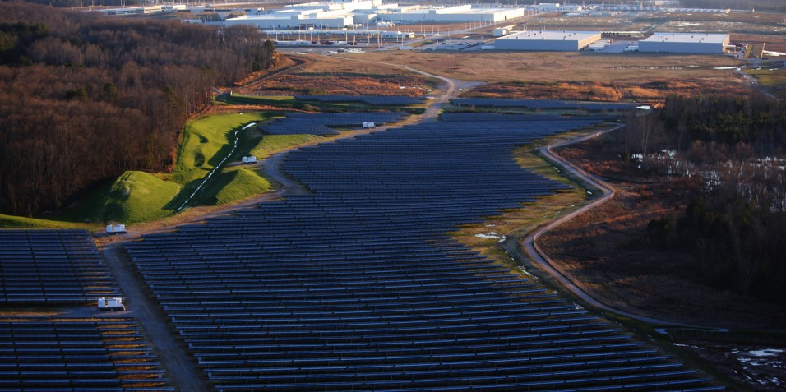
Natural Resources
Endangered Species
Historic Properties
Wetlands
Siting
Land Use
Visual Impacts

Slide 34
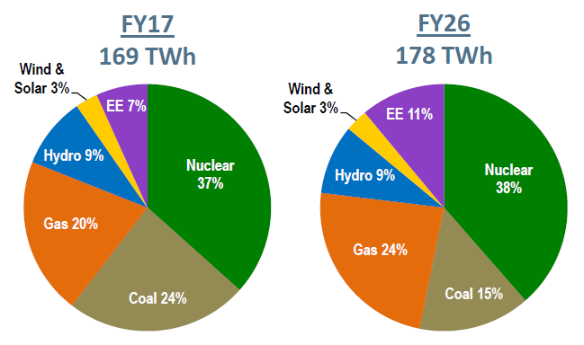
A Balanced, Cleaner Portfolio

Slide 35
Choosing Our
Energy Future II
A TOWN HALL DISCUSSION OF REGULATORY SCENARIOS
AND NO-REGRETS STRATEGIES FOR GEORGIA
October 14, 2016
#GAenergy

Slide 36


Moving Georgia into the Future
Marilyn A. Brown
Georgia Institute of Technology
Choosing Our Energy Future II: Town Hall Discussion
October 14, 2016
Atlanta, GA

Slide 37


What Do “Least Cost” Models Predict?
Three 2016 modeling reports produce electricity scenarios for the U.S., the South and Georgia:
  “Ongoing Evolution of the Electricity Industry: Effects of Market Conditions and the Clean Power Plan on States.” http://nicholasinstitute.duke.edu/
  “Annual Energy Outlook 2016.” http://www.eia.gov/forecasts/aeo/
  “The Clean Power Plan and Beyond.” http://cepl.gatech.edu/projects/ppce/cpp%26b#
Not all of the findings and conclusions are consistent.

Slide 38
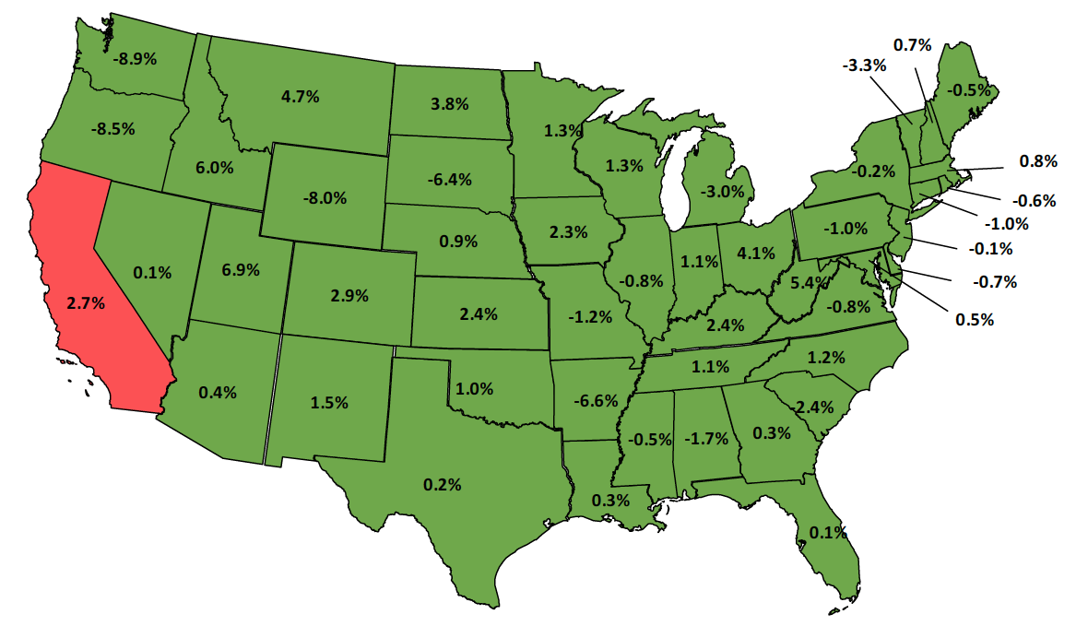
Policy costs are variable & depend on neighboring states
Costs of a Clean Power Plan mass policy with a new source complement (NSC). (Change in present value to 2040.)
Policy costs are estimated to be 0.5% for the nation.
They could be lower (0.1%) for a national mass policy without the NSC (that is, with “leakage”).
Exports of electricity and ERCs can lead to benefits (hence the negative numbers).

Slide 39
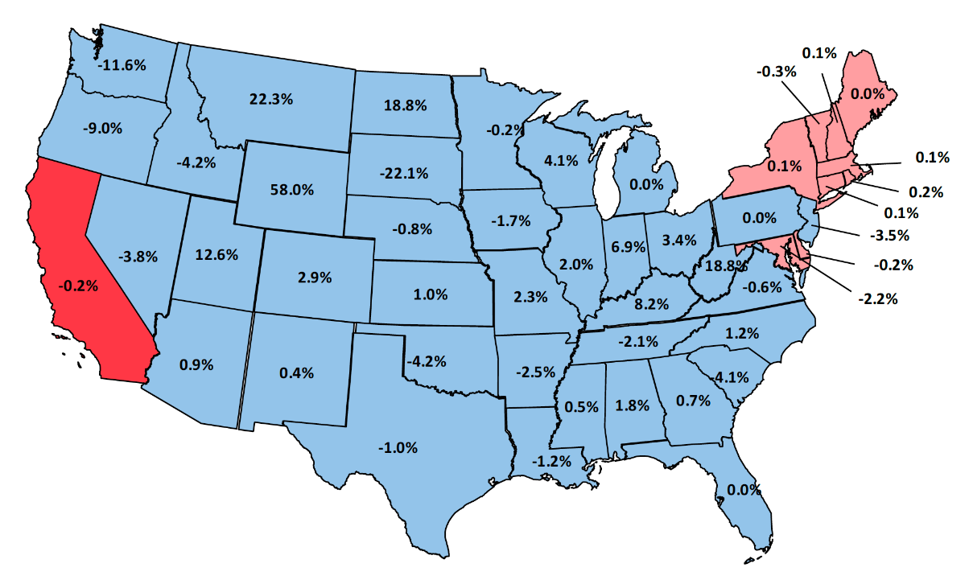
Georgia might need to import Emission rate credits under a dual-rate CPP policy
Unlike SC and TN (also with under-construction nuclear), GA’s local supplies from its new nuclear units may be insufficient to meet its needs.
Policy costs are more variable and could be quite high in some states (WY, MT, WV)

Slide 40

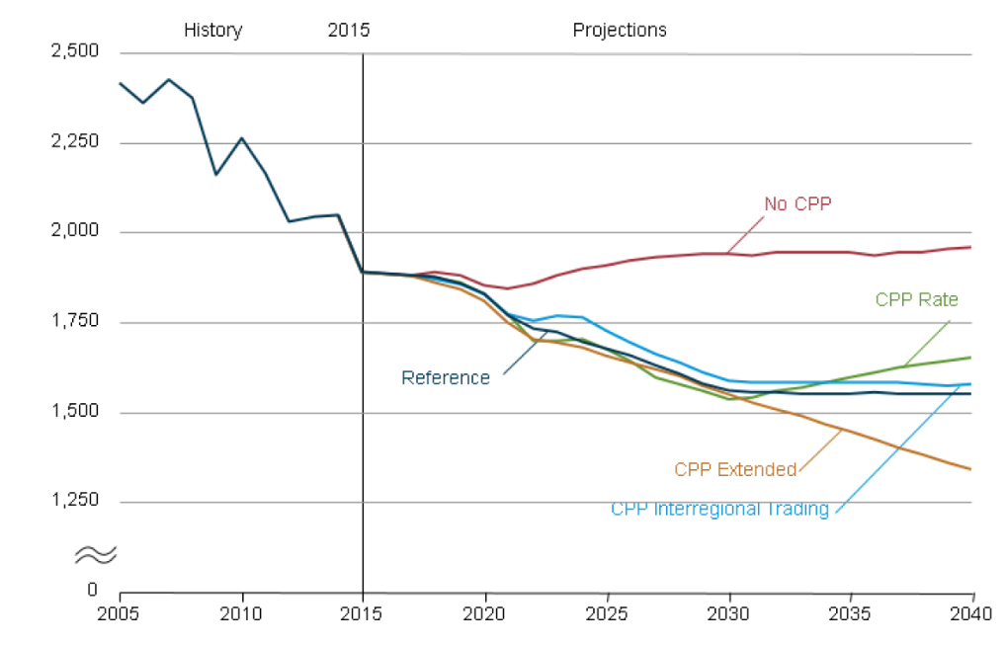
Rate-based goals allow co₂ emissions to rebound after 2030
CO₂ emissions from the electric power sector in five cases (million metric tons)
Planning for a CPP extension curbs the growth of natural gas in the 2022-30 compliance period.

Slide 41
The ELECTRICITY fuel mix reflects policies, prices, R&d, innovation, and CONSUMERS,
2015 was a banner year: natural gas = coal and wind + solar = hydro

Slide 42
Energy Efficiency is poised to make the clean energy transformation more affordable
2015-2030 Cumulative Energy Savings:
Residential - $8.5 Billion
Commercial - $6.8 Billion
Industrial - $6.8 Billion
Reference Case
Electricity Bills (in Billion $2013)
CPP-All+EE Case
It is well known that any individual making their home more efficient will save money on their energy bill, but it is not as well recognized that energy efficiency programs can actually reduce bills for all consumers.

Slide 43
Trading ERCs and carbon allowances from electricity efficiency could bring $ to Georgia
Estimated Potential for Georgia Carbon Allowances and ERCs in 2030
 | Electricity Savings (million MWh) | Carbon Allowances (billion 2013$) | ERCs (billion 2013$)
 |  | $ 15 / short ton CO2 | $ 15 /ERC
Residential | 7.9 | 0.10 | 0.12
Commericial | 10.1 | 0.12 | 0.15
Industrial | 16.4 | 0.20 | 0.25
Total | 34.4 | 0.41 | 0.52
As Physicist Amory Lovins said it, energy efficiency is not just a free lunch – but a free lunch you get paid to eat!
Notes:
https://www.theguardian.com/environment/2008/mar/23/ethicalliving.lifeandhealth4

Slide 44



For More Information
Dr. Marilyn A. Brown
Brook Beyers Professor of Sustainable Systems
Georgia Institute of Technology
School of Public Policy
Marilyn.Brown@pubpolicy.gatech.edu
Climate and Energy Policy Lab:
http://www.cepl.gatech.edu
Thanks to Gyungwon Kim, Yufei Li, and Liz Hyman for
assistance with this presentation.

Slide 45
Choosing Our
Energy Future II
A TOWN HALL DISCUSSION OF REGULATORY SCENARIOS
AND NO-REGRETS STRATEGIES FOR GEORGIA
October 14, 2016
#GAenergy

