Slide 1
Regional Impacts of Carbon Pricing in the U.S. Electric Sector Marilyn A. Brown* Regents’ and Brook Byers Professor of Sustainable Systems Georgia Institute of Technology
Sessions on Energy Transitions
Association of American Geographers
New Orleans -- April 11, 2018
*Co-author: Yufei Li, GRA at Georgia Tech

Slide 2
Motivation
The Paris agreement calls for “pursuing efforts to limit the temperature increase to 1.5 °C above pre-industrial levels”.
But few have studied mitigation pathways consistent with such deep decarbonization.
A 1.5 °C limit will require carbon pricing—how might that play out in the U.S. electricity sector?
What role could a strong push on energy efficiency play?
Notes:
The atmosphere belongs to everyone, and everyone should have access to the wealth created by allocating scarce access rights to it.
In 2015, signatories to the Paris Agreement agreed to limit increases in the global average temperature to well below 2 °C above temperatures preceding the industrial revolution.
This historic accord is the culmination of decades of climate negotiations aimed at preventing dangerous anthropogenic interference with the climate system.
In addition to the 2 °C warming threshold, the Paris Agreement calls for “pursuing efforts to limit the temperature increase to 1.5 °C above pre-industrial levels.”

Slide 3
How to Move Markets:
The “Carbon Dividends Plan”
A Carbon Tax with Revenues Recycled to Households
“I really don’t know the extent to which it is man-made, and I don’t think anybody can tell you with certainty that it’s all man-made, … the risk is sufficiently strong that we need an insurance policy and this is a damn good insurance policy.”
Former Secretary of State James Baker, February 2017 2017

Slide 4
Deriving a 1.5°C U.S. Budget for the Electricity Sector: Inertia + Equity
We adopt the global carbon budget from 2016 to 2040 as identified by Millar, et al. (2017): 939 Gt of CO₂.
The U.S. carbon budget is calculated as the average of two allocations: based on the U.S. GDP (“inertia”) and U.S. population (“equity”) relative to global values.
The U.S. electric sector target is calculated proportionate to its total U.S. emissions in 2016.

Slide 5
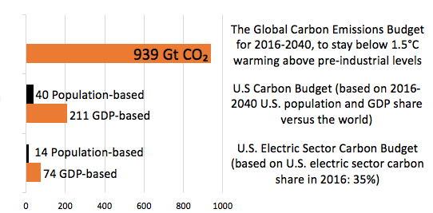
The Result = 44 GT CO₂
Mean=125
Mean=44
Cumulative Gigatons of CO₂ (2016-2040)

Slide 6
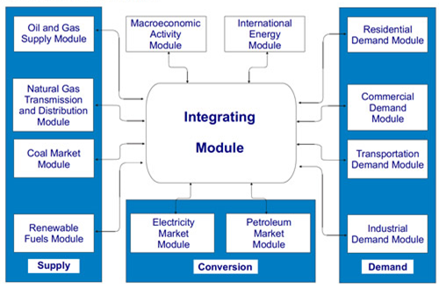
Demand-side strategies in the U.S. power sector have been poorly modeling to date
To help fill this gap, we develop a customized version of the National Energy Modeling System (NEMS), the nation’s premier energy model.
Notes:
Over the past several years, energy efficiency has been inadequately assessed in models of U.S. mitigation pathways
There are many reasons for this, including the fact that most least-cost utility modeling tools are not able to adequately represent EE.
One of the primary popular approaches is to assume an exogenous reduction of energy demand, then the power sector and its fuel supplies are modeled.
These models cannot reflect interactions such as when supply-side investments elevate electricity prices and make demand-side management more economically attractive.
In contrast, NEMS specifies end-use technologies embedded in a least-cost optimization algorithm that allows demand- and supply-side energy resources to compete head-to-head.

Slide 7
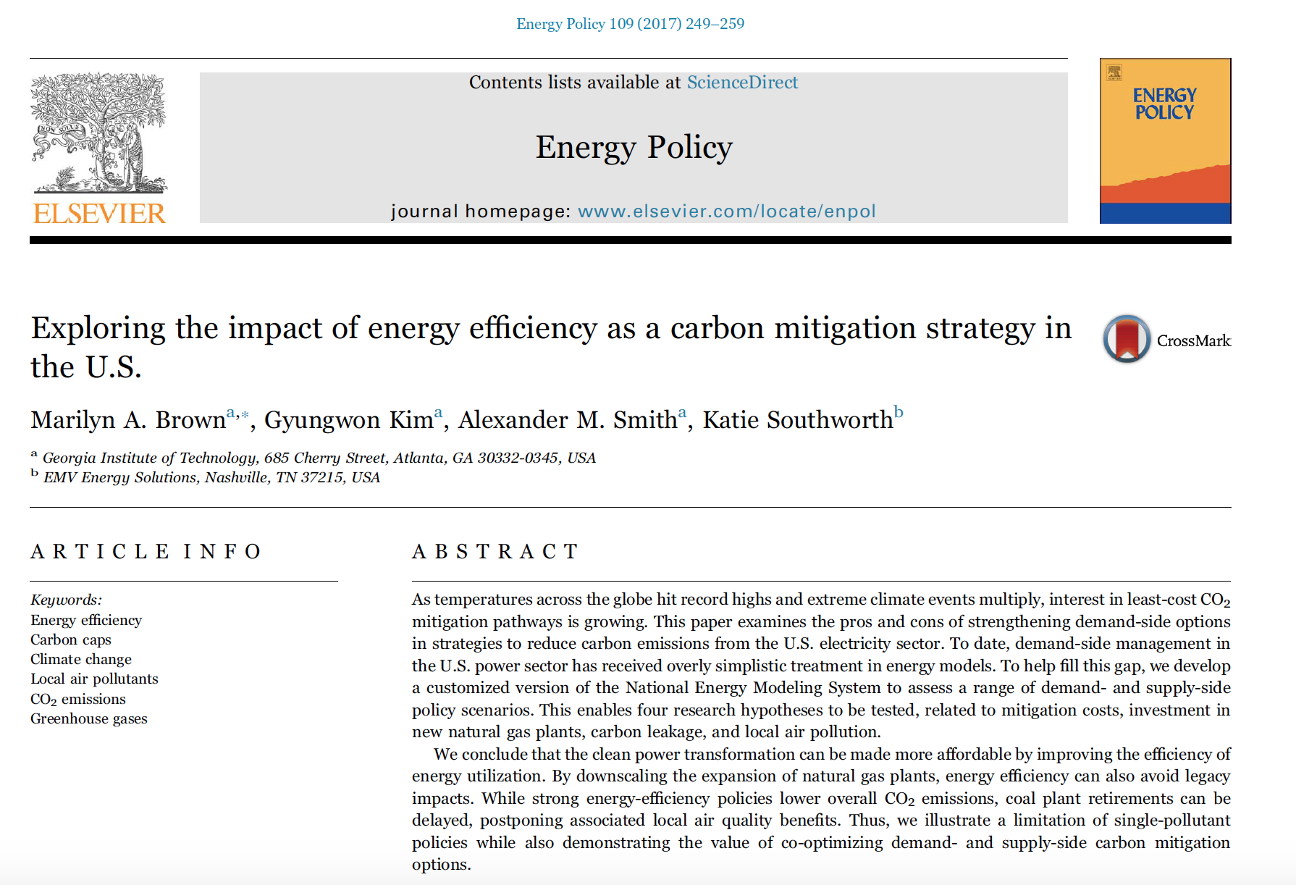
Notes:
Over the past several years, energy efficiency has been inadequately assessed in models of U.S. mitigation pathways
There are many reasons for this, including the fact that most least-cost utility modeling tools are not able to adequately represent EE.
One of the primary popular approaches is to assume an exogenous reduction of energy demand, then the power sector and its fuel supplies are modeled.
These models cannot reflect interactions such as when supply-side investments elevate electricity prices and make demand-side management more economically attractive.
In contrast, NEMS specifies end-use technologies embedded in a least-cost optimization algorithm that allows demand- and supply-side energy resources to compete head-to-head.

Slide 8
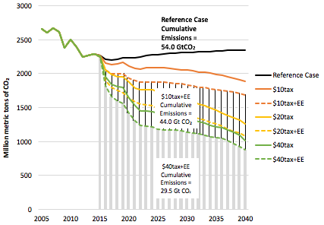
A $10 tax/tCO₂ with Strong EE Policies Could Meet the $44 GT CO₂
Million metric tons of CO₂
from the Electric Power Sector
Current policies would lead to 54 GT CO₂ in the U.S. electric sector from 2016-2040

Slide 9
U.S. Electric Sector Fuel Mix
“Carbon-Free”
Fuels
Fossil
Fuels
The carbon tax scenarios would shrink coal generation significantly, and would grow nuclear, wind, and solar.
The policy scenarios with strong energy-efficiency policies have lower fossil fuel generation.
Notes:
Electricity generation is forecast to increase in all of the forecasts, but the mitigation scenarios dampen the growth rate.
Pricing carbon without energy efficiency would lower total electricity generation compared to the Reference case by 1.5% (with a $10 tax) to 4.5% (with a $10 tax).
Strong energy-efficiency policies coupled with carbon pricing would further lower total generation by 11% to 14% below the Reference Case.
With nearly 20% demand growth forecast in the Reference case by 2040, expansions to the fuel mix are anticipated across all of the major fuels, with the largest increase in natural gas.
Each of the six carbon tax scenarios would shrink the generation from coal significantly relative to the Reference case.
To offset the decline in coal and natural gas, the fuel mix would have greater nuclear, wind, and solar. The policy scenarios with strong energy-efficiency policies have even less fossil fuel generation.

Slide 10
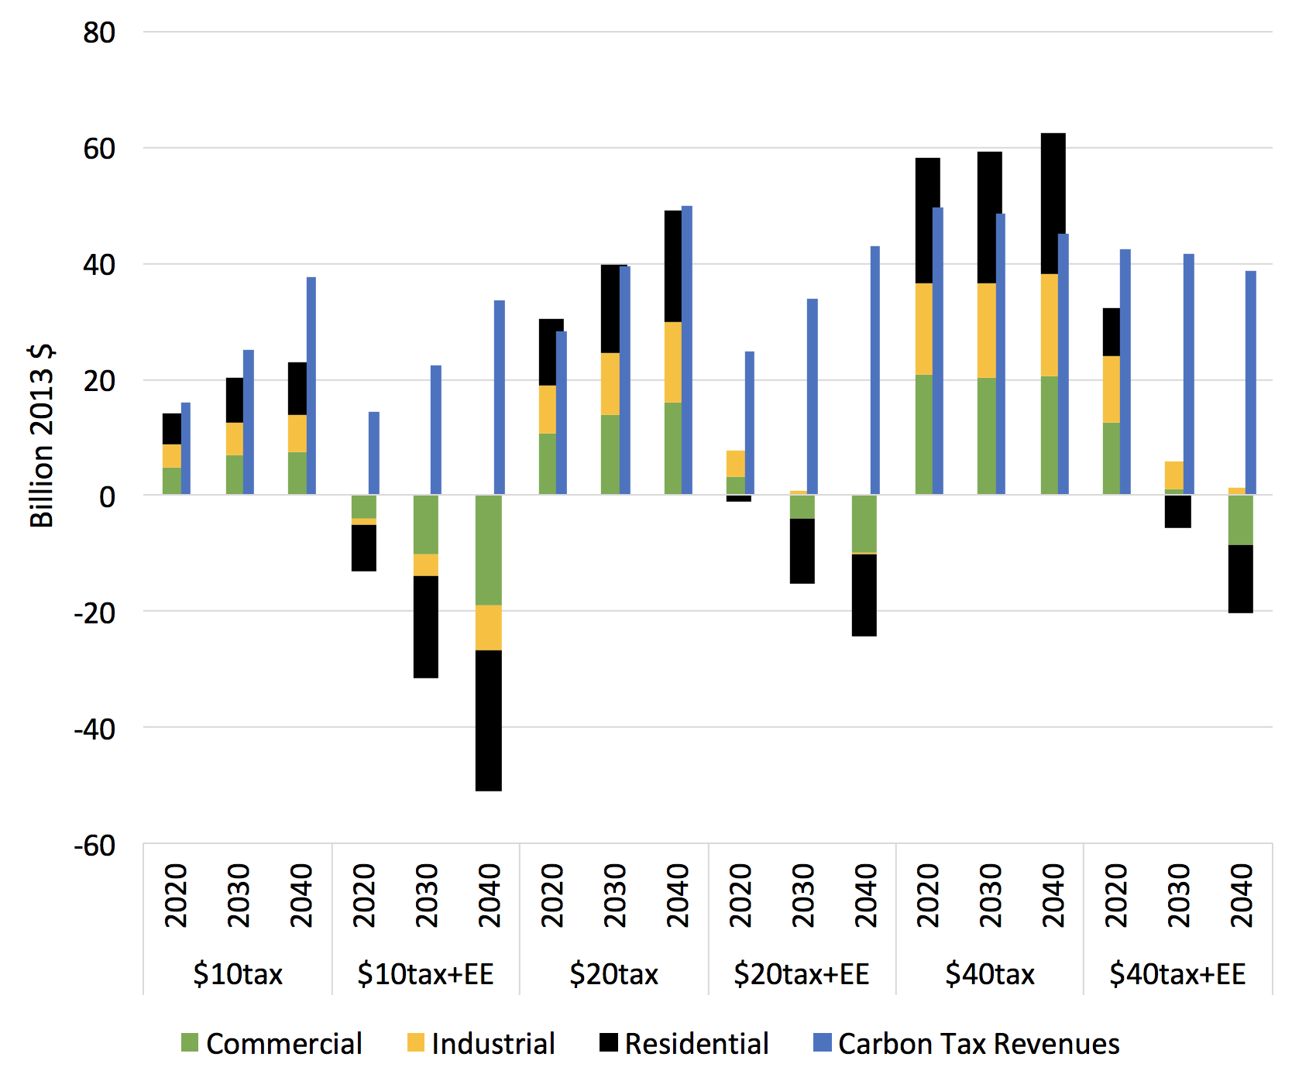
Impacts on Electricity Bills & Carbon Tax Revenues (in Billions $2013)
Carbon tax revenue recycling can compensate for the extra electricity expenditures from higher prices.

Slide 11
Measuring the Cost of Climate Policy
Cost of climate policy =
Utility Resource Costs
Energy Efficiency Costs
Carbon
Tax
Recycling
+
–
(Environmental benefits > welfare losses.)
Source: Brown, M. A., Kim, G., Smith, A. M., & Southworth, K. (2017). Exploring the impact of energy efficiency as a carbon mitigation strategy in the US. Energy Policy, 109, 249-259.
Notes:
Our research concludes that the clean power transformation can be made more affordable by investing in EE such as smart thermostats, LED lighting, high-efficiency air conditioning and boilers, and variable motor and drive systems
Increasingly, companies across sectors and geographies are turning to an internal carbon price as a tool to help them reduce carbon emissions, mitigate climate-related business risks, and identify opportunities in the transition to a low-carbon economy.
With such investments, CO2 mitigation can be achieved while lowering electricity bills.
These savings allow consumers to invest in more efficient equipment, better windows, and insulation.
The installation of such goods and services is also generally more labor-intensive and requires less capital than investments in more power generation.
As a result, CO2 mitigation strategies that focus on energy efficiency generally are more affordable and they generate jobs.

Slide 12
Cumulative Costs and CO₂ Reductions
Scenarios: | Cumulative Incremental Total Resource Costs, 2016-2040 (Billion 2013$) |  |  |  |  | Cumulative CO₂ Reductions, 2016-2040 (Million Tons of CO₂) | Policy Cost per CO₂ Reduction ($/Tons of CO₂ avoided)
 | Utility Resource Costs (URC) | Incremental Utility Resource Costs | End-Use Energy Efficiency Costs | Carbon Tax Recycling | Total Resource Costs (TRC)
Reference | 4,878.8
$10 Tax | 5,389.9 | 511.1 | 7.8 | 541.5 | -22.6 | 5,484 | -4.1
$10 Tax +EE | 4,659.4 | -219.4 | 280.3 | 484.2 | -423.3 | 9,994* | -42.4
$20 Tax | 5,949.7 | 1,070.9 | 21.2 | 826.0 | 266.2 | 14,445* | 18.4
$20 Tax +EE | 5,198.6 | 319.8 | 308.9 | 710.1 | -81.4 | 19,320* | -4.2
$40 Tax | 6,381.5 | 1,502.7 | 31.9 | 1005.5 | 529.1 | 20,104* | 26.3
$40 Tax +EE | 5,580.2 | 701.4 | 315.8 | 857.8 | 159.3 | 24,459* | 6.5
*Meets the proposed U.S. electric sector’s carbon budget.
Other reviews of carbon pricing suggest that higher carbon taxes are required to achieve climate goals of 1.5 to 2 °C—mitigation in the electric sector is relatively “cheap”.

Slide 13
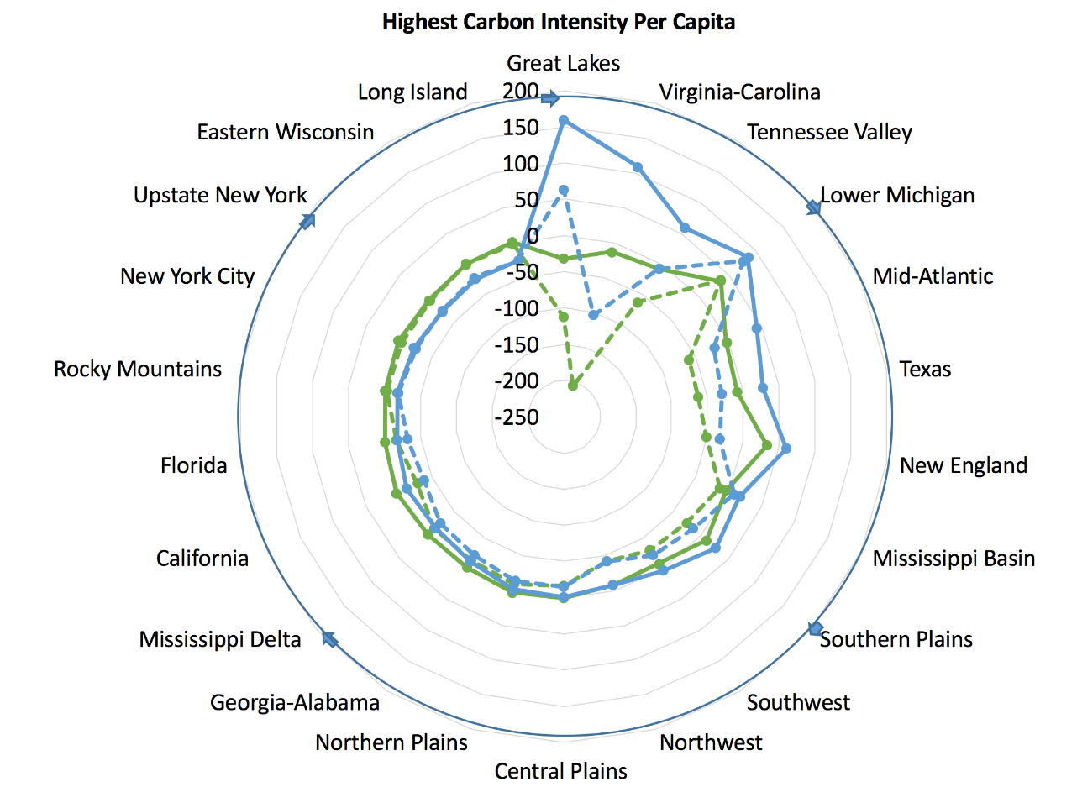
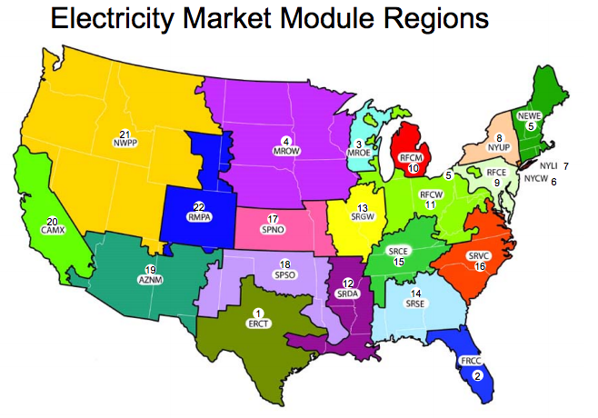
Carbon Tax Winners and Losers:
Policy Design Matters
The Carbon Dividends Plan’s regional wealth transfers (blue) could be minimized (green).
12
Per capita policy impacts in 2030:
Policy economics range from:
--a cost of ~$150 per capita to
--a benefit of ~$250 per capita.
Decreasing Carbon Intensity from Electricity Generation
Notes:
Our research concludes that the clean power transformation can be made more affordable by investing in EE such as smart thermostats, LED lighting, high-efficiency air conditioning and boilers, and variable motor and drive systems
With such investments, CO2 mitigation can be achieved while lowering electricity bills.
These savings allow consumers to invest in more efficient equipment, better windows, and insulation.
The installation of such goods and services is also generally more labor-intensive and requires less capital than investments in more power generation.
As a result, CO2 mitigation strategies that focus on energy efficiency generally are more affordable and they generate jobs.

Slide 14
Conclusions (1)
Strong EE policies with a $10/tCO₂ tax rising to $27/tCO₂ in 2040 could meet the U.S. electric sector’s 25-year cumulative carbon budget.
This policy scenario could also produce a net reduction in costs to the U.S. economy.
A $20/tCO₂ tax rising to $53/tCO₂ in 2040 could also meet the U.S. electric sector’s carbon budget, but it would be a costly approach to deep decarbonization

Slide 15
Conclusions (2)
Per capita recycling of carbon tax revenues could create winners and losers
A great deal is at stake, and policy design matters.

Slide 16
For More Information — and some late night reading??
Dr. Marilyn A. Brown, Regents Professor
Brook Byers Professor of Sustainable Systems
School of Public Policy
Georgia Institute of Technology
Atlanta, GA 30332-0345
Marilyn.Brown@pubpolicy.gatech.edu
Climate and Energy Policy Lab:
www.cepl.gatech.edu
2016 2015 2013

